Slide 1
Simulations of Midlatitude and Tropical Out-of-Cloud Convectively-Induced Turbulence
Katelyn Barber
University of North Dakota
Turbulence Impact Mitigation Workshop 2018
katelyn.barber@und.edu

Slide 2
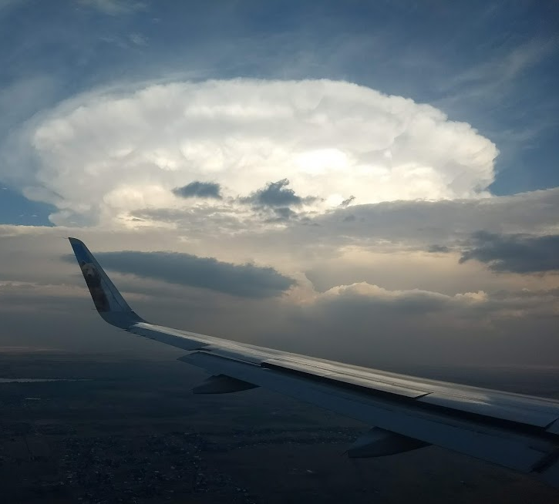
Motivation
Zovko-Rajak and Lane 2014; Lane and Sharman 2014; Lane et al. 2012; Lane et al. 2003; Pantley 1989
Convectively-induced turbulence (CIT) can propagate more than 100 km (62 mi) away from convective sources
Out of cloud
Forecasting of CIT is a challenge because convection must be accurately simulated
CIT due to developing convection
Midlatitude continental convection versus tropical oceanic convection
Courtesy of A. Karboski

Slide 3
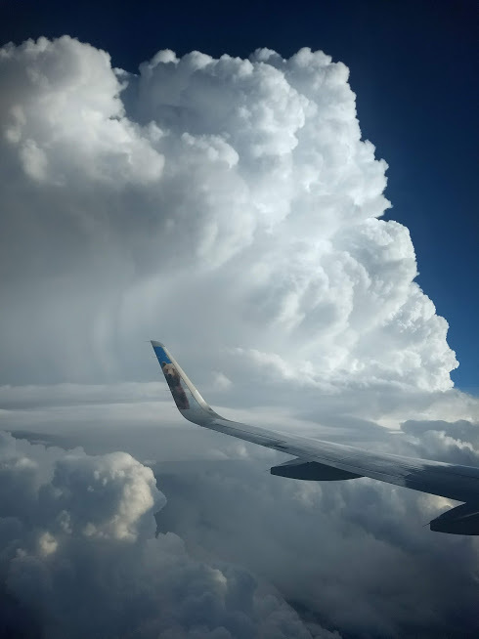
Research Questions
What is the role of developing convection in a severe turbulence case?
Tropical oceanic convective simulation
How does resolution influence turbulence prediction?
Midlatitude continental convective simulations
Courtesy of A. Karboski

Slide 4
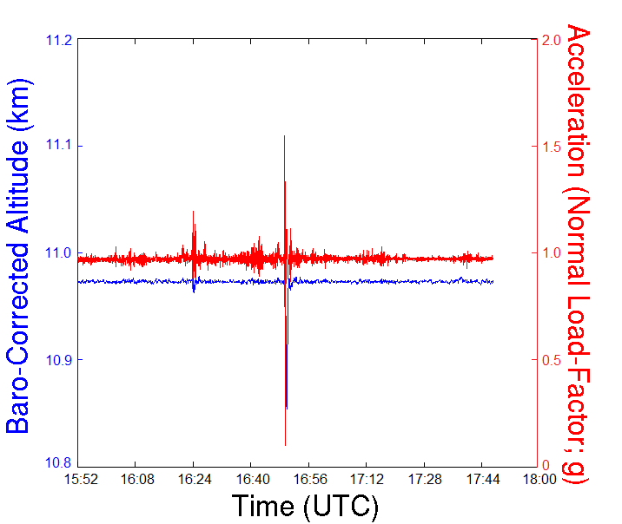
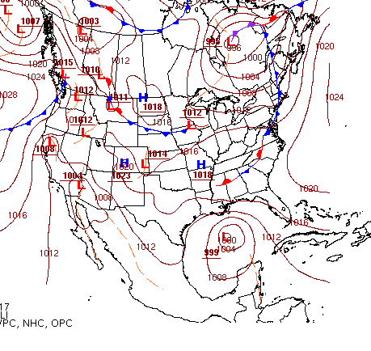
Tropical Oceanic Case
What was the spatial coverage and intensity of turbulence near developing convection?
In-Situ Observations
20 June, 2017
Severe turbulence
1651 UTC at 11 km (36 kft)
80 nm NE of Cancun, MEX
9 injuries
Active convection
Developing cells
Tropical oceanic region
Surface Analysis 1500 UTC

Slide 5
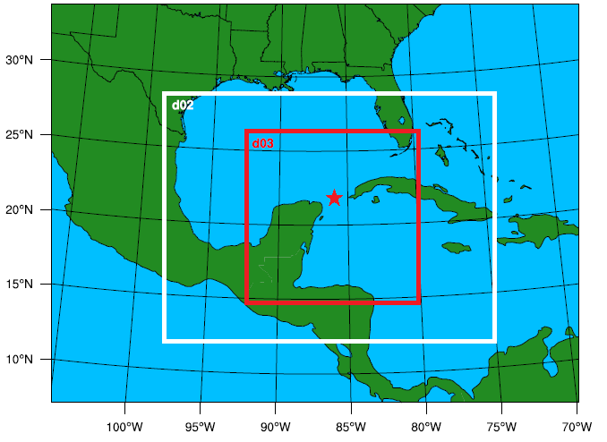
Methodology
Ahmad and Proctor 2012; Frehlich and Sharman 2004a, b
Weather Research and Forecast (WRF) v3.9
3 km horizontal grid spacing, 100 vertical levels
Initialized with ¼ degree GFS data
Turbulence diagnostics
Richardson number (Ri)
Stability and shear
Model derived eddy dissipation rate (ε^{1/3} )
Turbulent kinetic energy
Second-order structure functions (SF)
u and v velocity components

Slide 6
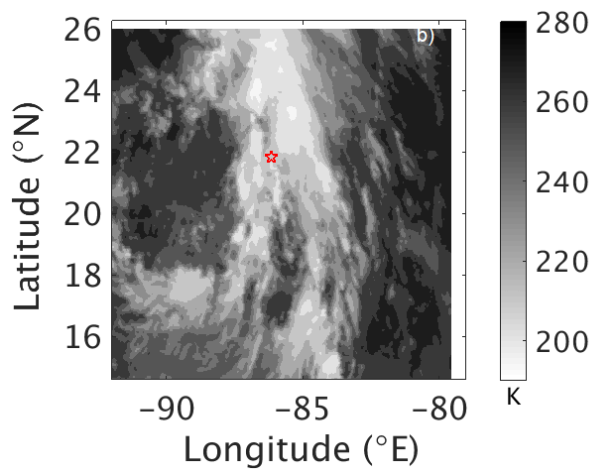
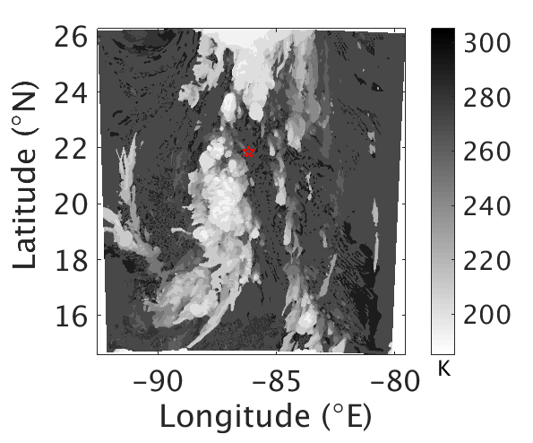
Observations vs. Simulation
GOES-16 Cloud Top Temperatures
Simulated Cloud Top Temperatures

Slide 7
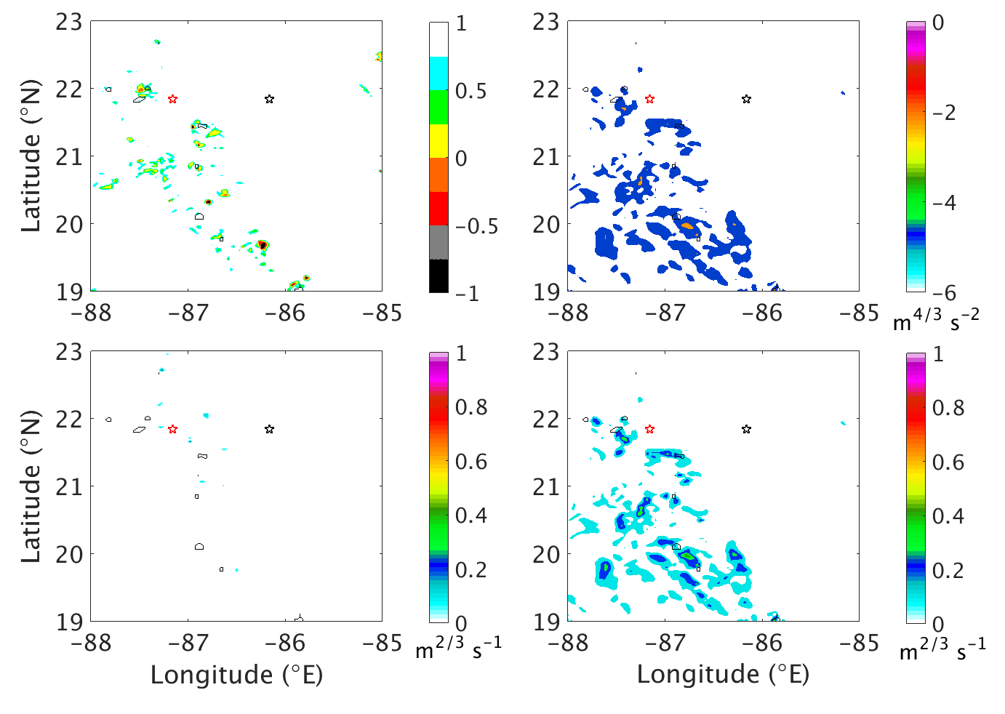
Tropical CIT
z = 11 km
─ echo top = 11 km
Richardson Number
log of ε^{2/3} (SF)
Ri
Most turbulence is out-of-cloud
Log of ε^{2/3} (SF) and ε^{1/3} (SF)
Most turbulence is out-of-cloud
Highest values are near convection
Moderate-severe
ε^{1/3} model derived
Under-predicted intensity and areal coverage
ε^{1/3} (model derived)
ε^{1/3} (SF)

Slide 8
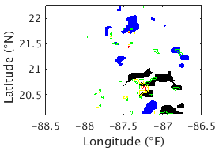

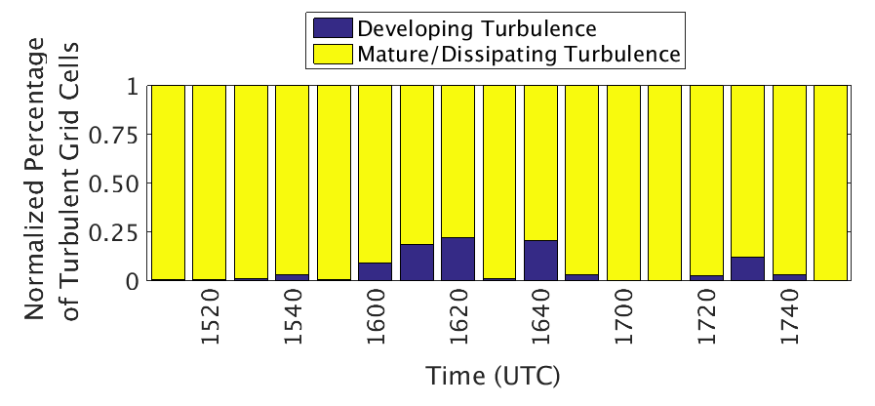
Developing Convection
Convective objects: Echo top heights ≥ 8 km (26 kft)
Maximum vertical velocity increasing with time and < 90th percentile of vertical velocities
Closest convective object to turbulent grid cell

Slide 9
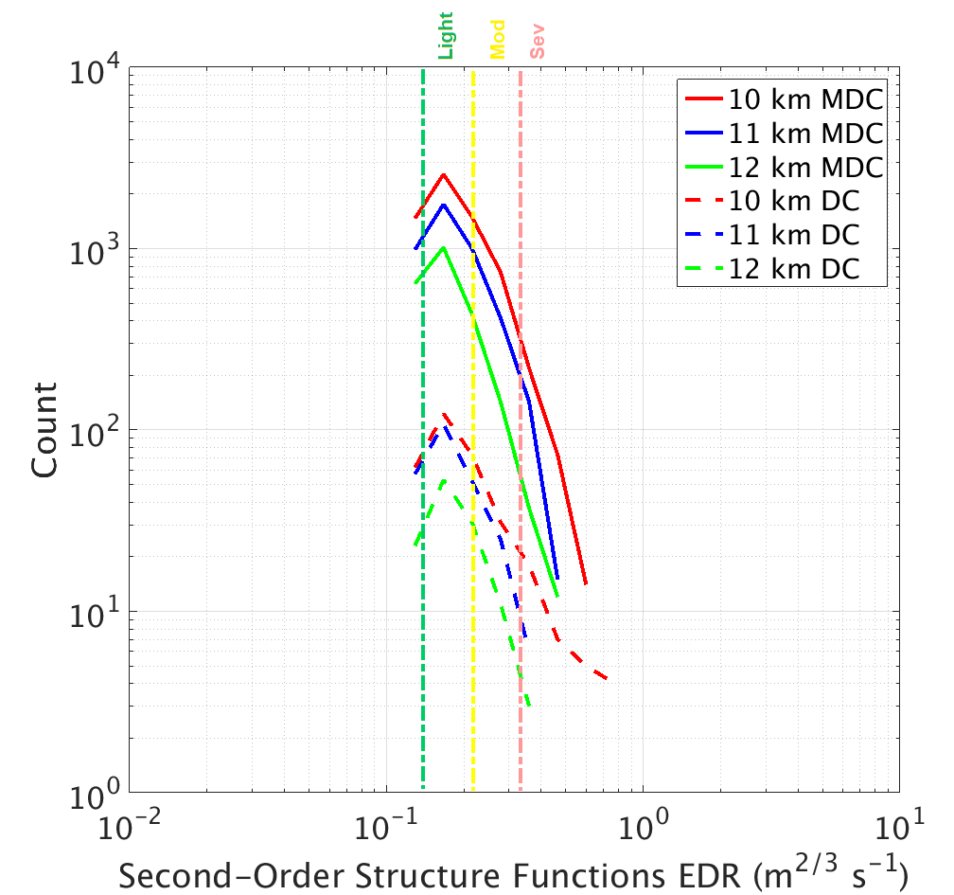
Developing Convection
More turbulence is associated with mature and dissipating convection
Highest intensity of turbulence is associated with developing convection at 10 km in altitude
Convective object closest to severe turbulence had rapid development
9 m s⁻¹ increase in vertical velocity
3 km (~10 kft) increase in storm height
Areal Coverage →
Intensity →

Slide 10
Discussion
Turbulence diagnostics (uncalibrated)
Richardson number: Turbulence was predicted near convection
EDR: Under-predicted turbulence
Structure functions: Predicted severe turbulence near convection
Greatest areal coverage of turbulence is associated with mature/dissipating convection
Most intense turbulence is associated with developing convection
Increased hazard for aviation operations
More research on developing convection and turbulence is needed

Slide 11
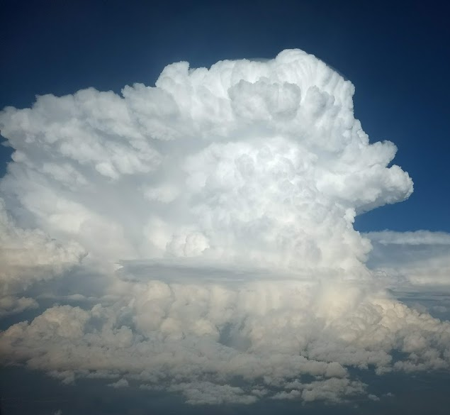
Research Objective II
Sharman and Pearson 2017; Pearson and Sharman 2017; Lester 1994
How does model resolution influence the distribution of turbulence?
Current operational turbulence forecast systems are now running on a 3 km horizontal grid spacing
Indices are being scaled for finer grid spacing
Turbulence that influences aviation occurs on scales of 10-1000 m
Courtesy of A. Karboski
Barber et al. 2018 JAMC

Slide 12
Methodology
Ellrod and Knapp 1992; Ahmad and Proctor 2012
Numerical simulations of convection in northern Great Plains using WRF
10-17 July 2015
Turbulence diagnostics
Model derived eddy dissipation rate (ε^{1/3})
Turbulent kinetic energy
Ellrod Index
Convergence, deformation, and vertical wind shear
Model | Horizontal grid spacing | Mean vertical grid spacing
S1 | 12 km | 550 m
S2 | 3 km | 550 m
S3 | 3 km | 325 m
S4 | 500 m | 325 m
Barber et al. 2018 JAMC
WRF: Weather Research and Forecasting model

Slide 13
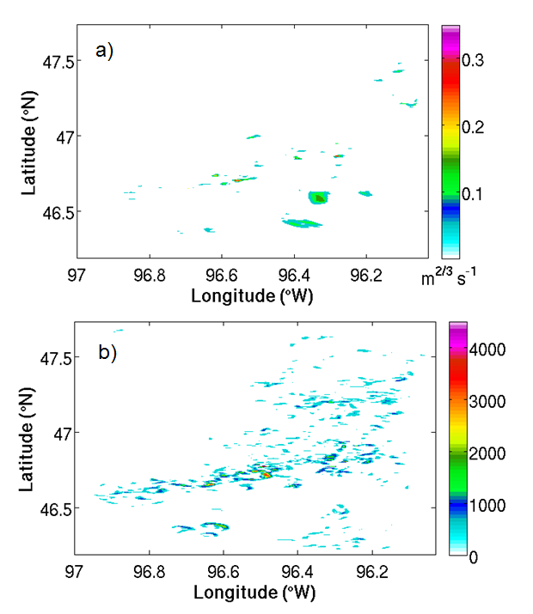
Midlatitude CIT
∆x = 500 m z = 8 km
Moderate
Light
ε^{1/3}
Light to moderate turbulence
Ellrod Index
Resolution sensitivity
Areal coverage of severe turbulence is much greater than ε^{1/3}
Magnitudes need to be scaled
Brown 1
Locations of maximum intensity vary between diagnostics
ε^{1/3}
∆x = 500 m z = 8 km
Ellrod Index
Severe
Barber et al. 2018 JAMC

Slide 14
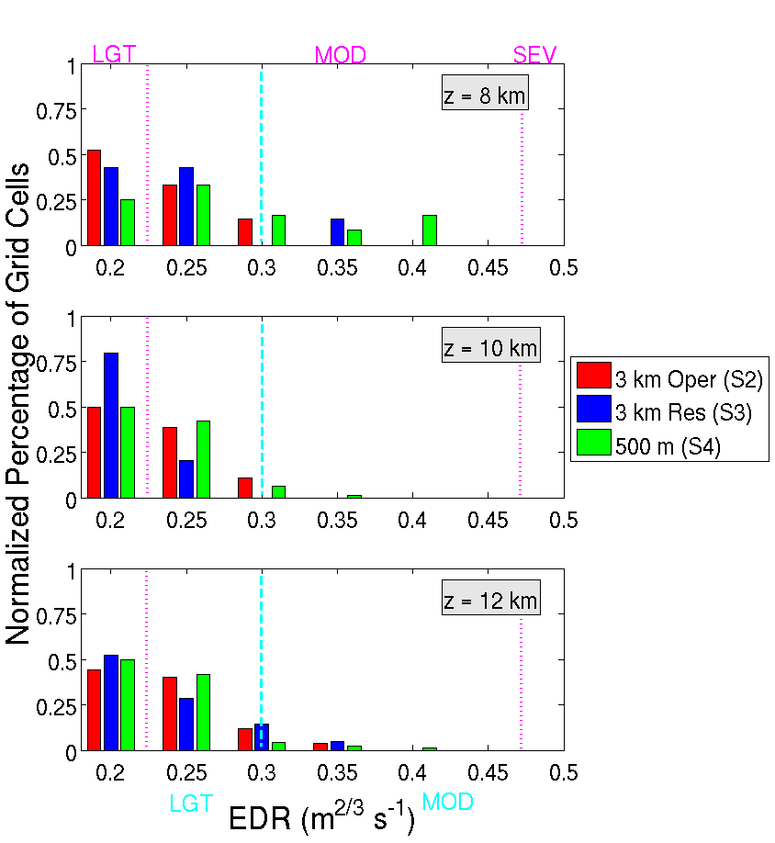
Midlatitude CIT
Coarser model resolution distributes the most turbulence towards lower thresholds
Finer vertical and horizontal grid spacing is needed to predict extreme turbulence
8 km = 26 kft
10 km = 33 kft
12 km = 39 kft
Barber et al. 2018 JAMC

Slide 15
Discussion
Resolution influences the distribution of turbulence
Increased horizontal and vertical resolution is important for turbulence prediction
Moderate to severe turbulence was found more than 20 mi away from convection
Turbulence prediction is sensitive to convective type and dynamical forcing (i.e. isolated convection and mesoscale convective systems)
Barber et al. 2018 JAMC

Slide 16
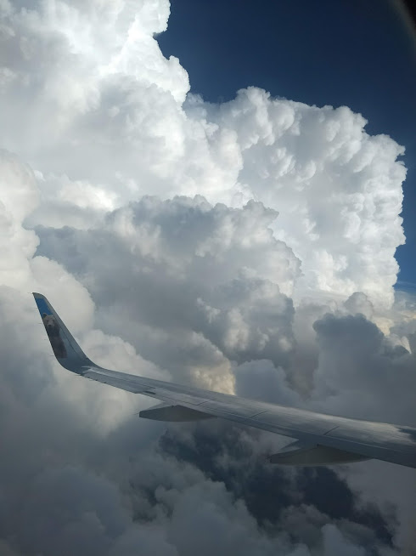
Conclusions
More research about CIT caused by developing convection is needed
Midlatitudes and tropics
Storm type specific FAA guidelines
Increase efficiency
Can convective parameters statistically be used as turbulence diagnostics?
Courtesy of A. Karboski

Slide 17
References
Ahmad, N. N., and F. H. Proctor, 2012: Estimation of eddy dissipation rates from mesoscale model simulations. NASA Tech. Report AIAA Paper-2012-0429, 24 pp, https://ntrs.nasa.gov/search.jsp?R=20120000925.
Barber, K. A., G. L. Mullendore, and M. J. Alexander, 2018: Out-of-cloud convective turbulence: Estimation method and impacts of model resolution. J. Appl. Meteor. Climatol., 57, 121–136, https://doi.org/10.1175/JAMC-D-17-0174.1.
Ellrod, G. P., and D. L. Knapp, 1992: An objective clear-air turbulence forecasting technique: Verification and operational use. Wea. Forecasting, 7, 150–165.
Frehlich, R., and R. Sharman, 2004a: Estimates of turbulence from numerical weather prediction model output with applications to turbulence diagnosis and data assimilation. Mon. Wea. Rev, 132, 2308–2324.
Frehlich, R., and R. Sharman, 2004b: Estimates of upper level turbulence based on second order structure functions derived from numerical weather prediction model output. Preprints, 11th Conf. on Aviation, Range, and Aerospace Meteorology, Hyannis, MA, Amer. Meteor. Soc., CD-ROM, P4.13.
Lane, T. P., and R. D. Sharman, 2014: Intensity of thunderstorm-generated turbulence revealed by large-eddy simulation. Geophys. Res. Lett., 41, 2221–2227, https://doi.org/10.1002/2014GL059299.
Lane, T. P., R. D. Sharman, S. B. Trier, R. G. Fovell, and J. K. Williams, 2012: Recent advances in the understanding of near-cloud turbulence. Bull. Amer. Meteor. Soc., 93, 499–515, https://doi.org/10.1175/BAMS-D-11-00062.1.
Lane, T. P. and R. D. Sharman, 2008: Some influences of background flow conditions on the generation of turbulence due to gravity wave breaking above deep convection. J. Appl. Meteor. Climatol., 47, 2777–2796, https://doi.org/10.1175/2008JAMC1787.1
Lane, T. P., R. D. Sharman, T. L. Clark, and H.-M. Hsu, 2003: An investigation of turbulence generation mechanisms above deep convection. J. Atmos. Sci., 60, 1297–1321, https://doi.org/10.1175/1520-0469(2003)60<1297:AIOTGM>2.0.CO;2.
Lester, P. F., 1994: Turbulence: A New Perspective for Pilots. Jeppesen Sanderson, 212 pp.
Pearson, J. M., and R. D. Sharman, 2017: Prediction of energy dissipation rates for aviation turbulence. Part II: Nowcasting convective and nonconvective turbulence. J. Appl. Meteor. Climatol., 56, 339–351, https://doi.org/10.1175/JAMC-D-16-0312.1.
Sharman, R. D., and J. M. Pearson, 2017: Prediction of energy dissipation rates for aviation turbulence. Part I: Forecasting nonconvective turbulence. J. Appl. Meteor. Climatol., 56, 317–337, https://doi.org/10.1175/JAMC-D-16-0205.1.
Zovko-Rajak, D., and T. P. Lane, 2014: The generation of near-cloud turbulence in idealized simulations. J. Atmos. Sci., 71, 2430–2451, https://doi.org/10.1175/JAS-D-13-0346.1.

Slide 18
Extra Slides

Slide 19
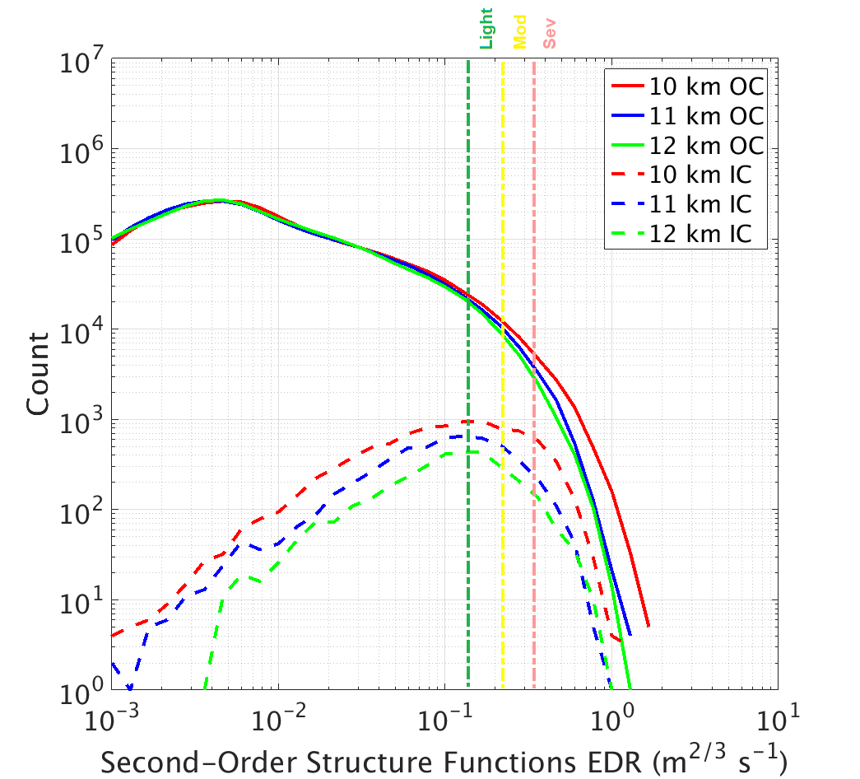
Tropical CIT
Out-of-cloud turbulence has the largest areal coverage
Most severe turbulence is out of cloud
10 km in altitude has the greatest likelihood of experiencing severe turbulence (in and out of cloud)
Majority of turbulence is above cloud
Areal Coverage →
Intensity →

Slide 20
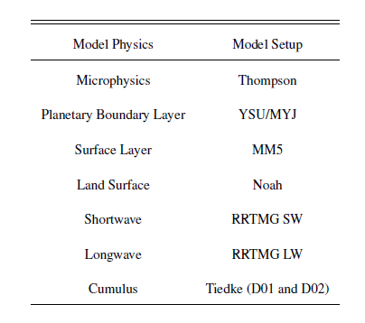
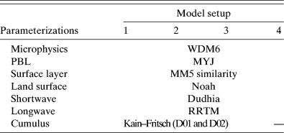
Model Physics

Slide 21
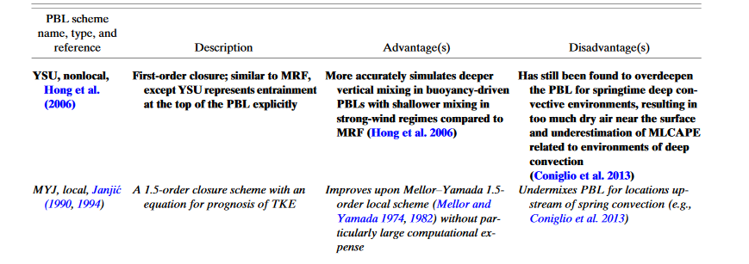
Model Physics
PBL:
YSU- no prognostic variables, diagnostic- diffusivity of heat
MYJ- prognostic variable- TKE, diagnostic- diffusivity of heat, length scale
YSU (diagnostic scheme) imposes this profile based on diagnosed PBL height h
MYJ (prognostic scheme) tries to develop it organically by predicting TKE
(Fovell 2018)

