Slide 1
Impact of Turbulence on Unmanned Aerial Vehicles
Larry B. Cornman
National Center for Atmospheric Research

Slide 2
Weather impacts on UAS operations
Key Wx factors:
Steady wind: headwind, tailwind, crosswind
Wind shear
Turbulence and discrete gusts
C&V
Heavy precip.
Icing
Air density
Temperature
FAA Weather Related Aviation Accident Study 2003-2007
Part 91, 121, 135, and 137
But UAS are typically more sensitive to wx than larger vehicles
= Wind-Related
Source:
NTSB Aviation Accident and Incident Database

Slide 3
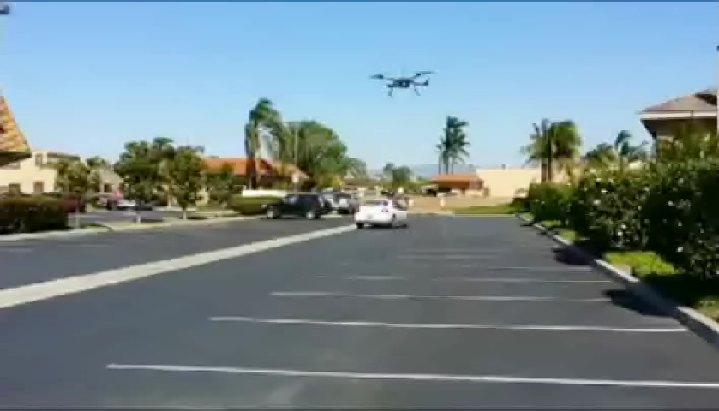
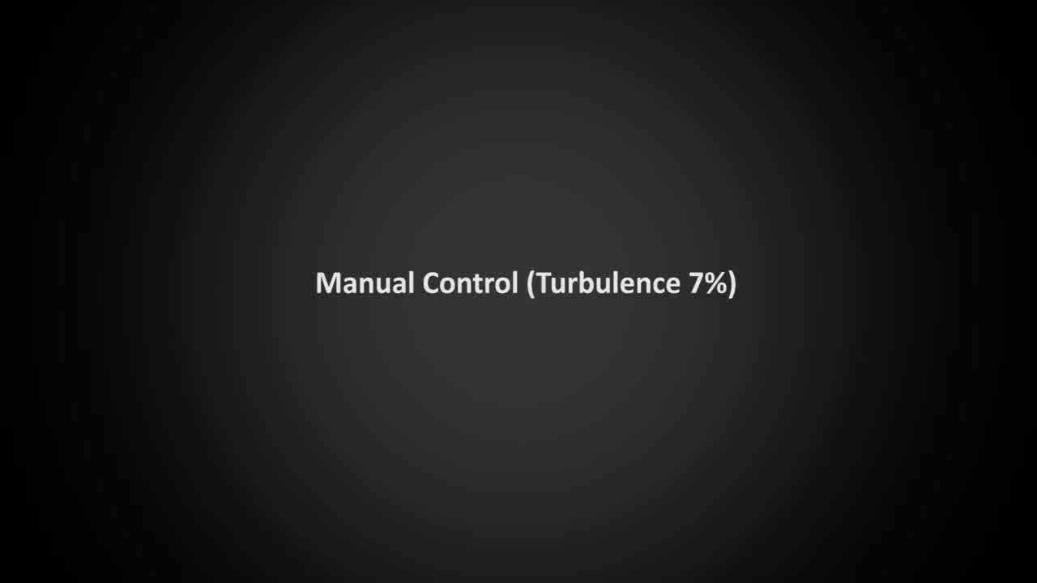
Most UAS are small, rigid, light, and slow moving => high sensitivity to wind gusts
Quadcopter in gusty conditions source: https://youtu.be/h-s9RbKNUyE
Fixed wing UAS: w/ and w/o autopilot courtesy, RMIT UAS Research Team (RUASRT), RMIT©

Slide 4
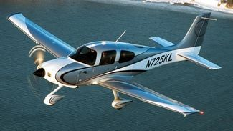
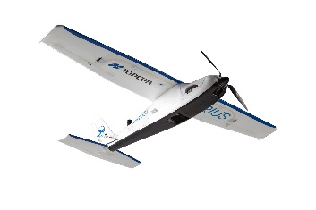
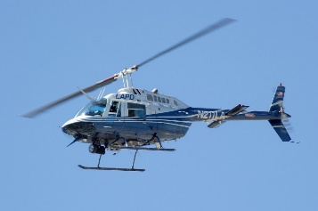
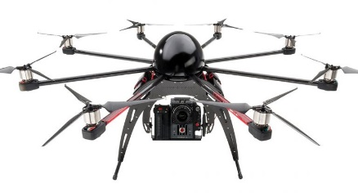
Fixed-wing vs. multirotor UAS
Many fixed-wing UASs can be considered as “scaled-down” conventional aircraft.
Most multirotor UAS are very different from conventional helicopters.
There is a large established literature regarding the effect of winds/turbulence on fixed-wing aircraft and conventional helicopters – but very little relative to multirotors & unconventional fixed-wing UAS.
≈
≠

Slide 5
Wind and turbulence impacts on airborne vehicles
Three classes of forces:
Aerodynamic
Propulsive
Gravitational
The effect of wind and turbulence are mainly manifest through aerodynamic forces
We consider control forces (e.g., elevator, ailerons, rudder) as aerodynamic in nature.
Propulsive forces due to propellers (thrust) can also be considered aerodynamic.

Slide 6
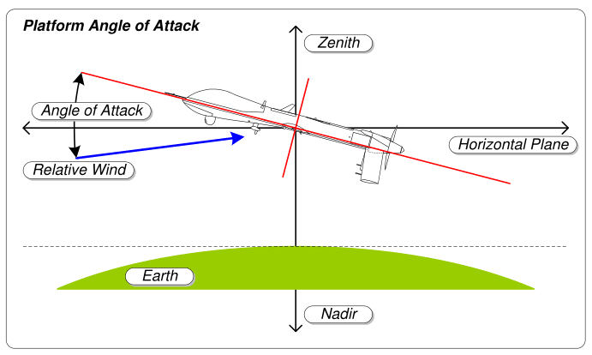
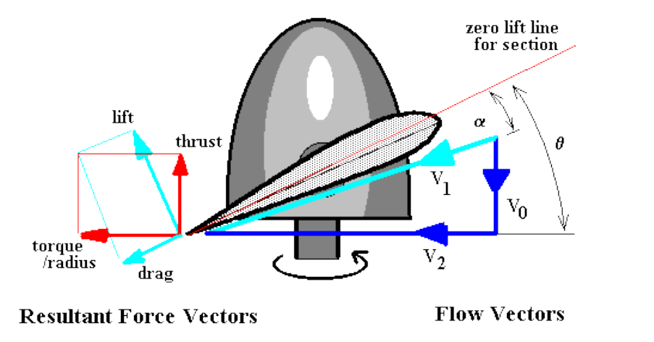
Aerodynamic forces: Lift
Since an airborne vehicle must counteract gravity to stay aloft, it is the vertical component of the lift force that is key.
The relative motion of the lifting surface through the air produces the lift
For fixed-wing vehicles, it’s the forward motion of the wing and tail.
For multirotors it’s the rotary motion of the propeller.

Slide 7
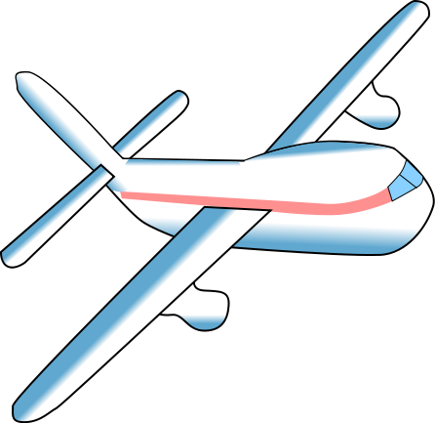
Fixed-wing vehicle: Lift forces produce translational (mainly vertical) and rotational motions
Differential lift on wing and tail produces pitching moment
Differential lift across wing (or tail) or side wind (dihedral effect) produces rolling moment
Side wind on vertical tail surface produces yawing moment

Slide 8
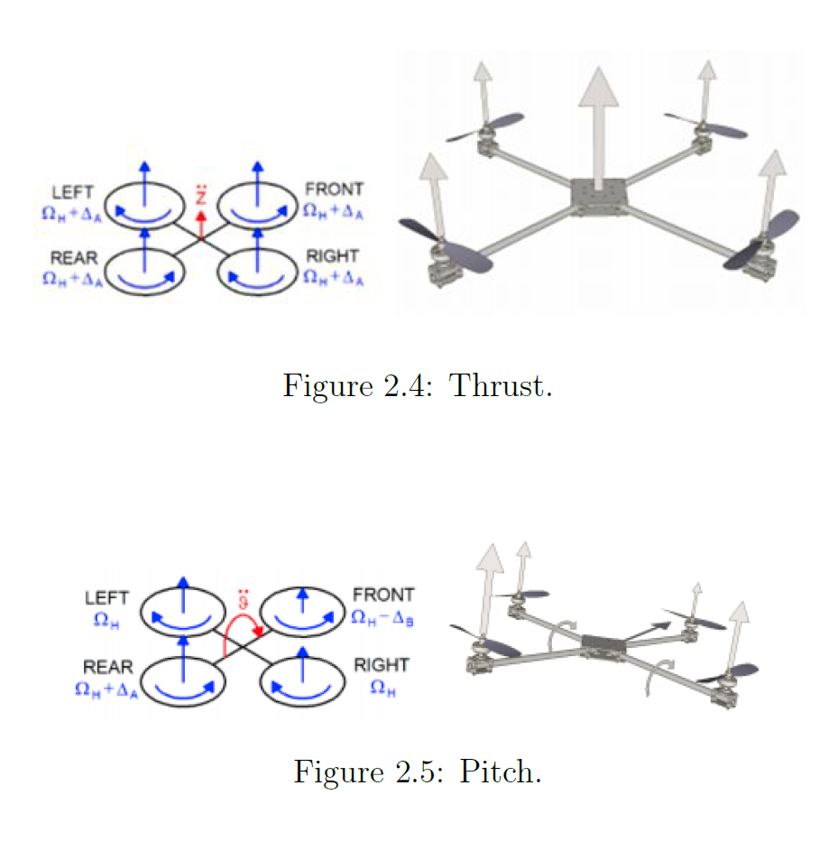
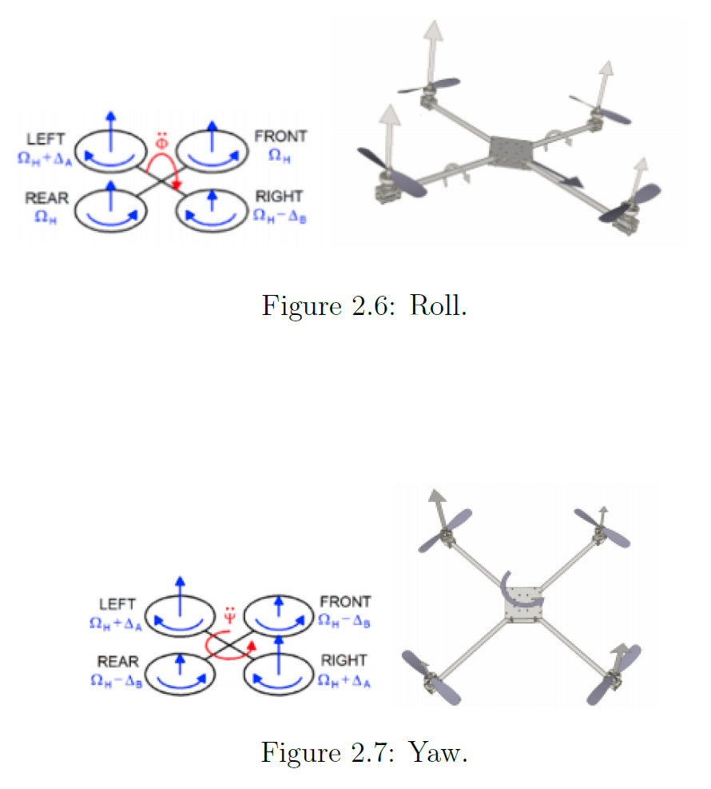
Quadrotor motion and orientation changes via differential thrust and torque
+
+
+
+
+
-
Vertical motion via uniform thrust
Rolling motion and translation via differential “left-right” thrust
+
-
+
-
+
-
Pitching motion and translation via differential “front-rear” thrust
Yawing motion via adjacent-paired differential reactive torque

Slide 9
Modeling impact on UAS due to winds & turbulence
Clearly, loss of lift resulting in large vehicle translations (e.g., hitting the ground) is important.
For manned vehicles, another important metric is large vertical accelerations (e.g., impact on occupants, stress on vehicle).
Not yet clear what other metrics might be relevant to UAS (e.g., large attitude changes that result in stability & control problems).

Slide 10
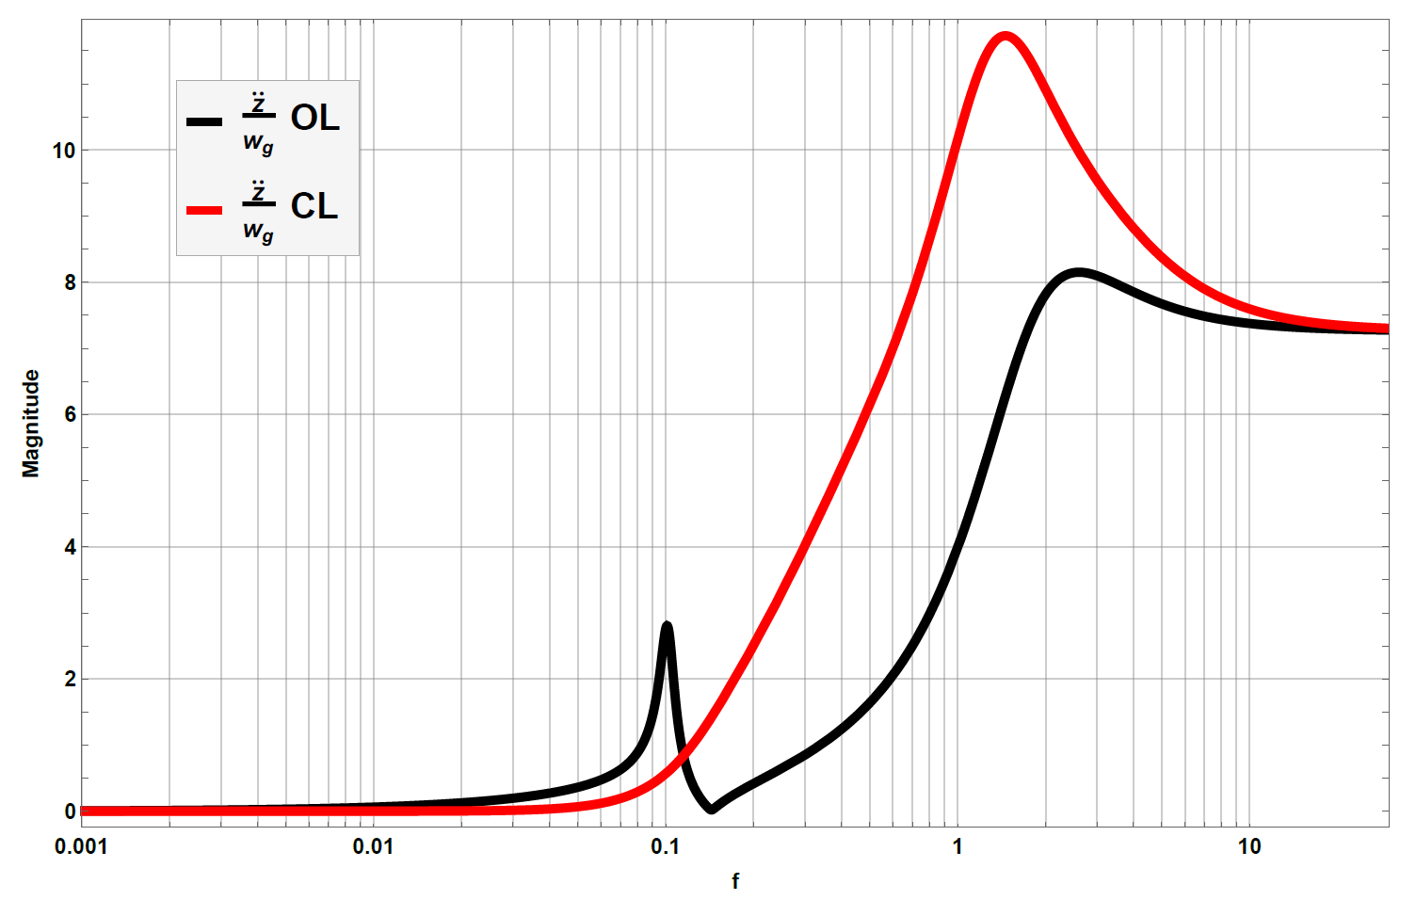
Autopilot has a significant effect on vertical acceleration response to vertical gust
Autopilot
stiffens pitch response
Autopilot
dampens
airspeed
response
Small UAV

Slide 11
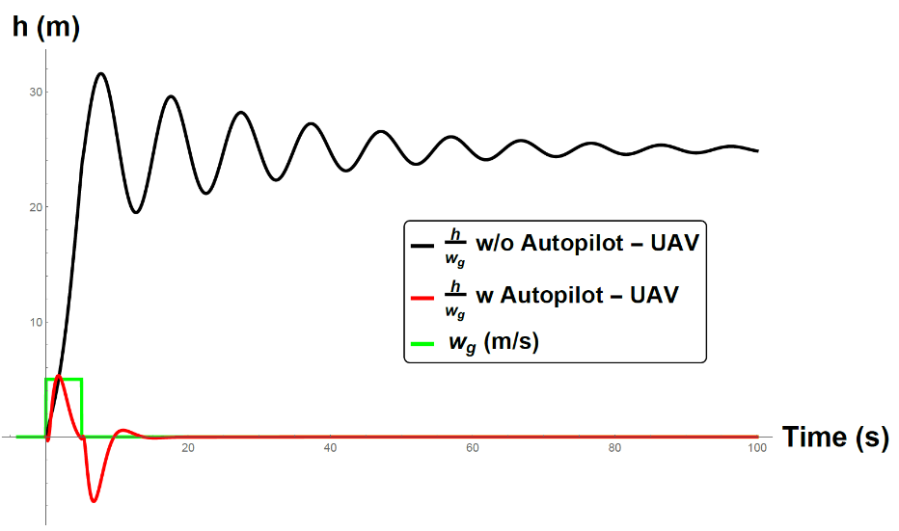
Autopilot has a dramatic effect on UAS height response to vertical gust
Vertical Displacement Response to Updraft

Slide 12
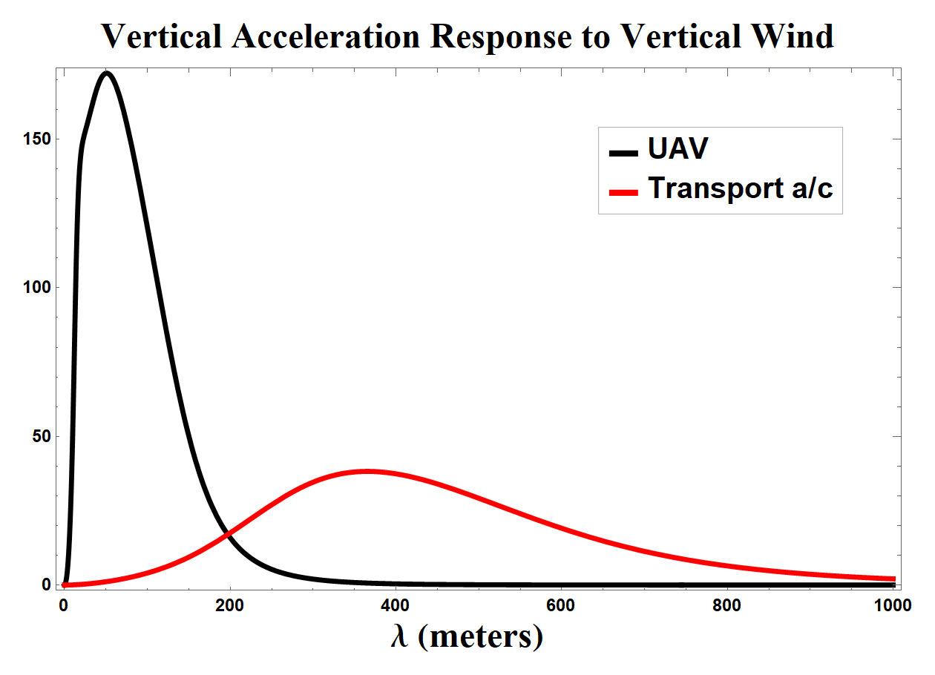
The importance of including realistic winds in UAS flight modeling and simulation
Accurate UAS flight simulation requires accurate winds at UAS scales (m-10’s m).
LES model output is inherently filtered; e.g., 25 m spatial resolution results in accurate winds at ~200 m.
Most of the accurately resolved scales
from LES are larger the UAS response scales
Accurately resolved LES scales (25 m grid)
Solution: merge LES wind with subgrid turbulence

Slide 13
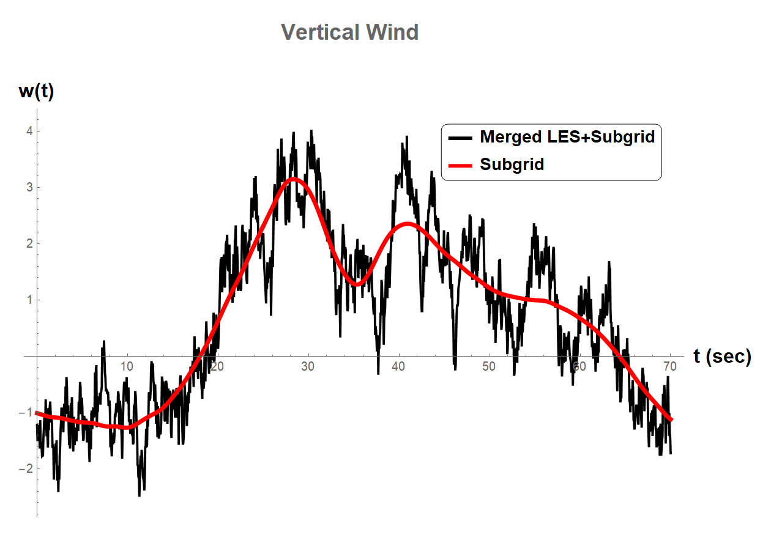
LES + subgrid merging example
70 s @ 20 m/s = 1.4 km
Result: realistic large and small scale wind

Slide 14
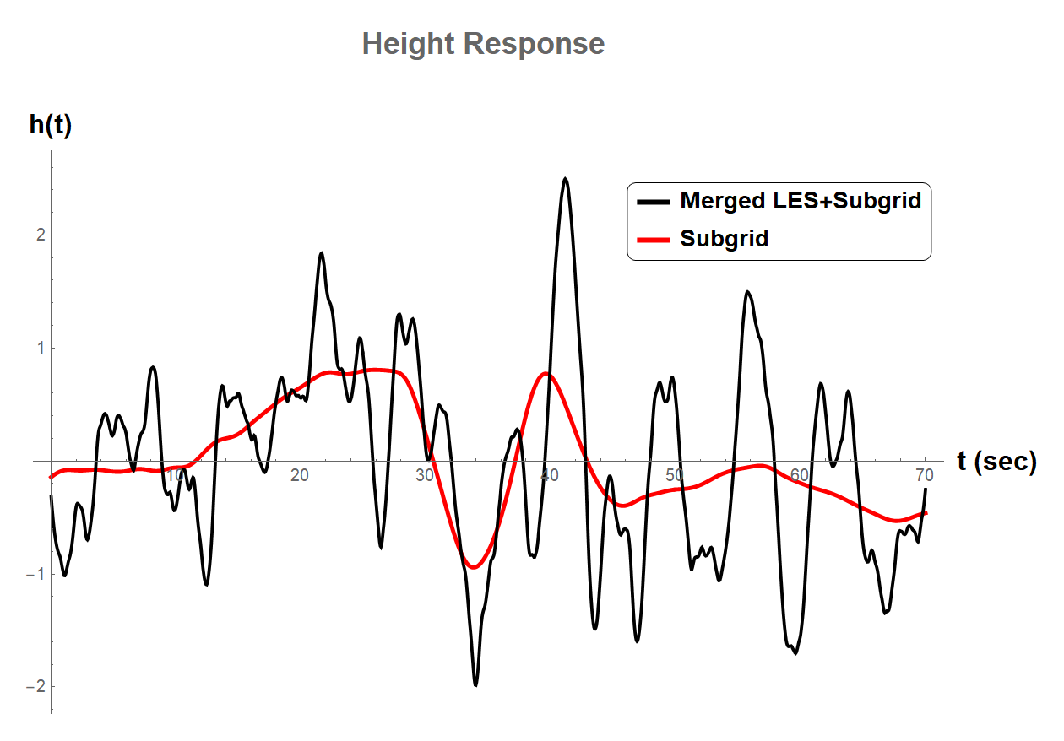
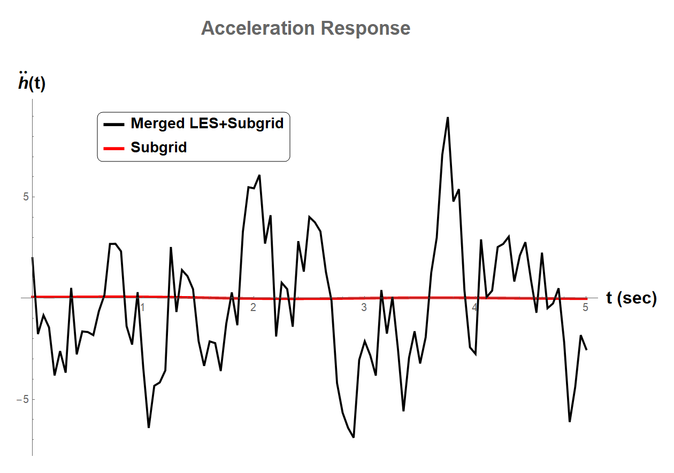
UAS simulation through LES and LES+subgrid wind fields
Height Response
Acceleration Response
70 s
5 s
Using LES-only gives ballpark results for height, but
is inadequate for acceleration simulation

Slide 15
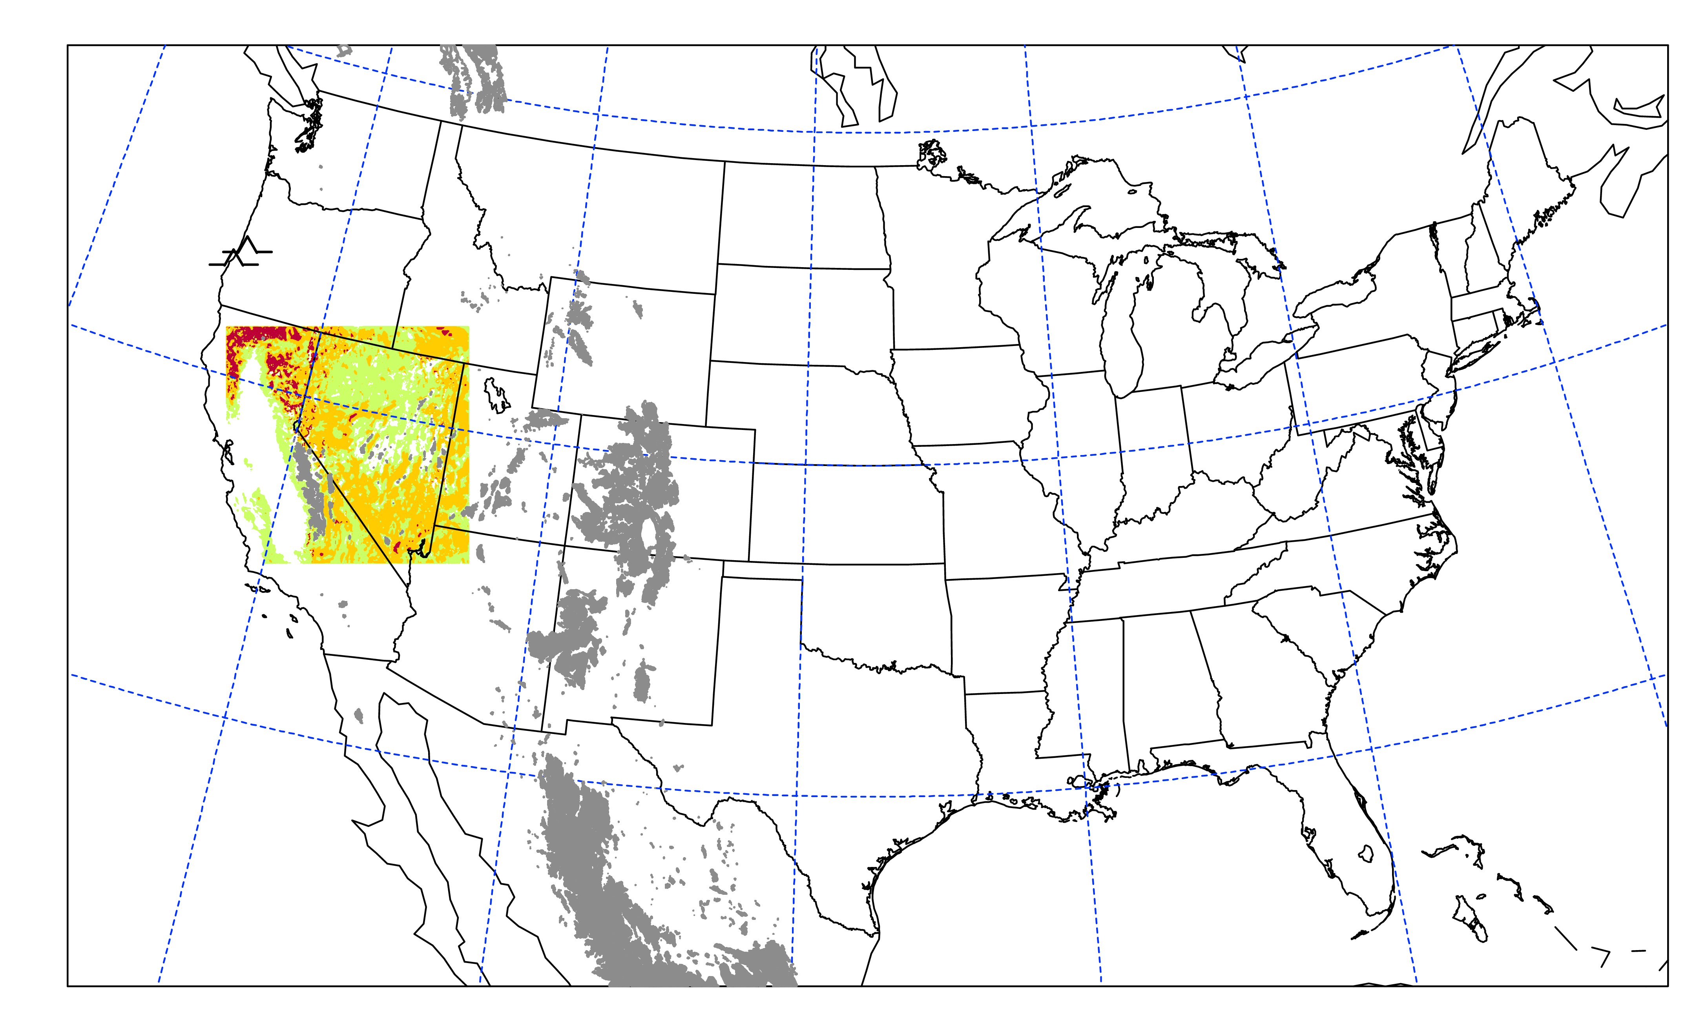
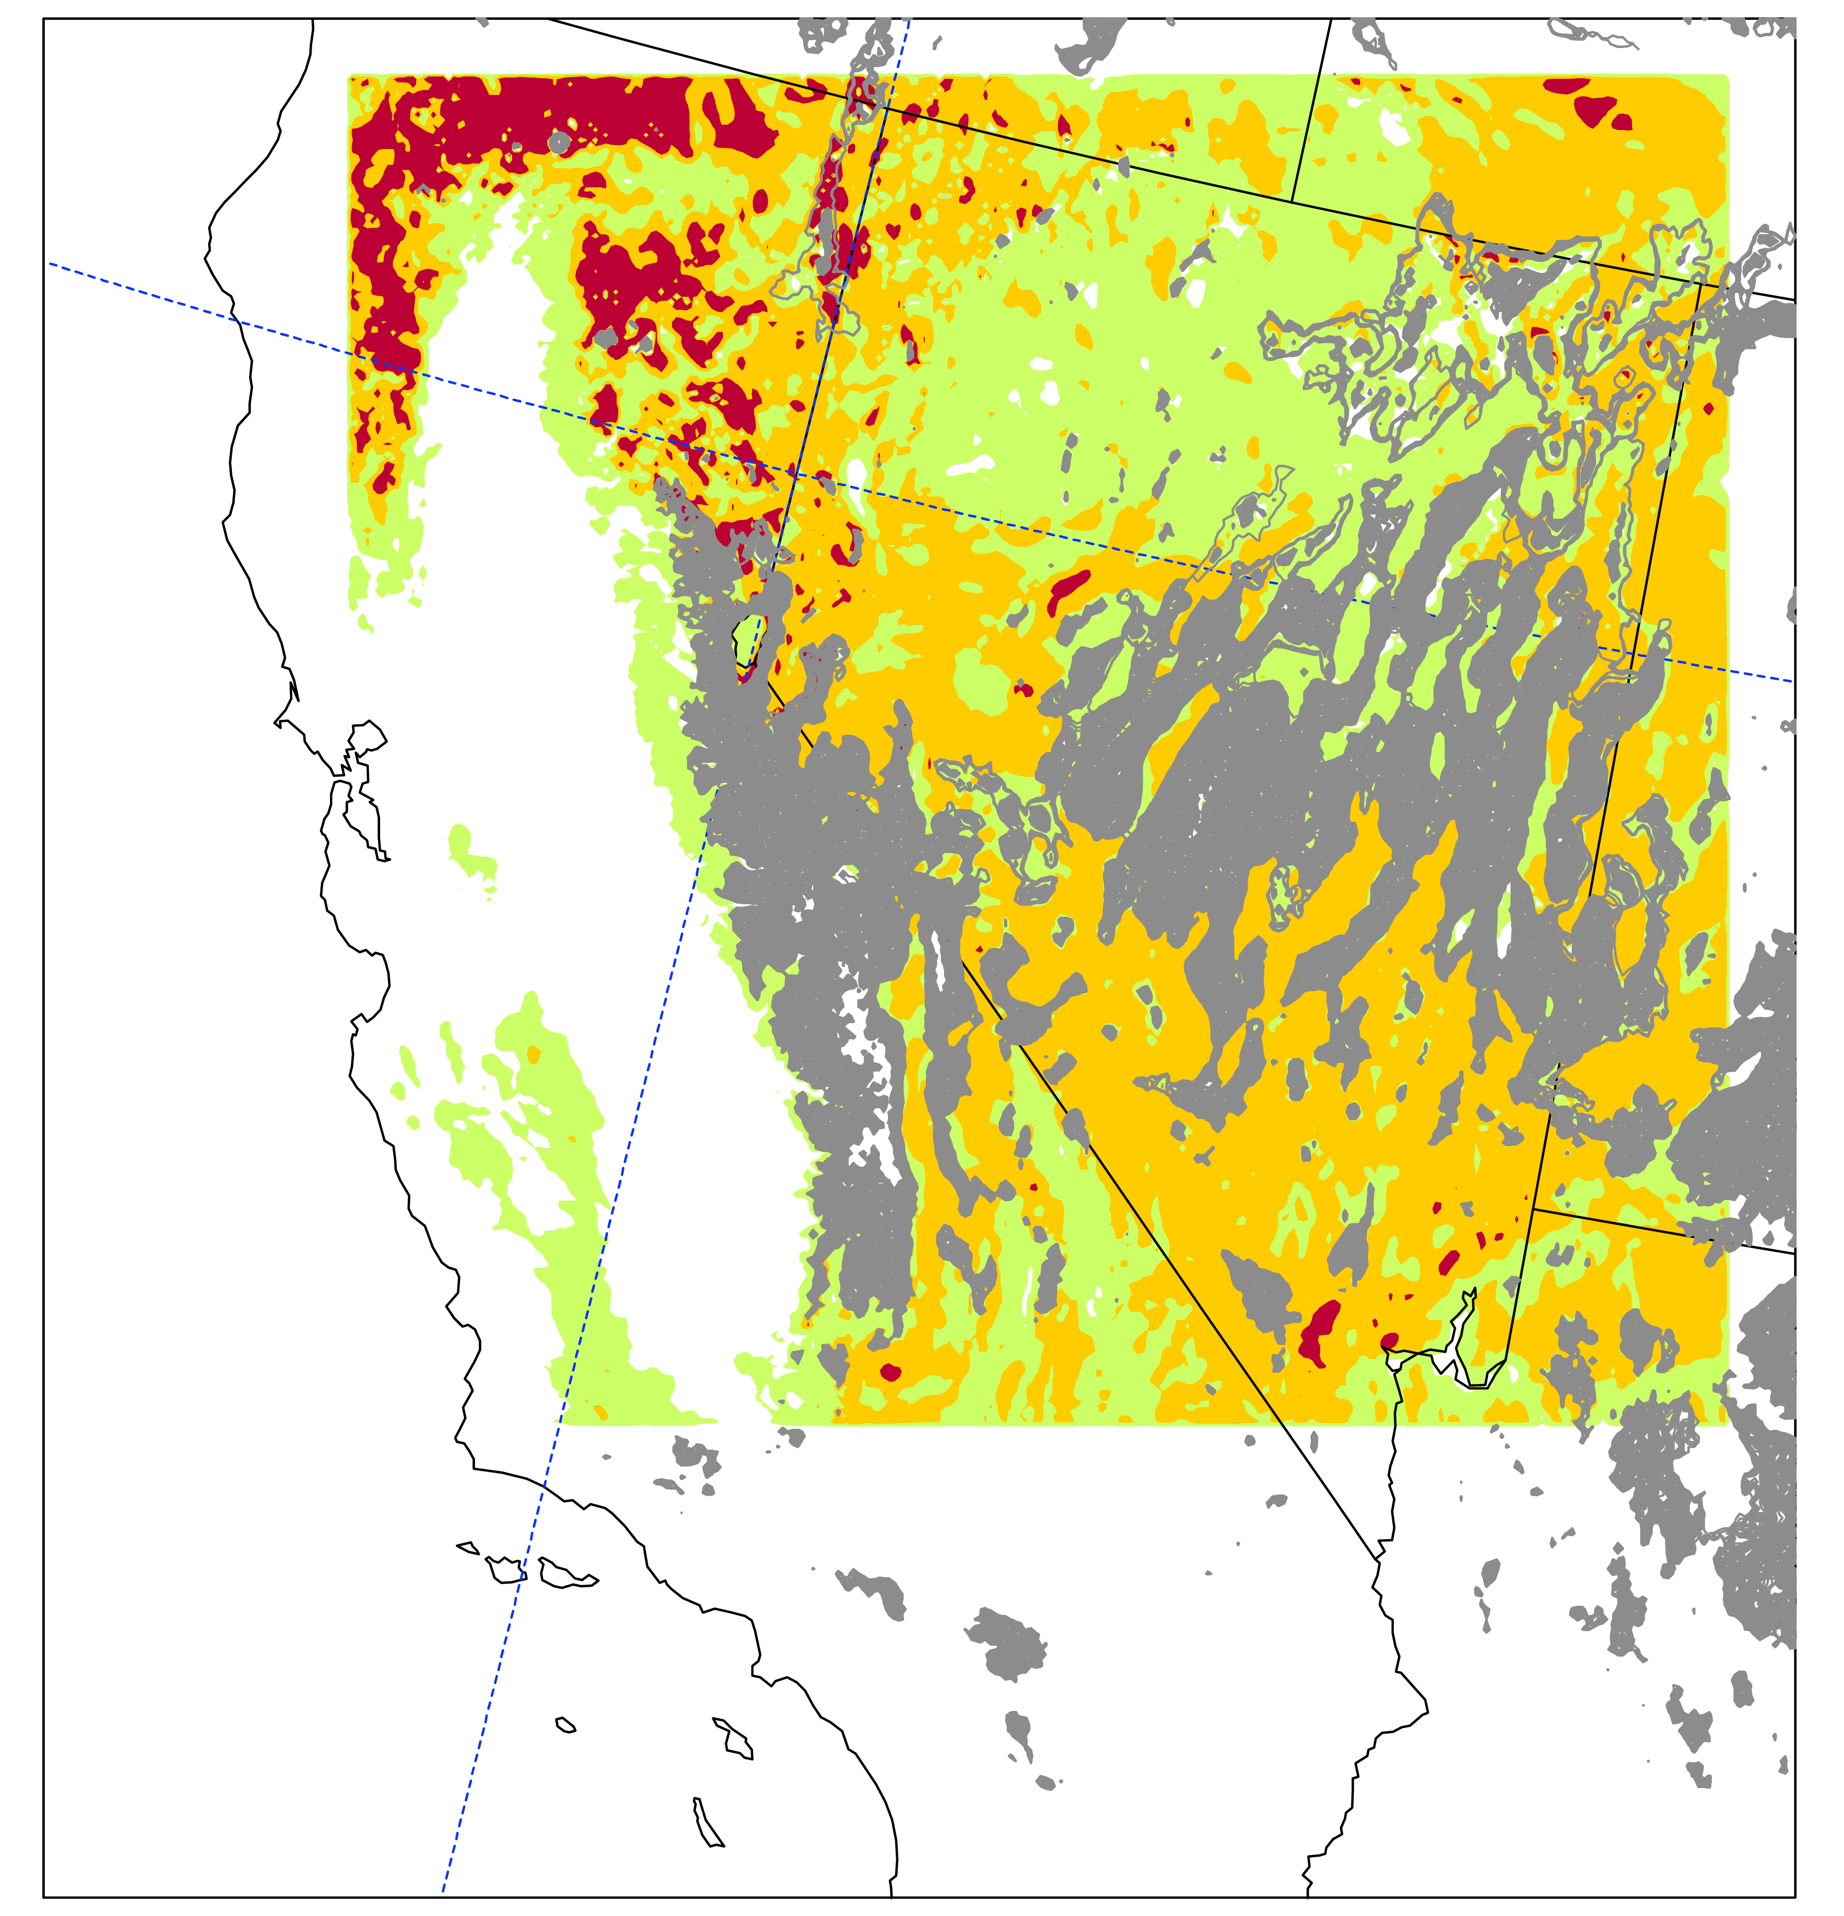
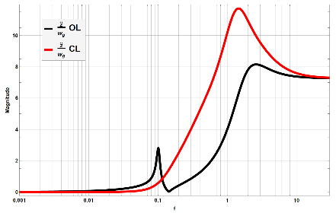
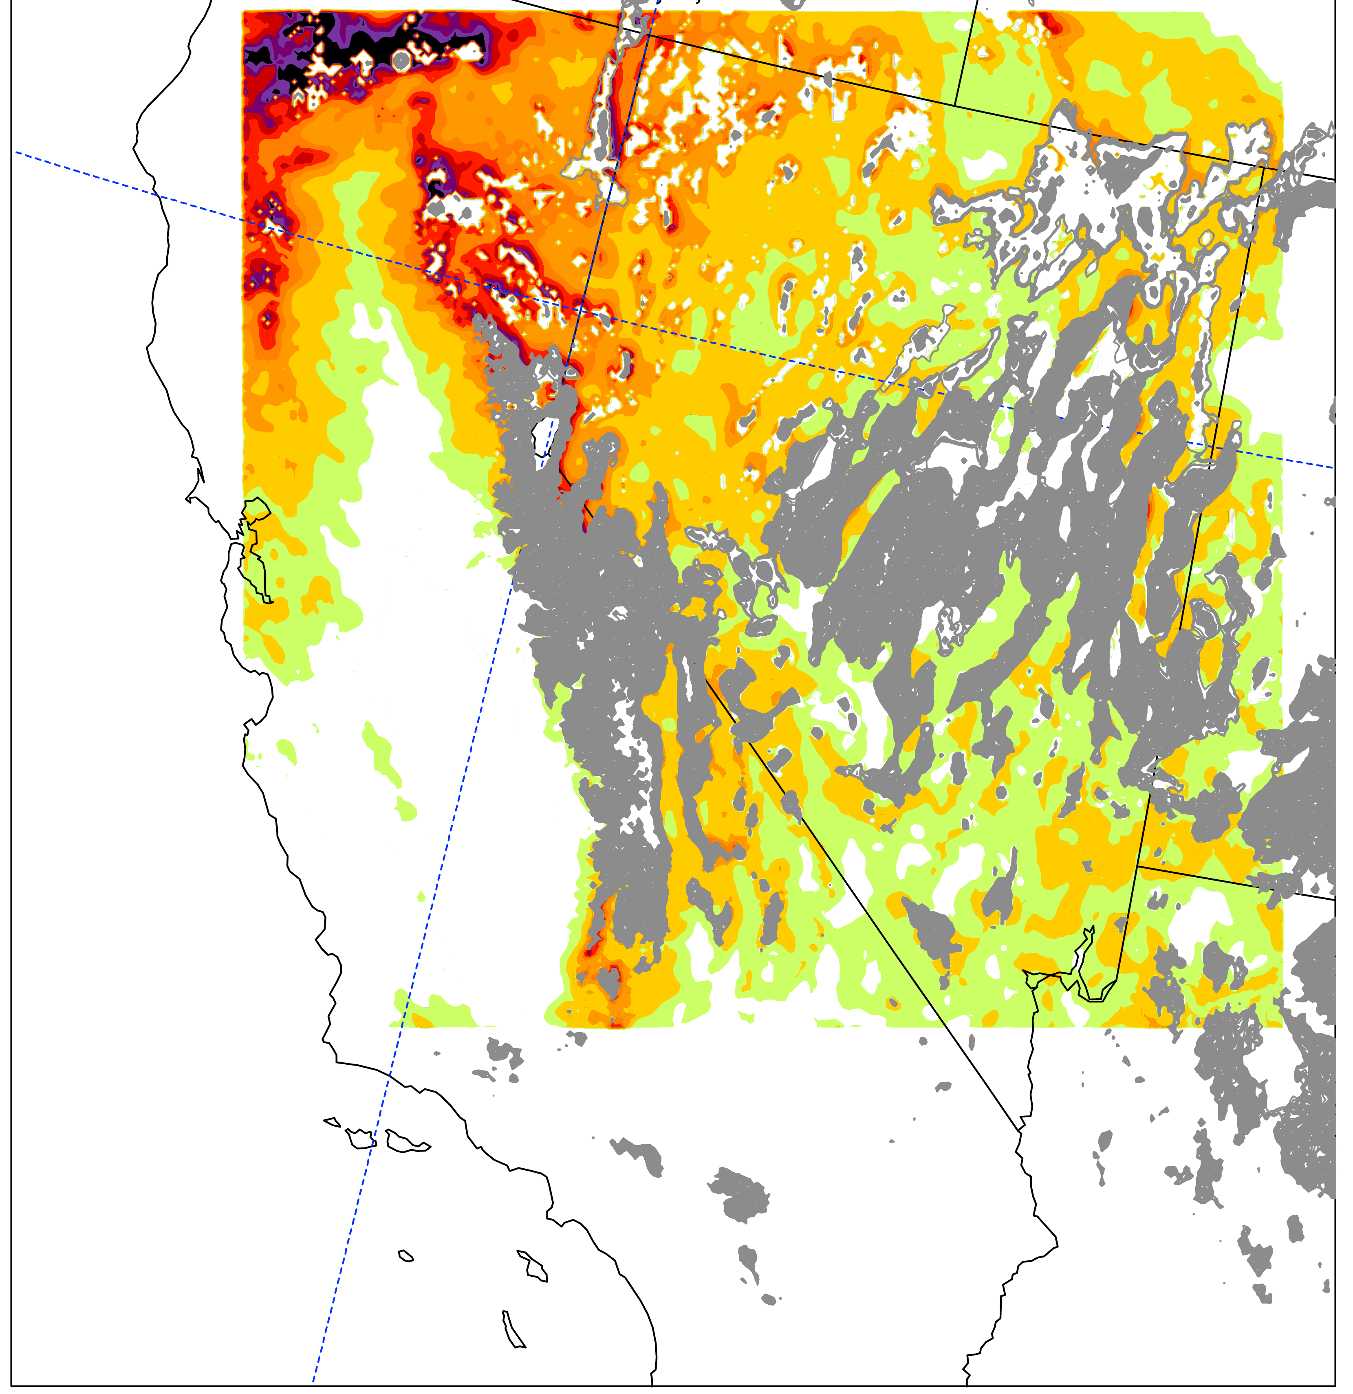
Application of research to operations
HRRR 3km
data cutout
GTG Turbulence
Product
UAS turbulence
response
UAS impact
values
Goal: End-to-End Turbulence Forecasting/Nowcasting System
for UAS Operations

Slide 16
Where do we go from here?
User needs assessment:
What are the wind/turbulence impact variables of importance (performance and/or stability & control metrics)?
What are the required temporal/spatial scales?
What are the accuracy requirements?
How is the information provided to users (decision support systems)?
Research activities:
Vehicle modeling/simulation (fixed-wing and multirotor).
Translation algorithms (model output -> vehicle impact).
Flight test/demos.

