Slide 1
HEMS
Weather Summit 2013
Industry Taskforce Presentations
December 18, 2013 Washington, D.C.
Facilitators:
Rex Alexander, National EMS Pilots Association
Tom Judge, International Helicopter Safety Team

Slide 2
Presentations
HEMS Part 135 compared to other Charter Part 135 & 121
HEMS Weather Accident Statistics
HEMS Weather Tool A Historical Perspective
HEMS Regulatory Requirements for Weather
Weather Regulations, Advisory Circulars, LOA’s, MOU’s
Economic Impact of the HEMS Weather Tool
HEMS Weather Tool for other Aviation Operations
HEMS Weather Tool Input Data

Slide 3
HEMS Part 135 compared to other Charter Part 135 & 121
Rex Alexander

Slide 4
HEMS Part 135 compared to other Charter Part 135 & 121
What a HEMS pilot in the field can expect.
  12-14 hour on site shifts
  7-on/7-off rotations, with day night switching
  A local area with a 25-50 nm radius.
  A service areas with a 150nm radius and greater.
  An on call, immediate response status.
  10 minutes or less expected response time.
    *Note Weather status (Green, Yellow & Red)

Slide 5
HEMS Part 135 compared to other Charter Part 135 & 121
HEMS 135 On Demand
Part 121
Unscheduled
Takeoff times 10min or less
Destination(s) identified at notification
Destination can change enroute
Flight planning done individually
Off airport location (Hospitals)
Generally no onsite weather reporting
limited IFR infrastructure
Weather 5000’ feet and below
Generally cruising at 500’ to 1000’ AGL
Remote offsite scene operations
Time sensitive & critically ill or injured
Scheduled
Takeoff times known months in advance
Destination(s) known months in advance
Destination never changes
Flight planning teams
Terminal locations, airports only
Always onsite weather reporting
Fully accessible IFR infrastructure
Weather above 12,000’
Generally cruising at 12,000’ MSL and up
No offsite operations
Standard passengers

Slide 6
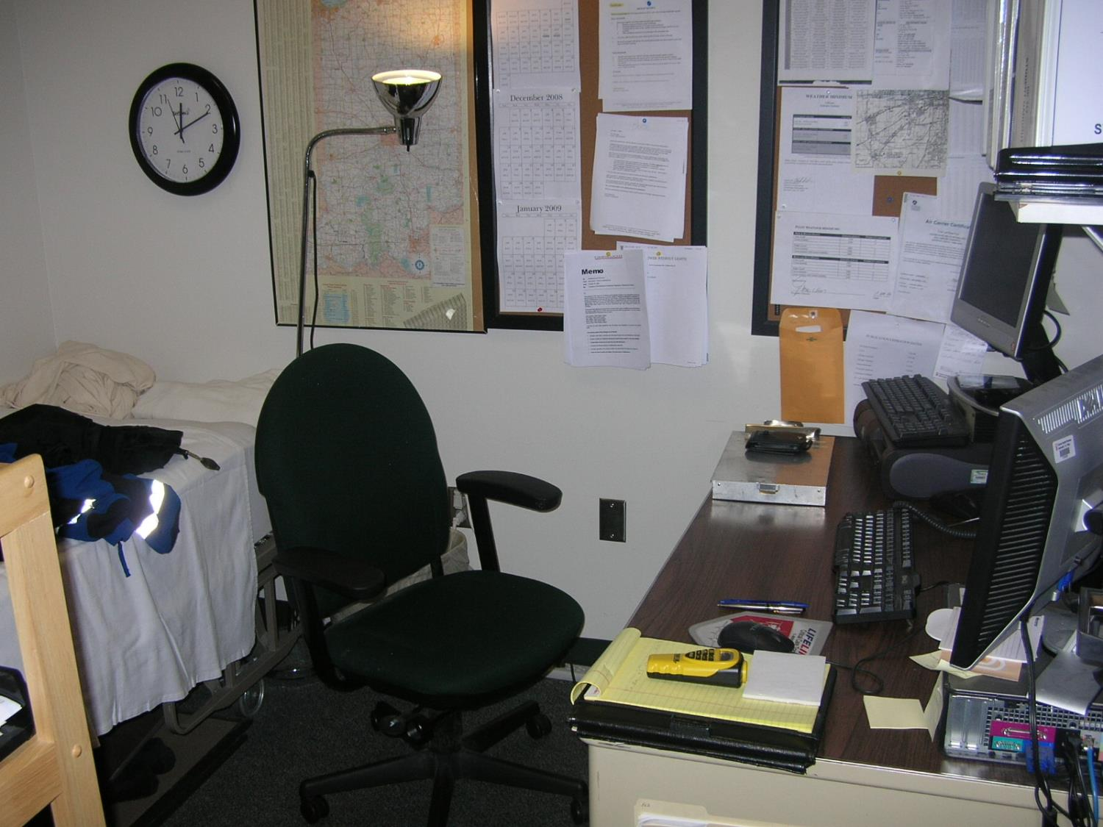
HEMS Part 135 compared to other Charter Part 135 & 121
What HEMS pilots have had to work with in the past to accomplish this.

Slide 7
HEMS Part 135 compared to other Charter Part 135 & 121
What a Part 135 HEMS pilot uses for weather reporting?
  Anything they can get their hands on!

Slide 8
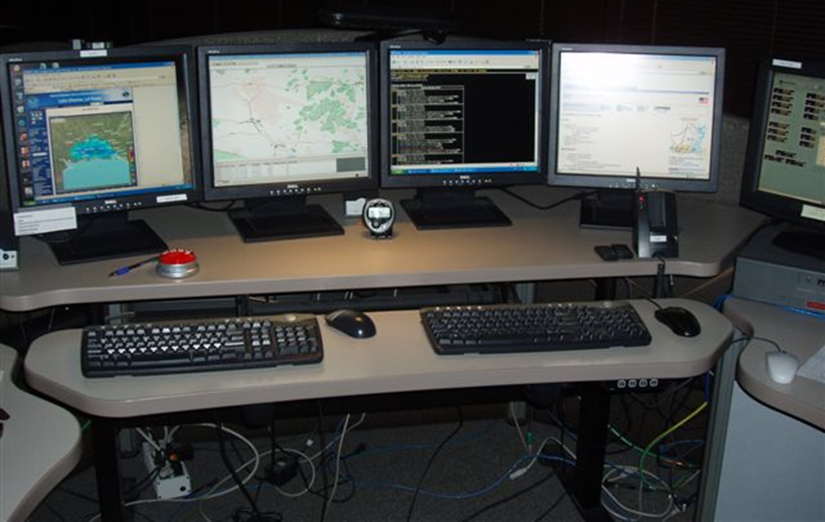
HEMS Part 135 compared to other Charter Part 135 & 121
As a result of HEMS accidents, the NTSB made certain recommendations, one of which is the incorporation of-
Operational Control Centers

Slide 9
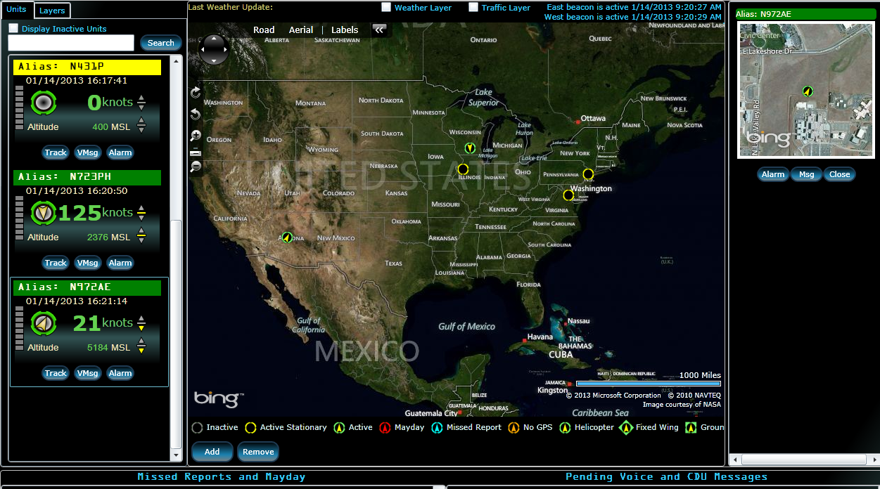
HEMS Part 135 compared to other Charter Part 135 & 121

Slide 10
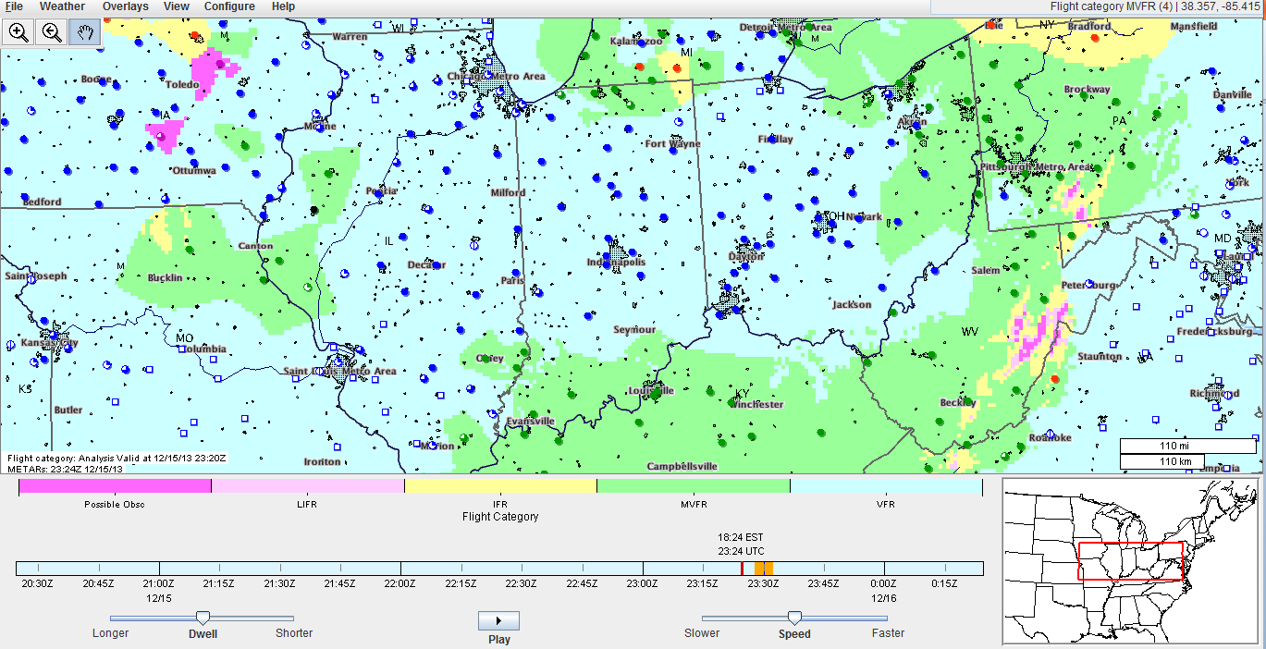
HEMS Part 135 compared to other Charter Part 135 & 121
A key element to both the pilot on the line and the Operational Control Center is the HEMS Weather Tool.

Slide 11
HEMS Weather Accident Statistics
Tom Judge

Slide 12

When and Why? 1998-2010
OSI-HEMS “Keyword”
  Human Factors: 94%
  Weather-related: 25%
  Mechanical: 24%
  CFIT: 21%
  LZ accidents (scenes): 19%
  Loss of Control: 19%
  Collision with obstacles: 17%
  IIMC: 15%
NTBS “Undetermined” – 3%
Ref: Ira Blumen (for AMTC 2013, Virginia Beach)

Slide 13
Recent Fatal HEMS Accidents
Whittier, AK – Dec. 3, 2007 – BK117 – 4 fatal
Cherokee, AL – Dec. 30, 2007 – Bell 206 – 3 fatal
S. Padre Island, TX – Feb. 5, 2008 – AS350 – 3 fatal
La Crosse, WI – May 10, 2008 – EC135 – 3 fatal
Huntsville, TX – June 8, 2008 – Bell 407 – 4 fatal
Flagstaff, AZ – June 26, 2008 – 2x Bell 407’s – 7 fatal
Greensburg, IN – Sept. 1, 2008 – Bell 206 – 3 fatal
Forestville, MD – Sept. 28, 2008 – AS365N1 – 4 fatal
Aurora, IL – Oct. 15, 2008 – Bell 222 – 4 fatal
Georgetown, SC – Sept. 25 2009– AS350 – 3 fatal
Doyle, CA – Nov. 14, 2009 – AS350 – 3 fatal
El Paso, TX --Feb. 6, 2010 -- AS350 – 3 fatal
Brownsville, TN, - 26 March 2010, AS350 – 3 fatal
Midlothian, TX– 5 June 2010—Bell 222 – 2 fatal
Kingfisher, OK– 22 July, 2010---AS350– 2 fatal
Tucson, AZ— 28 July, 2010—AS350—3 fatal
Scotland, AR– 31 August, 2010- Bell 206– 3 fatal
Kearney, MO –26 August, 2011– AS350--- 4 fatal
Greenville Springs, FL– 26 December 2011— Bell 206 —3 fatal
Rochelle, IL– 11 December 2012-- BK117– 3 fatal
Cerro Gordo Cty, IA, 3 January 2013, B407- 3 fatal
Oklahoma City, Ok. 25 February 2013, AS350- 2 fatal
Manchester, KY, 6 June 2013, B206- 3 fatal
Talihina, OK, 11 June 2013, AS350– 1 fatal, 2 critical, 1 injured
Somerville TN, 22 Oct. 2013 AS350– 3 fatal
_______________________________________________
Blue= day time., Orange = night, clear conditions Red = night, marginal weather, low visibility.
With exception of MSP Trooper 2 crash (Forestville, MD) all aircraft operating VFR.
Notes:
Five of these seven night accidents, shown in RED, occurred in reduced visibility conditions or instrument conditions.
Additionally, several of these accidents involved controlled flight into terrain, lack of dispatch and flight following, and no terrain avoidance warning systems installed.

Slide 14
When and Why? 1998-2013
Night:
  50% of all accidents
  67% of all fatal accidents
Scenes: 45% of the accidents during patient-related missions
Ref: Ira Blumen (for AMTC 2013, Virginia Beach)

Slide 15
When and Why? 1998-2013
Weather-related accidents
  25% of all accidents
  Fatal Accidents
    58% of weather-related accidents were fatal (compared to 33% of all accidents having a fatality)
Ref: Ira Blumen (for AMTC 2013, Virginia Beach)

Slide 16
HEMS Weather Tool
A Historical Perspective
Eric Lugger

Slide 17
HEMS Weather Tool Historical Perspective
FAA Weather Summit-Mar 2006
  Sponsored by FAA AFS-250 and NCAR
    Concept-create a graphical gridded weather product for HEMS
HEMS Industry Review-May 2006
  NCAR development team at Air Evac EMS Communications Center
  NCAR developed HEMS industry perspective on the HEMS Tool
  AFS-250 sponsored Advisory Circular-Operational Control Centers

Slide 18
HEMS Weather Tool Historical Perspective
Development meeting-NCAR Boulder CO-Sept 2006
  Development team brain storming session
  Initial release of the HEMS Tool
  Planned enhancements in Phase II release
FAA implementation-Nov 2006
  Hosted on the NCAR experimental website
  Same version remains currently-two changes
  Beta with enhancements will be shown today

Slide 19
HEMS Weather Tool Historical Perspective
En-route Ceiling and Visibility funding diverted to terminal WX
Discussions with ATO WX planning-lack of support
Discussions with AFS WX planning-lack of support
Discussions with Congressional Staff for Reauthorization bill
Discussions with NTSB-advocate for HEMS Tool 4 years ago
Operational version at NSW should be renamed VFR WX Tool
Helicopter Ops in other sectors use HEMS WX Tool
Quick onscreen review of current version

Slide 20
HEMS Regulatory Requirements for Weather
Ed Stockhausen / Gerry Pagano

Slide 21
General Requirements
Adequate weather reporting facilities
Approved sources of weather reports and forecasts to control flight operations
A system or method of obtaining reports and forecasts of adverse weather phenomena
Notes:
While there are a vast number of regulations pertaining to weather within the FAR’s we will stay focused on General regulatory and Part 135 Specific regulatory requirements.

Slide 22
Sources of Weather reporting facilities, reports, & forecasts
U.S. National Weather Service
  FAA recognizes NOAA information as equivalent
Sources approved by the U.S. National Weather Service
  NWS Offices
  FSS
  ASOS
  AWOS
  SAWRS
  LAWRS
Notes:
NOAA focuses on conditions of the ocean and atmosphere. NWS is a line office within NOAA. FAA considered information provided by NOAA as equivalent to that provided by NWS for the purposes of satisfying 14 CFR.
Supplementary Aviation Weather Reporting Systems
Limited Aviaiton Weather Reporting Stations

Slide 23
Sources of Weather reporting facilities, reports, & forecasts (cont)
Sources approved by the Administrator
  NWS for US and territories located outside of the 48 contiguous US
  US and NATO military observing and forecasting sources
  Members of the World Meteorological Organization (WMO)
  Meteorological offices of ICAO subscribing foreign states
  ICAO member state, authorized meteorological station or automated observation
  EWINS produced weather products
Notes:
NOAA focuses on conditions of the ocean and atmosphere. NWS is a line office within NOAA. FAA considered information provided by NOAA as equivalent to that provided by NWS for the purposes of satisfying 14 CFR.

Slide 24
Reports & Forecasts of Adverse Weather Phenomena
Adverse weather or conditions that reduce or threaten safety of operations
  Thunderstorms
  Icing
  LLWS
  Turbulence
  Natural Hazards - Volcanic Ash
  Any Meteorological condition causing contamination of a runway or other takeoff surface and directly effect aircraft performance
Notes:
Additional General Requirement

Slide 25
Specific Regulatory Requirements Part 135
Sources
  Part 135.213
    NWS
    A source approved by the NWS or
    A source approved by the Administrator
Notes:
Specific to Part 135 Certificate Holders

Slide 26
Specific Regulatory Requirements Part 135 (Cont.)
When the weather report is not available through the sources above there is a stipulation for operations conducted under the Visual Flight Rules
Pilot in command may use weather information based on his own observations or those of other persons competent to supply those observations
Notes:
Person means an individual, firm, partnership, corporation, company, association, joint-stock association, or governmental entity. It includes a trustee, receiver, assignee, or similar representative of any of them.

Slide 27
Specific Regulatory Requirements Part 135 (Cont.)
Reports & Forecasts of Adverse Weather Phenomena
  135.227
    Snow or Ice accumulation
    Flight into known or forecast icing
  135.69
    Adverse weather reports or forecasts
Notes:
Weather system that provides information on obtaining reports and forecasts of icing conditions on the ground or en route and other forecasts of adverse weather phenomena

Slide 28
Regulatory Intent
Certificate Holder, PIC, Dispatcher, or Person authorized to exercise Operational Control
  All available weather information when making the decision on whether or not to dispatch, release, or operate (continue) a flight.
    Worst weather conditions take precedent
  “Current”, “Available” or “Latest”
Notes:
“Current,” with respect to a weather report, means present and actual.
· “Available,” with respect to a weather report and/or forecast, means for immediate use, obtainable, and accessible.
· “Latest,” with respect to a weather report and/or forecast means just completed, most current, and up-to-the-minute.

Slide 29
Other Regulatory Requirements
FAR Part 119.5
(g) No person may operate as a direct air carrier or as a commercial operator without, or in violation of, an appropriate certificate and appropriate operations specifications. No person may operate as a direct air carrier or as a commercial operator in violation of any deviation or exemption authority, if issued to that person or that person's representative.
Notes:
Operation Specifications are also regulatory

Slide 30
A010 Aeronautical Weather Data
Enhanced Weather Information Systems EWINS
HEMS Tool
  “The FAA has authorized the certificate holder to use the experimental ADDS HEMS Tool to support VFR flight planning. The ADDS HEMS Tool controls only in the negative (it is applicable only in the “No-Go” decision). The certificate holder may not conduct flight operations based solely on an indication by the ADDS HEMS Tool that safe conditions have been assessed along the proposed route of flight.”
Notes:
A010 Sources of weather approved by the FAA are listed in A010. The HEMS Tool pursuant to FSIMS guidance can be approved to be used for a no-go!

Slide 31
A021 Weather Requirements
OpSpecs A021
  VFR Minimums Class G airspace all legs
    Table 1
Notes:
VFR in Class G airspace minimums specified in table 1
Weather report does not have to be at the location of landing
Departures

Slide 32
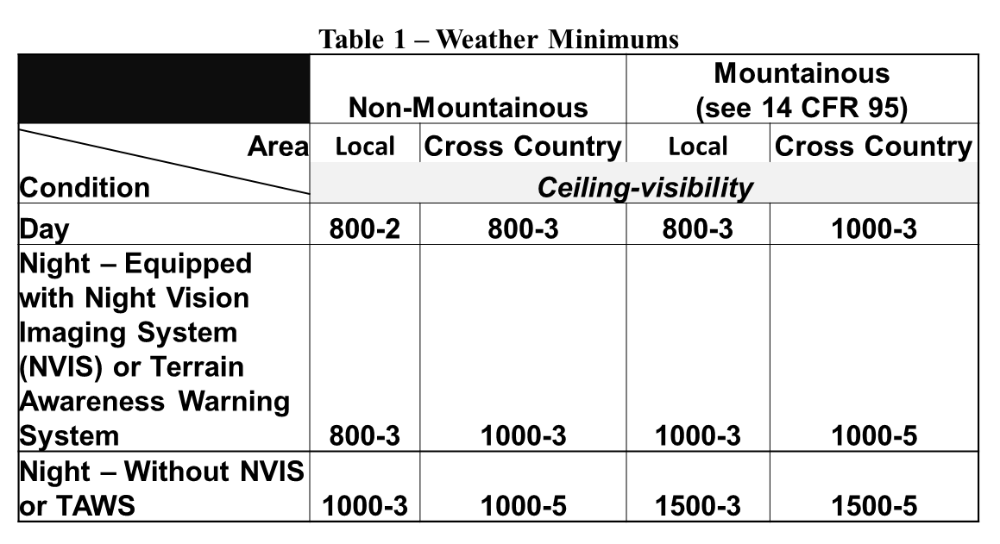
A021 - VFR Weather Minimums
Class G Airspace – Table 1
Notes:
VFR minimums may be individualized for each Operator but not less than these.

Slide 33
A021 Weather Requirements (Cont.)
A021
The certificate holder must use an approved weather reporting source if located within 15 nautical miles from the destination landing area, or use the area forecast if no such weather reporting source is available.
Notes:
This gives ability to approve a flight based on area forecast when no wx reporting is within 15m

Slide 34
Pending Regulations
New Regulations 135.607, 609, may be more restrictive
IFR Departures in Class G Airspace
Destination WX Reporting within 15 nm and Area Forecast
Notes:
IFR departures will require minimums in table. (good thing)
The and as opposed to or completely changes the meaning of A021 as now written. Enhancement of the HEMS Tool and Flight Standards operational suitability assessment could help with this issue.

Slide 35
Weather Regulations, Advisory Circulars, LOA’s, MOU’s
Tom Judge

Slide 36
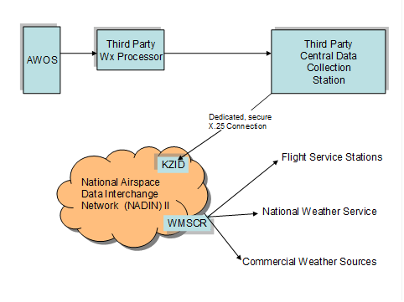
Weather Regulations, Advisory Circulars, LOA’s, MOU’s
NADIN: App. 900 stations
80 AWOS
759 ASOS
15 Automated Weather
Sensors
Airport Terminals

Slide 37
Weather Regulations, Advisory Circulars, LOA’s, MOU’s
Non-Federal AWOS
1900 +/-
AWOS IV and III.
FAA Certified
FAA Commissioned
For Part 135 Ops IFR
Terminal / Other
Increase 70 per year
DOT: States
2400 Environmental
Sensor Stations and Road Weather Information Systems
Commercial Wx.
Cameras and Sensors

Slide 38
Weather Regulations, Advisory Circulars, LOA’s, MOU’s
Regulatory Issues:
Non-Federal Wx. Sources into NADIN
  FAA Order 7110.104
  AC 150-5220-16D
  FAR 135.213
  MOU FAA and NOAA/ NWS
  NASAO MOU
  Security of Information Exchange
  Cost

Slide 39
Weather Regulations, Advisory Circulars, LOA’s, MOU’s
Regulatory Issues:
Non-Federal Wx. Sources into HEMS ADDS
  Technically and regulatory possible?
  NTSB A09-92
  Enroute weather
  Security of Information Exchange
  Cost

Slide 40
Weather Regulations, Advisory Circulars, LOA’s, MOU’s
AWOS Categories
AWOS A Altimeter reporting only
AWOS I Altimeter, Temperature/RH, Wind Speed, Wind Direction
AWOS II Adds Visibility to an AWOS I
AWOS III Adds Ceilometer (cloud height) to an AWOS II
AWOS IIIP Adds Present Weather to an AWOS III (current type precip)
AWOS IIIP/T Adds thunderstorm sensor to an AWOS IIIP
AWOS IV Adds runway surface temp / freezing rain AWOS IIIP/T.
AWOS AV Has all the sensors of an AWOS II or AWOS III with only the Altimeter and the Visibility sensor being FAA certified and required for IFR ops

Slide 41
Weather Regulations, Advisory Circulars, LOA’s, MOU’s
Improving Weather
  Funding
    Non-Federal Cost Benefit
  Maintenance
  FAA Approved
  FAA Commissioned
  Case Study

Slide 42
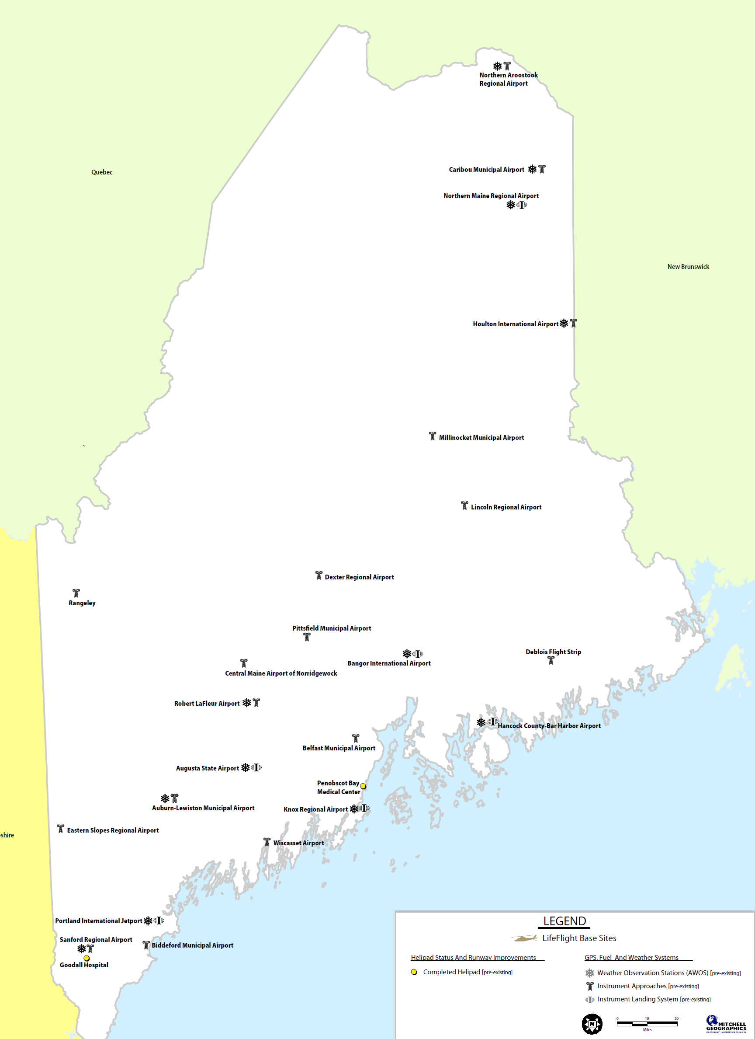

Slide 43
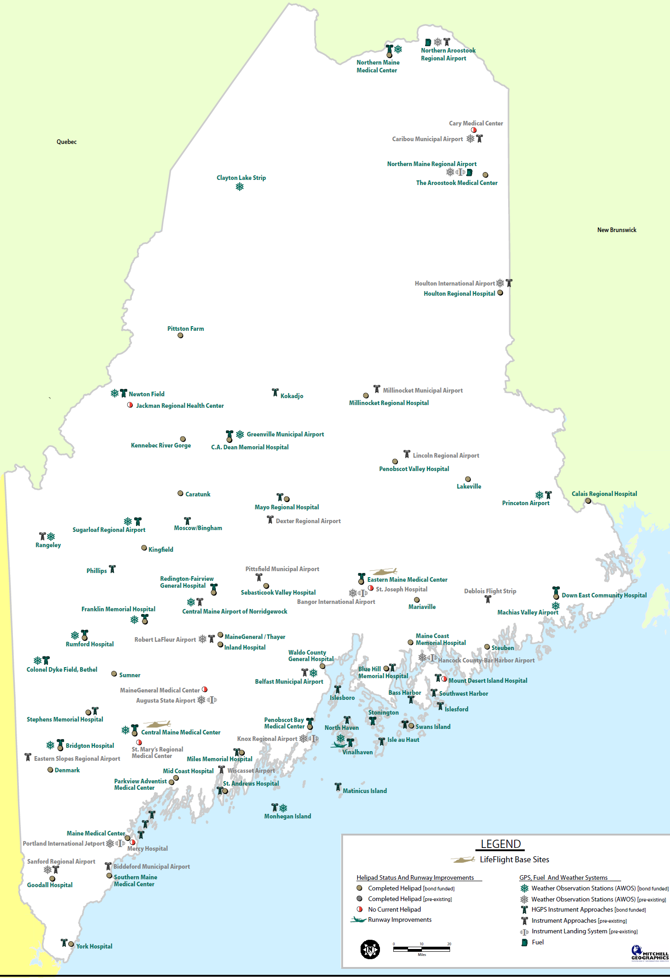

Slide 44
Economic Impact of the HEMS Weather Tool
Chris Eastlee

Slide 45
Economic Impact of the HEMS
Weather Tool
HEMS Industry Data Points
Transported more than 298,000 patients in 2011.
Directly employs 18,000 people
Approximately 1,000 helicopters
$3.4 Billion per year industry
Over $900 Million on safety improvements since 2006

Slide 46
Economic Impact of the HEMS
Weather Tool
HEMS Industry OCC’s and Weather
HEMS Operational Control Centers (OCC’s) direct aircraft dispatch, provide pilot information- weather most critical.
All HEMS OCC’s use the Weather Tool
Cost of OCC’s exceed $13 Million per year
Weather reporting impacts as many as 20% of air medical flights (~$680 Million)

Slide 47
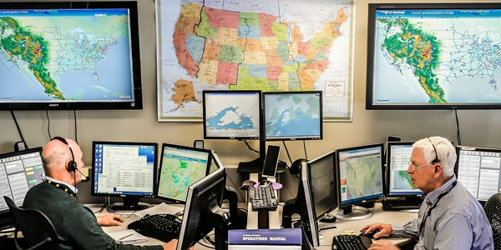
Economic Impact of the HEMS
Weather Tool
OCC

Slide 48
Economic Impact of the HEMS
Weather Tool
HEMS Industry Data Points
298,000 patients transported in 2011
Estimate 363,896 total flight hours in 2011
Estimate 40%-60% of patient flight request turndown rate (of those, as many as 80% may be due to weather)
Approximately 20% of REQUESTS may end in “aborts” in which the aircraft took off and turned back due to weather; those do not result in a patient transport and are not included in patient transport total.

Slide 49
Economic Impact of the HEMS
Weather Tool
HEMS Industry Weather Aborts
Weather Aborts increase risk, interrupt patient transport
Frequency of these aborts can dramatically decrease with better, more accurate weather
The lost economic value of these transports is hard to estimate, but the impact on safety and the medical system (as the patient is not transported) is profound.
An enhanced HEMS Weather Tool used as a “legal” weather source can greatly reduce these events.

Slide 50
Economic Impact of the HEMS
Weather Tool
HEMS Industry Data Points
NTSB cites weather as causal factor in 11 fatal accidents involving 34 fatalities from 2007 to 2013.
DOT Value of Statistical Life (VSL) for 2012 is $9.1 Million. 34 X $9.1= $309 Million

Slide 51
HEMS Weather Tool for other Aviation Operations
J Heffernan

Slide 52
HEMS Weather Tool for other
Aviation Operations
HAI currently recognizes 28 commercial helicopter uses in addition to HEMS
  From Oil and Gas to Livestock Management
  In both Urban and Wilderness scenarios
  Many performed in joint operations with or in direct support of Fixed Wing Aircraft

Slide 53
HEMS Weather Tool for other
Aviation Operations
The HEMS tool provides:
  Specific localized weather.
  The ability to study surrounding area weather and projected weather.
  Creates a “Sense of the weather” mindset.
  Allows the pilot to “use” the weather rather than “fight” the weather.

Slide 54
HEMS Weather Tool for other
Aviation Operations
USABLE WEATHER INFORMATION FOR A HELICOPTER IS BY LOGICAL EXTENSION USABLE WEATHER INFORMATION FOR A FIXED WING AIRCRAFT

Slide 55
HEMS Weather Tool for other
Aviation Operations
Currently the major limitation for the HEMS Weather Tool is INPUT
  Many excellent sources of information already exist
  AWOS, Law Enforcement, Interstate Highway System, Railroads
  Potential to add an acceptable reporting system at VOR sites
  Increase types of weather approved by NWS to gain acceptance by FAA Administrator

Slide 56
HEMS Weather Tool for other
Aviation Operations
Based on 7+ years of usage
  Move the HEMS Weather Tool from Experimental status to full support by NWS

Slide 57
HEMS Weather Tool Input Data
Rex Alexander

Slide 58

HEMS Weather Tool Input Data
Weather Interpretation and the Gestalt Effect.
  Pilots interpret weather information differently, based on:
    Experience
    Training
    Education
    Mood
    Internal Pressures
    External Pressures
    Equipment

Slide 59

HEMS Weather Tool Input Data
Additional data points help fill in
the blanks for offsite locations
where HEMS pilots operate.
The HEMS Weather Tool helps cut through pilot misinterpretation.
KAID 152047Z 26010G20KT 10SM OVC048 M07/M12 A3004=
KANQ 152155Z AUTO 25010KT 10SM FEW025 OVC029 A2994 RMK=
KANQ 152135Z AUTO 26010KT 10SM OVC029 A2993 RMK=
KANQ 152115Z AUTO 26012KT 10SM OVC027 A2993 RMK=
KANQ 152055Z AUTO 26013KT 220V290 10SM OVC027 A2992 RMK=
KASW 152155Z AUTO 26012KT 10SM BKN070 OVC090 M09/M12 A3001
RMK AO2=
KASW 152135Z AUTO 26012G17KT 10SM SCT060 SCT075 BKN090
M09/M13 A3000 RMK AO2=
KASW 152115Z AUTO 25011KT 10SM OVC060 M09/M13 A2999 RMK AO2=
KASW 152055Z AUTO 26014KT 10SM OVC060 M08/M13 A2998 RMK AO2=
KBAK 152145Z 26008KT 10SM OVC070 M03/M07 A3009=
KBAK 152045Z 24011KT 10SM SCT047 OVC070 M03/M06 A3009=
KBMG 152153Z 25009KT 7SM SCT018 OVC070 M04/M08 A3009 RMK AO2
SLP198 T10391078=
KBMG 152127Z 26009KT 7SM BKN017 OVC065 M04/M08 A3009 RMK AO2
T10391078= (SPECI)
KBMG 152053Z 25010KT 8SM OVC070 M04/M08 A3007 RMK AO2 SLP192
T10391083 56002=
KEKM 152150Z 25011KT 4SM -SN OVC027 M09/M13 A2999 RMK AO2=
KEKM 152050Z 24012G16KT 5SM -SN OVC023 M08/M13 A2997 RMK AO2=
KEVV 152154Z 23007KT 10SM OVC019 M01/M05 A3017 RMK AO2 SLP219
T10111050=

Slide 60
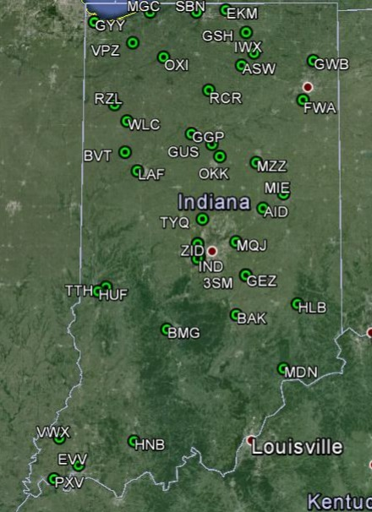
HEMS Weather Tool Input Data
Indiana, a case study
  AWOS & ASOS Sites reporting into the HEMS Weather System.
    Current
    Potential
  Source
    HEMS Weather Tool
    Airport Directory

Slide 61
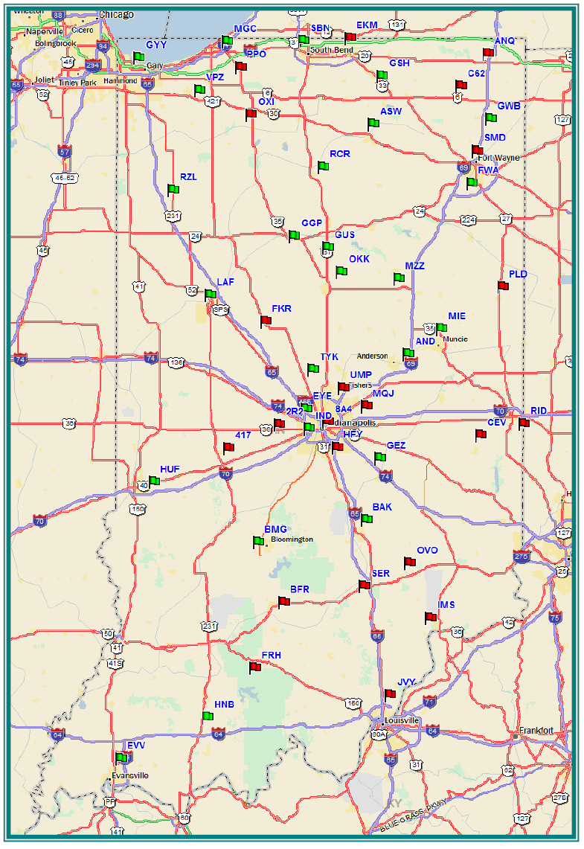
HEMS Weather Tool Input Data
The Low Hanging Fruit
  Example: Indiana
    FAA Airport Facilities Directory
    Compiled: 05/08/2012
37 | 11 | 27 | 26 | 29 | 39 | 29
AWOS-III | ASOS | NOAA | HEMS Tool | Any AWOS | DUAT | UCAR List
48
Weather Reporting Web Sites
NOAA AWOS Map: | http://www.wrh.noaa.gov/zoa/mwmap3.php?map=usa
HEMS Weather Tool: | http://weather.aero/tools/desktopapps/hemstool
Any AWOS: | http://www.anyawos.com/
DUAT: | https://www.duat.com/
UCAR Surface Stations: | http://weather.rap.ucar.edu/surface/stations.txt

Slide 62
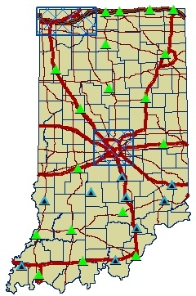
HEMS Weather Tool Input Data
D.O.T. Road Weather Sensors
  Weather Station
  Weather Station w/Camera
    Air Temperature
    Humidity
    Dew Point
    Wind Speed
    Wind Gust
    Wind Direction

Slide 63
HEMS Weather Tool Input Data
RAWS – Remote Automatic Weather Stations
  http://raws.fam.nwcg.gov/index.html
ROMAN – Real time Observation Monitor and Analysis Network.
  http://raws.wrh.noaa.gov/roman/
  Indiana has 8 RAWS sites

Slide 64
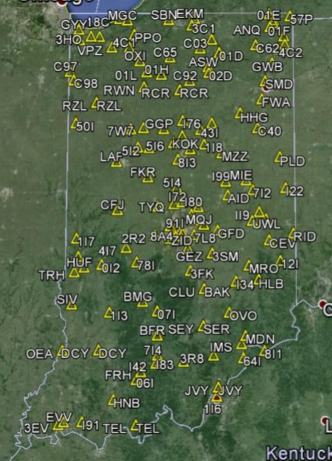
HEMS Weather Tool Input Data
Potential Weather Reporting Sites
  147
  Source
    Weather Graphics
http://www.weathergraphics.com/identifiers/

Slide 65
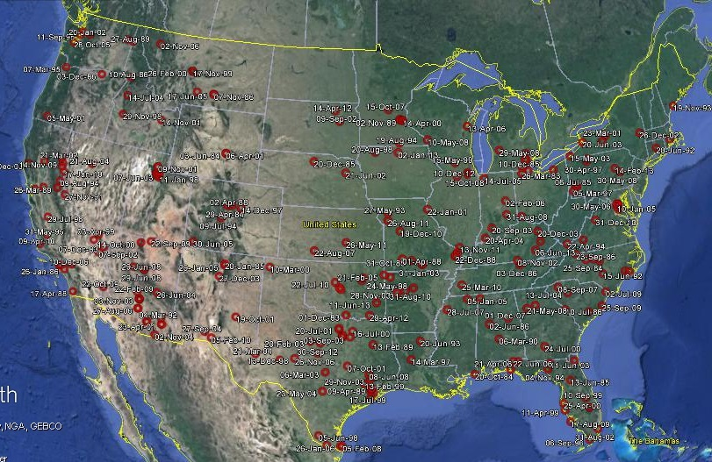
HEMS Accidents 1983-2013
References from NTSB Database

Slide 66
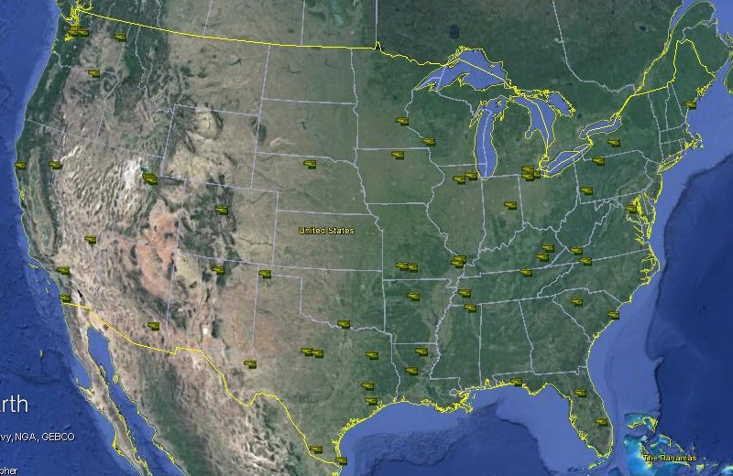
HEMS Wx Accidents 1983-2013
References from NTSB Database

Slide 67
CONCLUSION
The HEMS Wx Tool has been embraced by every HEMS pilot with open arms and has become an integral part of their weather decision making.
Multiple aviation entities, rotor and fixed, have also embraced the HEMS Wx Tool for weather reporting below 5,000’.
Numerous non-aviation agencies have discovered and are now using the HEMS Wx Tool for many diversified applications.

Slide 68
RECOMMENDATIONS
Fully fund the final development of the HEMS ADDS weather reporting system.
Move the HEMS Weather Tool from experimental to operational.
Increase the density of weather stations reporting into the HEMS Weather Tool.
Construct in-cockpit access for the HEMS Weather Tool.

Slide 69
QUESTIONS

Slide 70
HEMS Industry Representatives
HEMS Weather Summit 2013 Industry Representatives
Name | Email | Phone
Chris Baur | Chris.Baur@hughesaerospace.com | 281-591-4729
Chris Eastlee | ceastlee@airmedicaloperators.com | 219-743-3188
Colin Henry | chenry@medflight.com | 614-734-8047
Don Mynard | dmynard@phihelico.com | 480-773-4130
Ed Stockhausen | estockhausen@airmethods.com | 303-792-7400
Eric Lugger | ericlugger@gmail.com | 281-678-1823
Gerald Pagano | gpagano@hcdpbc.org | 561-719-6704
J Heffernan | j.heffernan@rotor.org | 703-683-4646 x1605
Matt Johnson | matt@mattjohnsonhelicfi.com | 513-678-4197
Neal Jacobs | neal1958@gmail.com | 206-372-2320
Ralph Petragnani | rpetragnani@belfortinstrument.com | 443-983-2726
Rex Alexander | rex@heliexp.com | 260-494-0891
Thomas Judge | tjudge@ahs.emh.org | 207-973-6706

