Slide 1

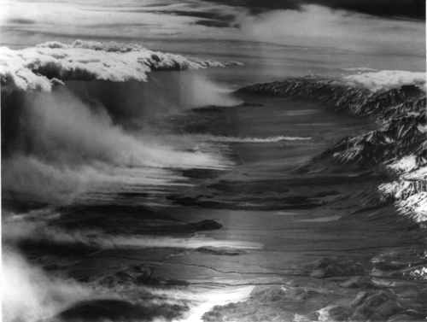
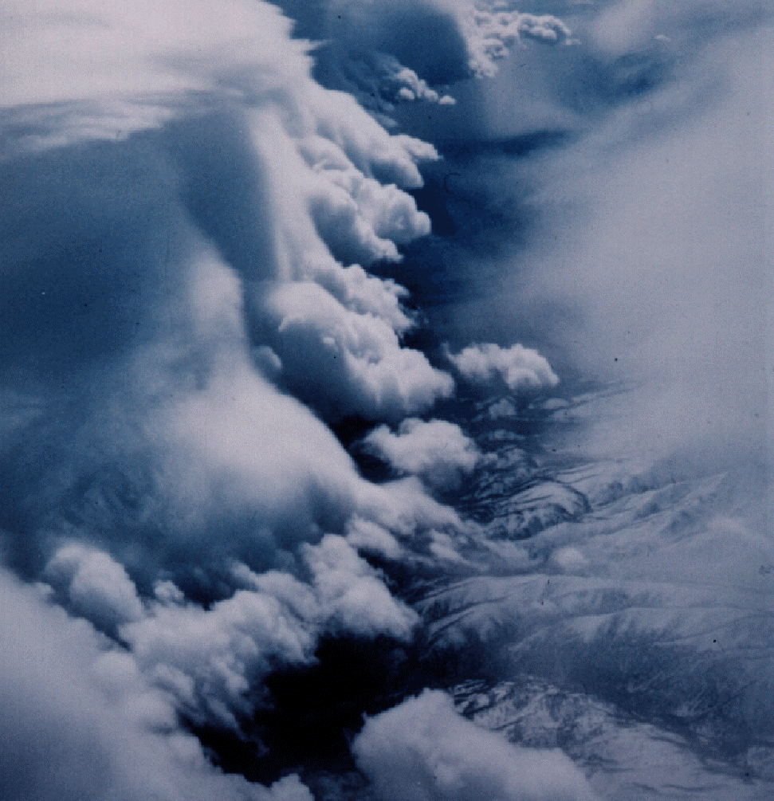
James D. Doyle U.S. Naval Research Laboratory, Monterey, CA
Acknowledgements: Bart Geerts (U. Wyoming), D. Durran (UW), A. Dörnbrack (DLR), S. Eckermann (NRL-DC), D. Fritts (Gats), Vanda Grubišić (NCAR), T. Lane (Monash), Q. Jiang (NRL), R. Sharman (NCAR), R. Smith (Yale), M. Taylor (Utah St.), M. Weissmann (DLR)
Mountain Wave Turbulence and Predictability
Outline
Background
Lee Waves and Rotors
Wave Breaking
Modeling and Predictability
Summary
Robert Symons
5 March 1950
T. Henderson

Slide 2
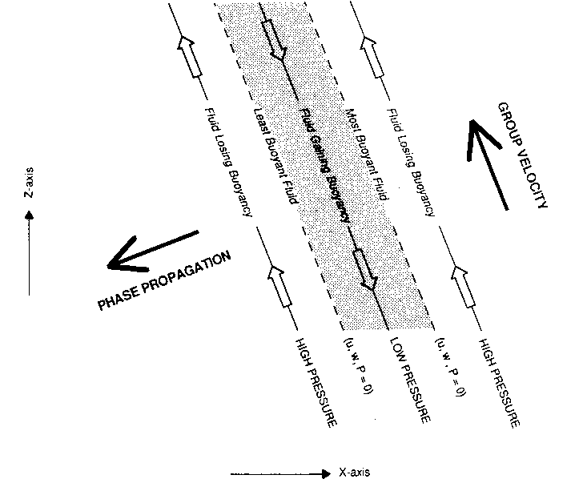
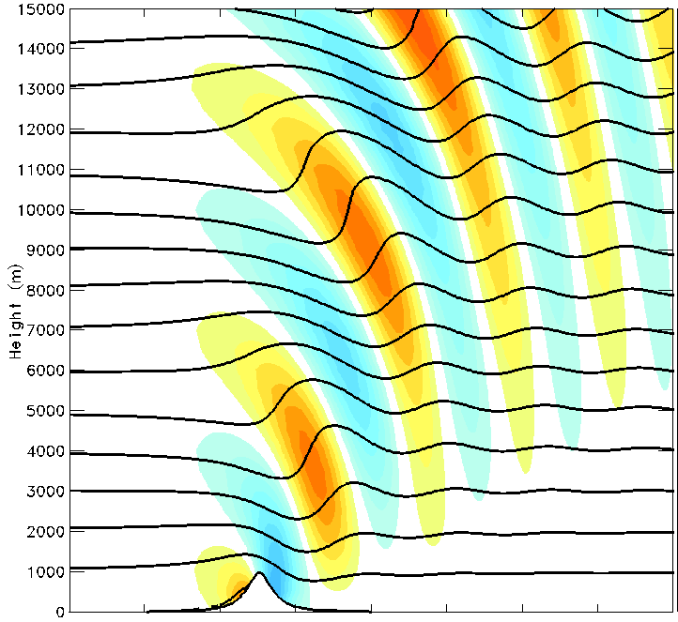
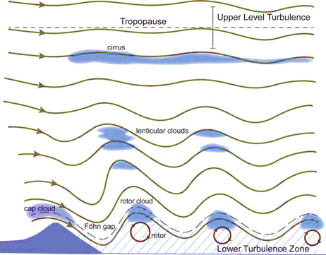
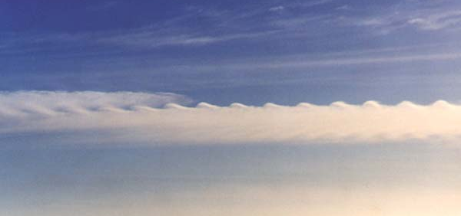
What is a Mountain Wave?
When Stably Stratified Air is Forced Over a Barrier a Disturbance is Created
Energy is Carried Away by Internal Gravity Waves
Buoyancy is the Restoring Force
Downward Phase Propagation ➔ Upward Energy Propagation (Group Velocity)
Vertical
Velocity
(Durran 1990)
(Doyle et al. 2016)
Distance (40 km)
Gravity Waves May Steepen & Break
- Nonlinearity, Critical Levels
- Decreasing Mean Density
- Breakdown via Secondary KH Instability
(Sakai)
NCAR

Slide 3
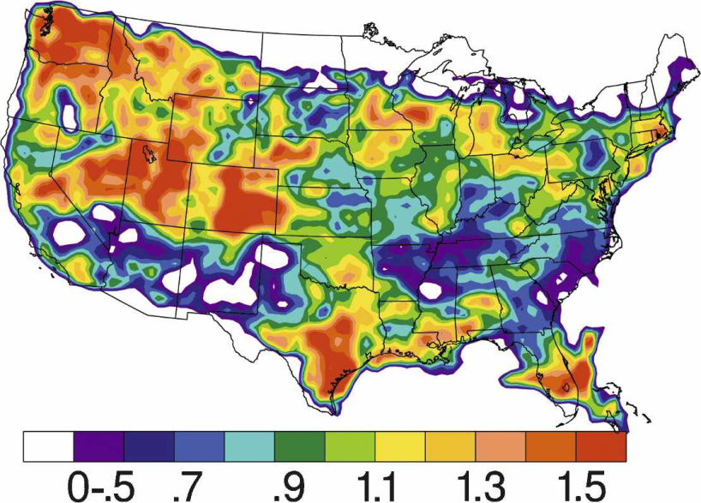
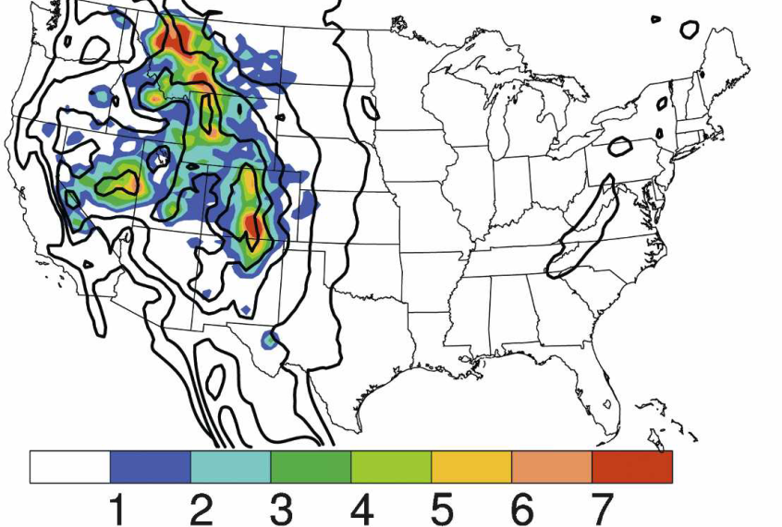
Mountain Wave Turbulence Climatology
Normalized PIREPS (MOG/Total)
1995-2005 (Wolff and Sharman 2008)
Percent of MOG MWT to Total PIREPs above FL180 (5.5 km) (12 YR) Wolff and Sharman (2008)
Major source of turbulence over the western U.S. is due to MWT
Correlation of the normalized MOG MWT pattern is apparent with topographic heights greater than about 1.5 km, consistent with previous studies (Reiter and Foltz 1967; Nicholls 1973, Lee et al. 1984)

Slide 4
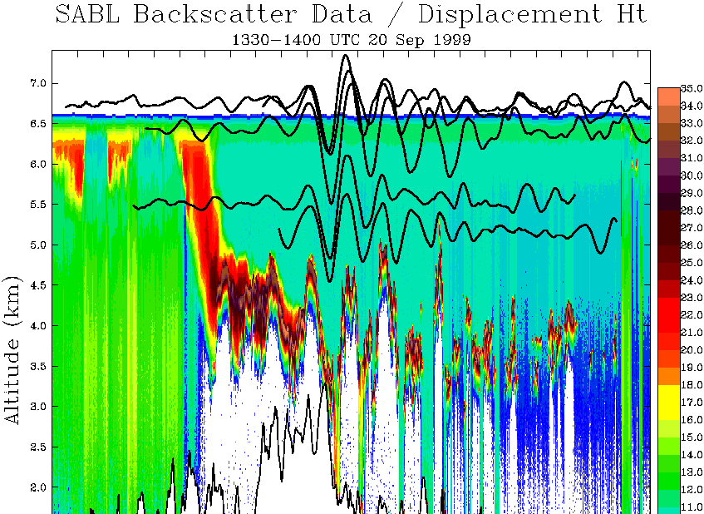
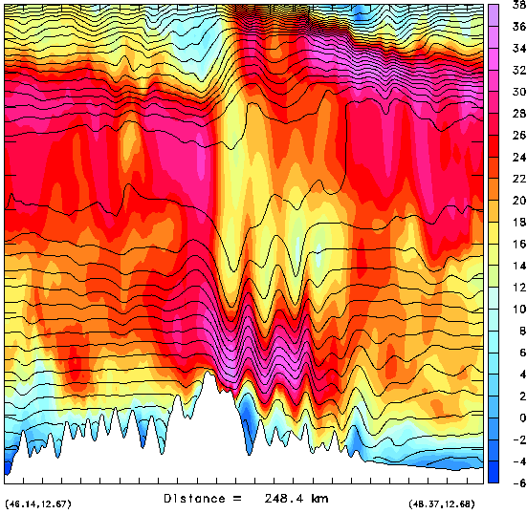
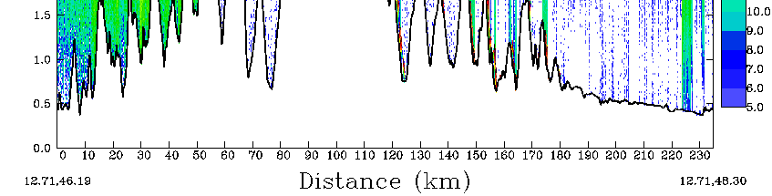
Lee Waves and Turbulence
SABL Backscatter & Electra Displacement Height
1330-1400 UTC 20 Sep 1999
COAMPS (dx=1 km) Wind Speed (color) and θ
1330 UTC 20 Sep 1999
14
7
12
Upper-Level
Breaking
6
10
5
8
4
Altitude (km)
Altitude (km)
3
6
Wave Duct
2
4
1
2
0
Alps (Hohe Tauern Range)
0
0
50
100
150
200
Distance (km)
Mountain lee waves are generally laminar though can be turbulent occasionally
Trapped wave generated by wave duct and flow over narrow terrain of Alps.
Wave duct enhanced by upstream moist processes.
Doyle and Smith (2003) QJRMS

Slide 5

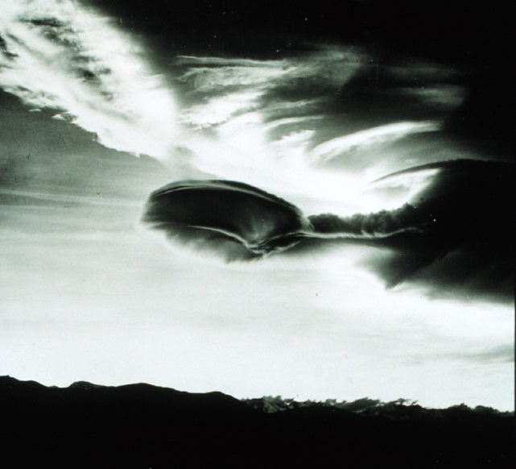
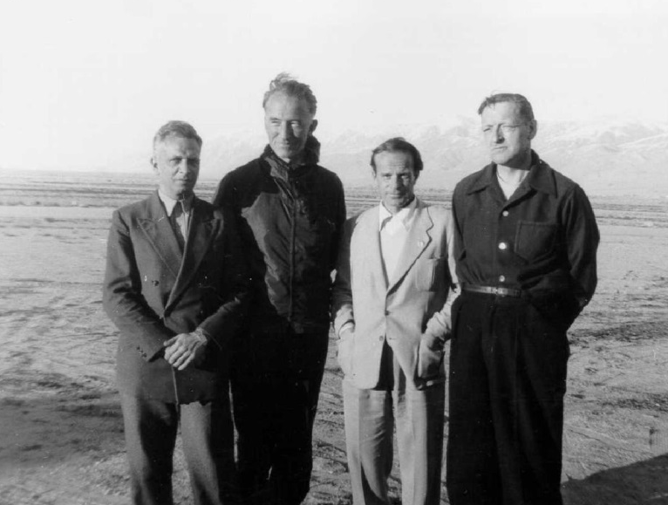
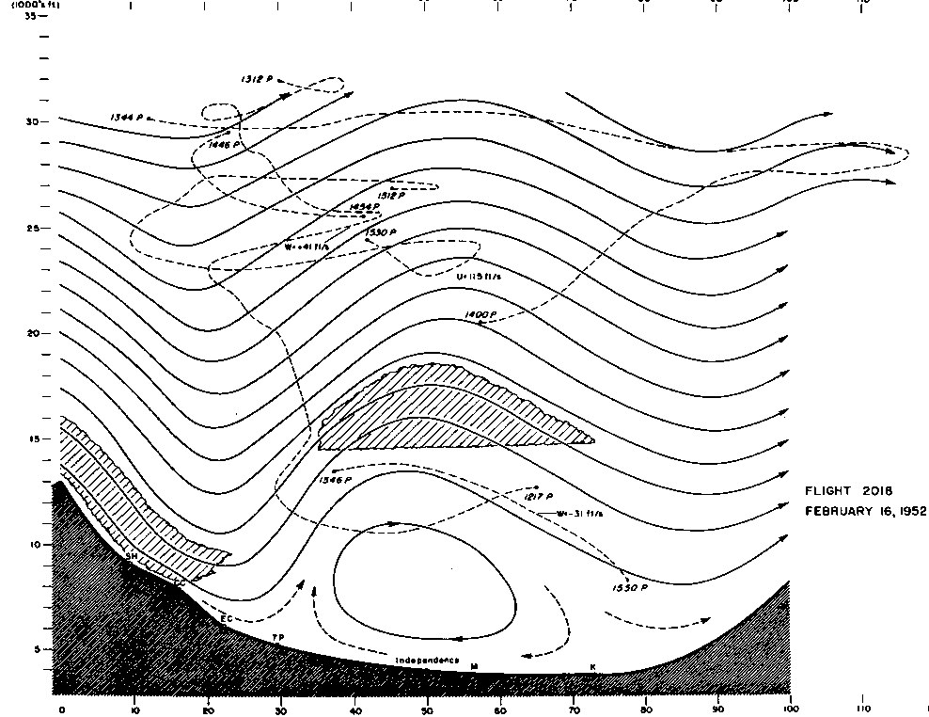
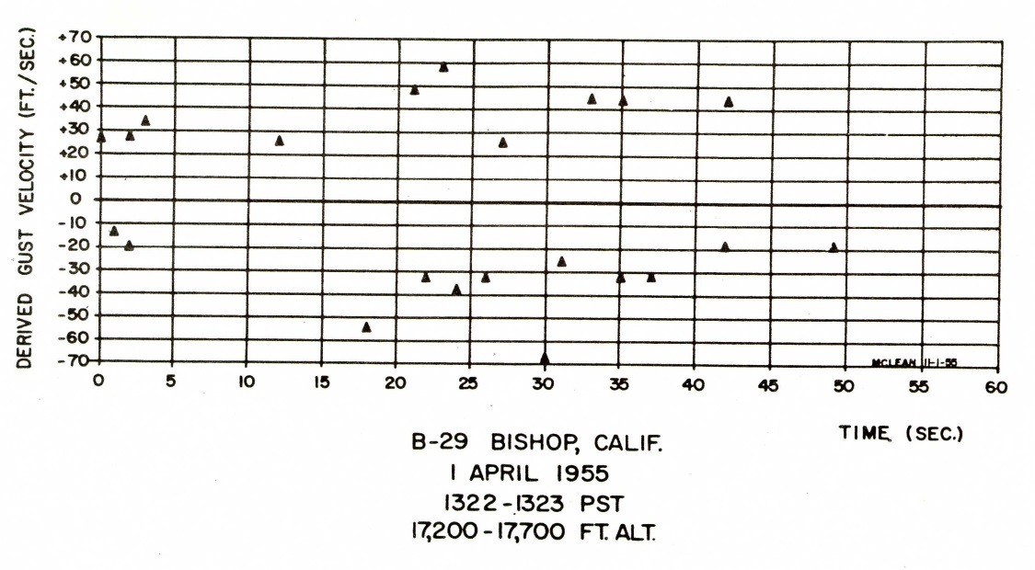
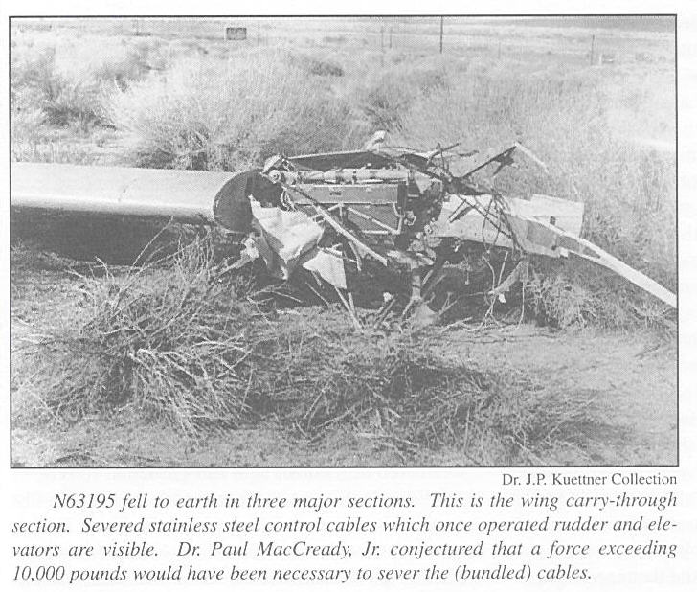
Rotors: Sierra Wave Project
Sierra Nevada Range is well known for spectacular mountain wave phenomena and rotors
Mountain Wave Clouds, Dust & Rotor Clouds From a P-38 With Engine Off (w_{max}~35 m s⁻¹)
R. Symons
NOAA Archive
J. Kuettner
Rotor structure and characteristics were documented in several cases during SWP
Mountain Wave and Rotor Flow
Derived From Glider Measurements
Vertical Velocity in a Rotor at 5.1 km for 50 s Time Period
20 m s⁻¹
•
w=12.5 m s⁻¹
-20 m s⁻¹
Time (sec)
•
25 April 1955
w=-9.4 m s⁻¹
13 Gust Measurements > 10 m s⁻¹
Holmboe and Klieforth 1957
Sailplane destroyed in mid-flight during rotor encounter (~16Gs) at 4 km
Surface gusts > 25 m s⁻¹
Holmboe and Klieforth 1957

Slide 6
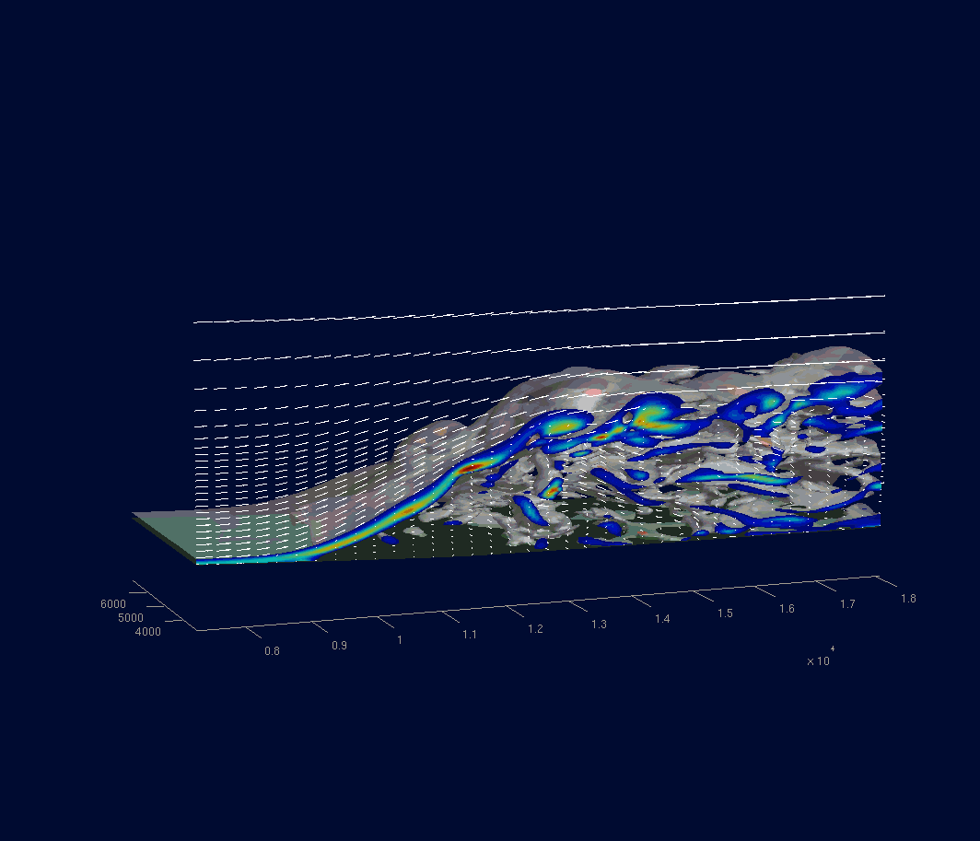
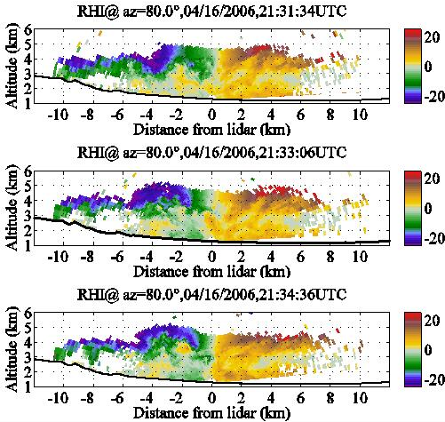
Rotors: T-REX
Subrotor Vortices During the Terrain-Induced Rotor Experiment
Doppler Lidar Velocities
COAMPS LES Simulation
2100 UTC 16 April 2007
[30 min. period, Δx=60 m]
η Vorticity (color)
η = 0.15 s⁻¹ (red)
η = 0.02 s⁻¹ (gray)
Doyle, Grubišić, Brown, De Wekker, Dörnbrack, Jiang, Mayor, Weissmann, 2009, JAS
Large Eddy Simulations of rotors underscores the key characteristics including flow separation, elevation of vortex street, and development of KH billows or sub-rotors downstream

Slide 7
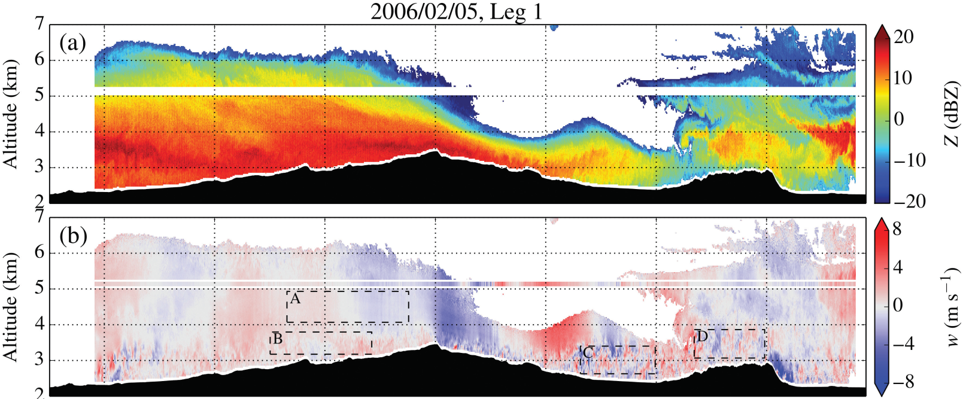

Rotors
Medicine Bow Mountains during the NASA Orographic Clouds Experiment
Hydraulic jump type of rotor
Severe turbulence is encountered in the downdraft, with maximum σ²w and EDR_{w} of 16.4m²s⁻² and 0.77m^{2/3}s⁻¹
Strauss et al. (2015)
How does the turbulence differ between hydraulic-like jump rotors and
lee wave rotors?

Slide 8
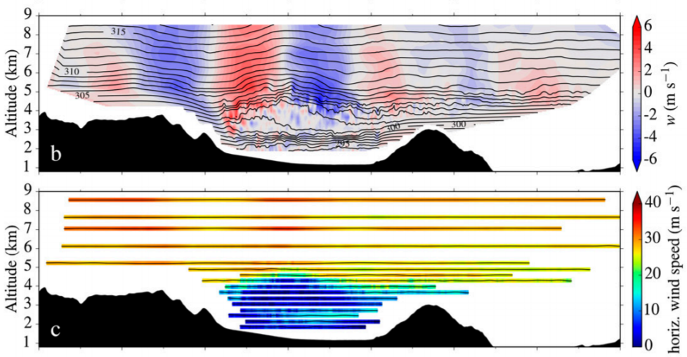
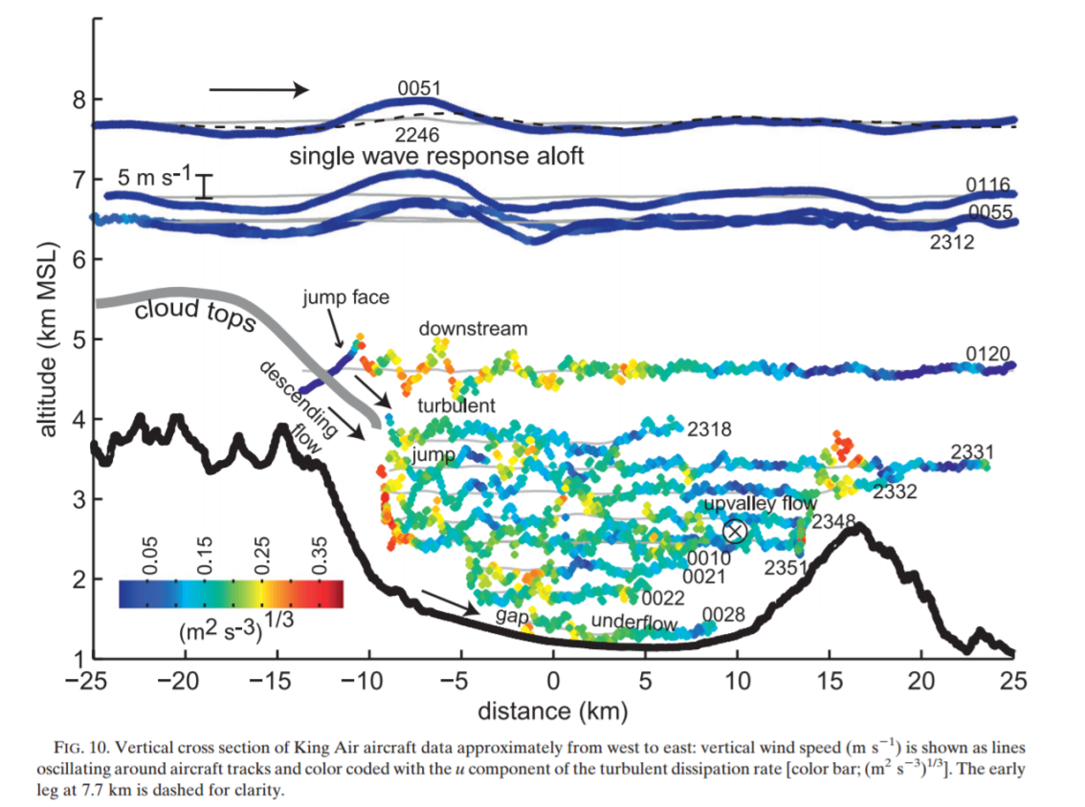
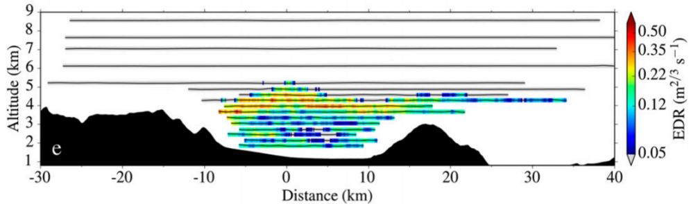
Hydraulic Jumps and Rotors
Wave Breaking / Rotor Regime
Hydraulic Analogue
Armi and Meyer (2011)
Strauss et al. (2016)
Internal hydraulic jump vs. low-level wave breaking paradigms
Characteristics of turbulence and relationship to vortex breakdown are important

Slide 9
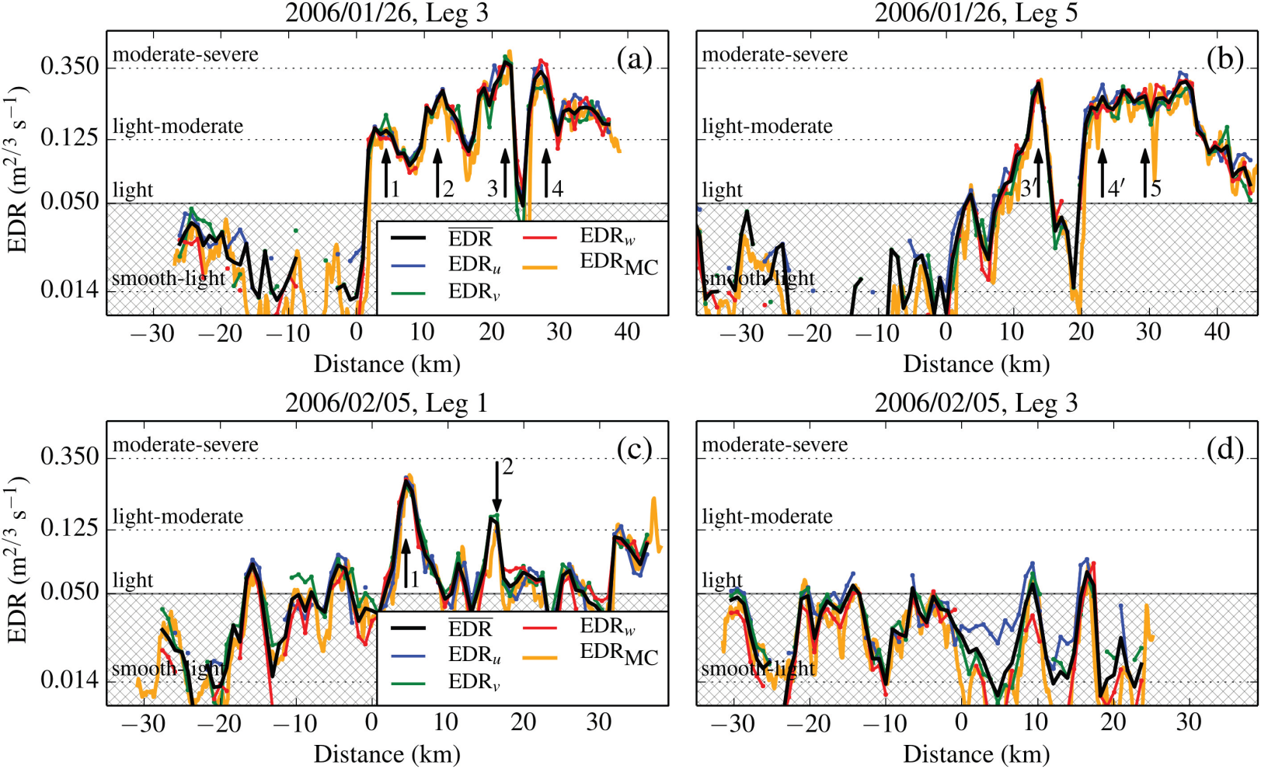
Low-Level Wave Breaking
Strauss et al. (2015)
Measurements of low-level turbulence in rotors and wave breaking are rare

Slide 10
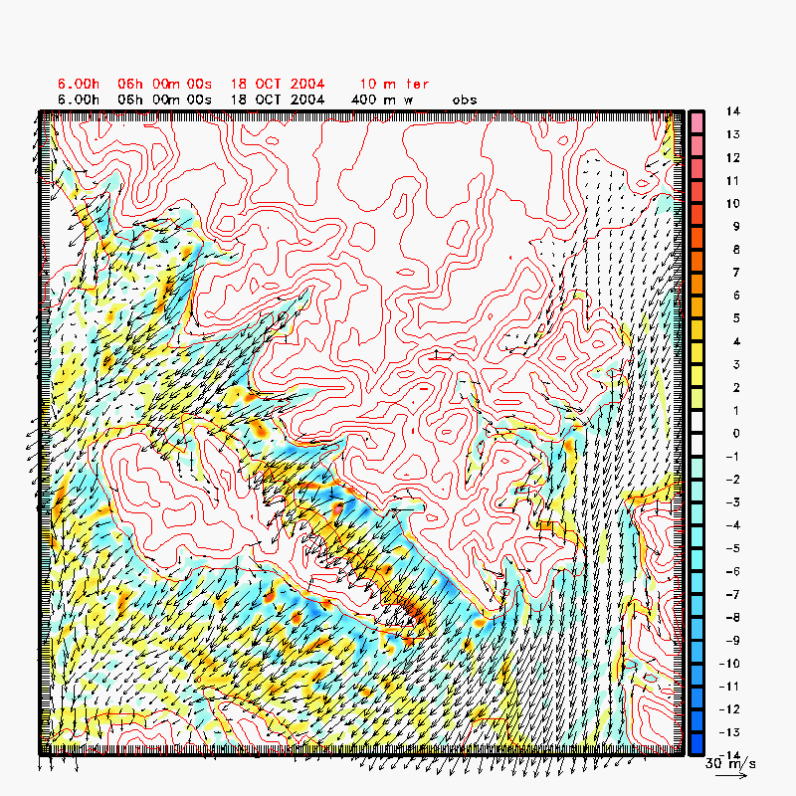
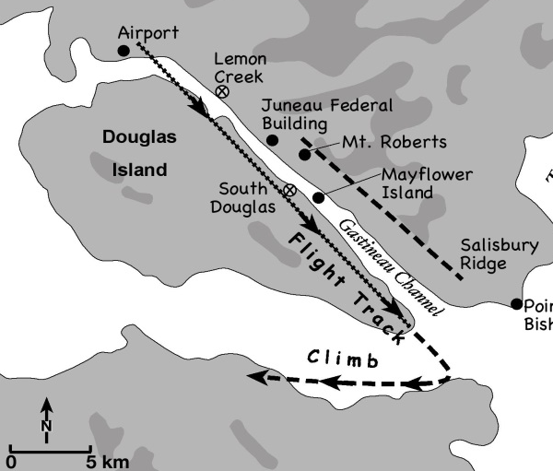
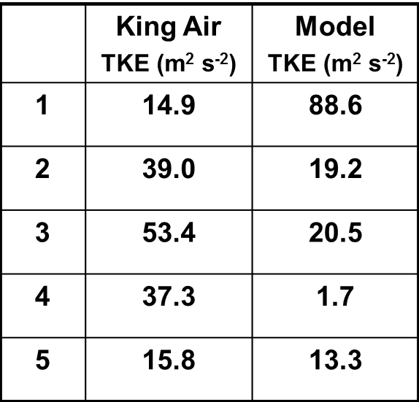
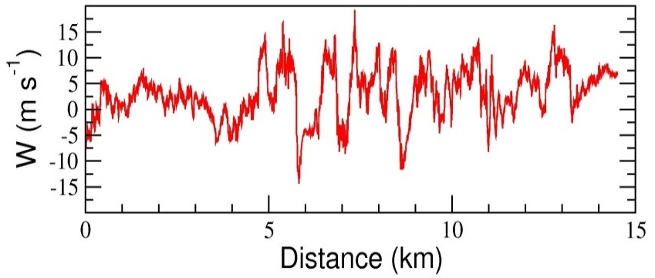
Low-Level Wave Breaking
SARJET (Alaska)
UW KingAir Flight Path
LES Wind and Vertical Velocity at 400 m
(Terrain in Red Contours) Δx=150 m
Bond et al. (2006)
Aircraft Observations of w
Explicit and LES modeling of wave breaking and secondary wave generation
What observations are needed of turbulent downslope winds to constrain models?
Notes:
1
When stably stratified air is forced to rise over a topographic barrier, mountain waves are generated and radiate away from the barrier. Mountain waves may be accompanied by severe downslope winds near the surface, occasionally in excess of 50 m s⁻¹, that rapidly decelerate in the lee and flow back toward the mountain as part of an intense circulation. These vortices, known as rotors, can be severe aeronautical hazards due to intense wind shear and have been cited as contributing to numerous aircraft accidents, including occurrences involving modern commercial and military aircraft. The characteristics of mountain waves and rotors forced by three-dimensional topography are investigated through a series of high-resolution real data simulations (150 m horizontal grid increment) with the non-hydrostatic COAMPS© model. The focus of this presentation is on a windstorm that occurred in the mountainous coastal region of Alaska near Juneau. Research aircraft observations show that strong downslope flow was characterized by substantial vertical wind shear and strong up and down vertical motion (in excess of 15 m/s). High data-rate measurements by a research aircraft in the region of vertical shear revealed extreme magnitudes of turbulence, most notably turbulent kinetic energy exceeding 50 m²/s⁻². The high-resolution simulations underscore the importance of the proper representation of topography and the necessity of high-horizontal resolution (150 m in this case). The simulations indicate that the strong region of vertical wind shear appears to be associated with a rotor-like circulation. Eddy resolving simulations using COAMPS, such as the vertical velocity at 400m shown on the right, underscore the aviation hazard potential of these wind shear zones for commercial and military aviation operations particularly helicopter operations. A series of strong eddies are shed off the terrain and trail downstream across the Gastineau Channel.

Slide 11
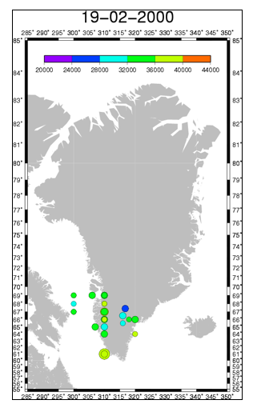
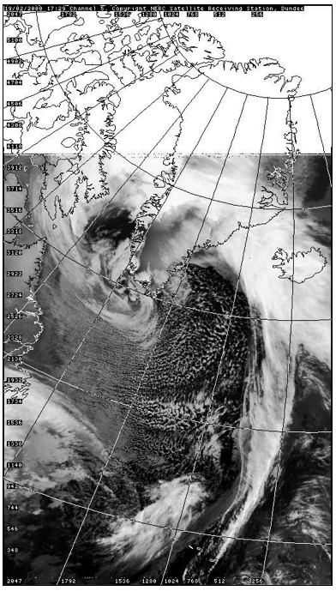
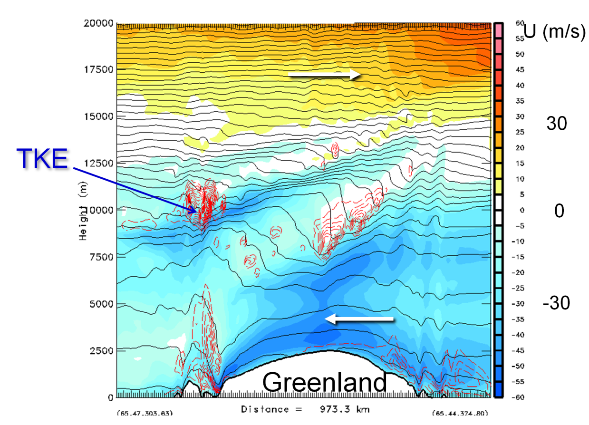
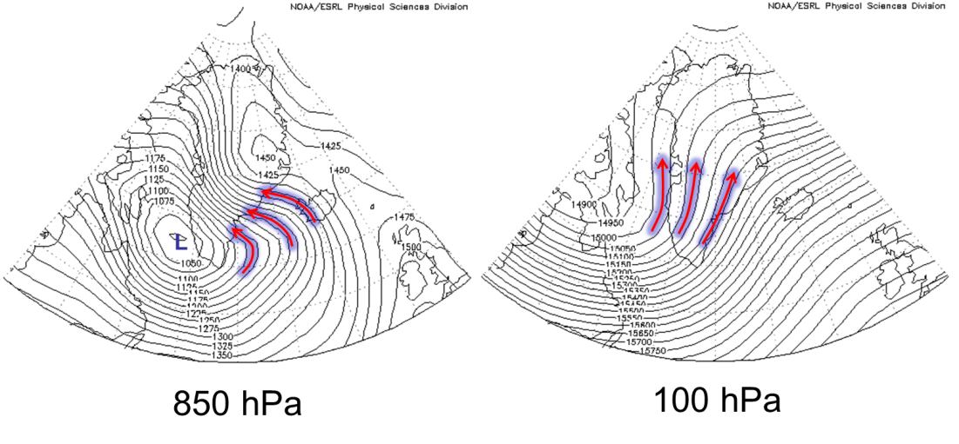
Critical Levels and Wave Breaking
1729Z 19 Feb 2000
COAMPS Simulation (5 km)
Low-level easterly flow and critical level (background) present.
Sloping layers of wave overturning and turbulent breaking.
Lane et al. 2009

Slide 12
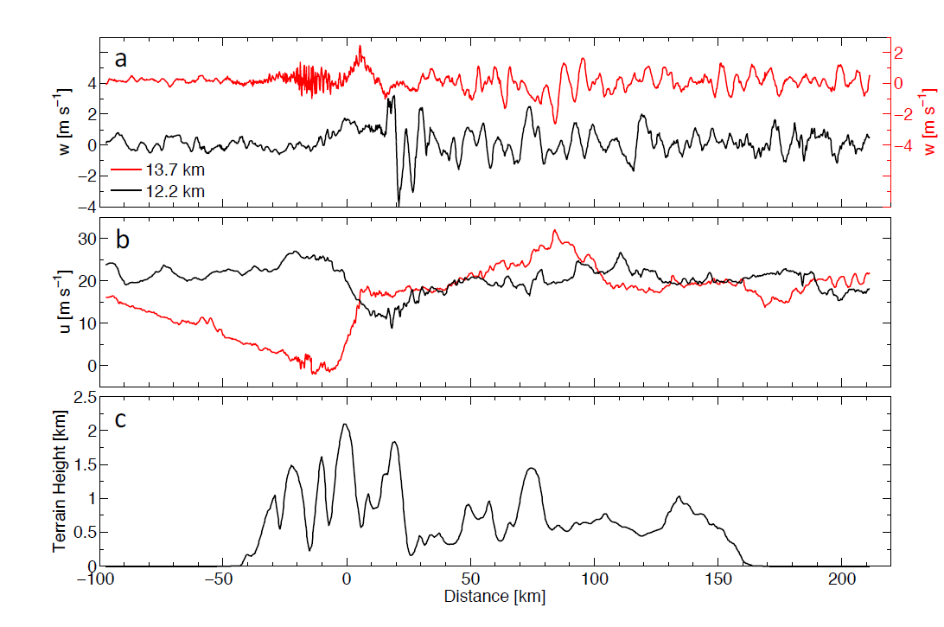
Upper-Level Wave Breaking
DEEPWAVE Wave Breaking (29 June)
FASTEX Wave Breaking
Smith et al. (2016)
Doyle et al. (2005)
Observed turbulent upper-level wave breaking (and mixing in UTLS)
Momentum flux diagnostics (including stratosphere - middle atmos.)
Real world complex flows (cyclones with time-dependent forcing)

Slide 13
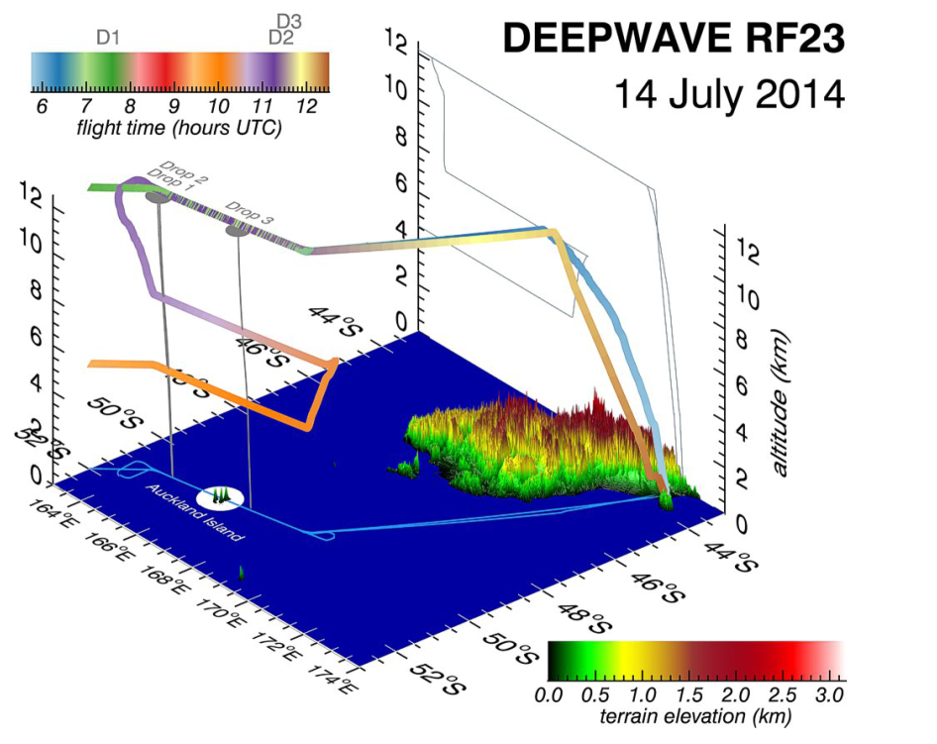
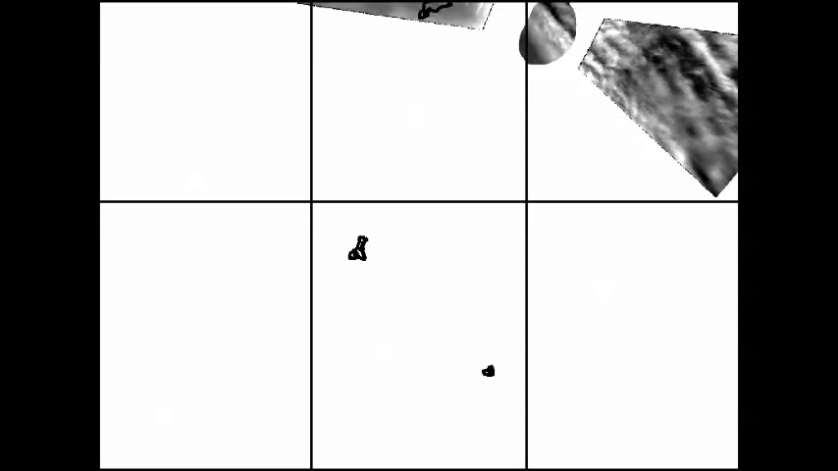
Upper-Level Wave Breaking
DEEPWAVE G-V Flight Over
Auckland Island
G-V AMTM Observations (~87 km)
Eckermann et al. (2016)
Pautet et al. 2015 (JGR)
Growing evidence that small islands may be important sources of gravity waves and upper-level turbulence

Slide 14
MWT Predictability
2D ensemble initialized with a sounding from Jan 11, 1972 Boulder windstorm
Maximum variance (uncertainty) occurs near the wave breaking threshold (h_{m}=1750 m)
Doyle and Reynolds (2008)

Slide 15
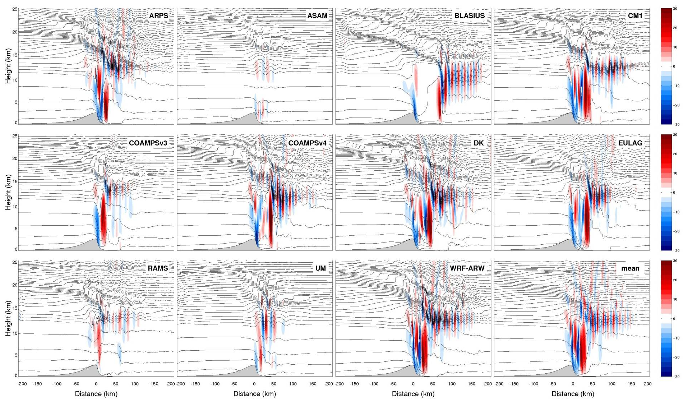
MWT Predictability
Model Intercomparison of Wave Breaking [w (m s⁻¹)]
Doyle et al. (2011)
Explicit and LES 2D modeling of wave breaking and secondary wave generation
Models still disagree radically for relatively simple problems (e.g., model error)

Slide 16
MWT Predictability
Weak Members
Strong Members
MWT
MWT
Reinecke and Durran (2009)
70-member ensemble simulation of a large-amplitude mountain wave during T-REX
Strong-member subset: Large-amplitude breaking mountain wave with an extensive region of turbulent mixing directly above and to the lee of the Sierra.
Weak-member subset: Wave breaking and turbulence are limited to a small region in the upper troposphere lower stratosphere
Differences in the synoptic-scale forcing are small

Slide 17
Summary
Measurements (research aircraft, PIREPS) and numerical simulations show a rich spectrum of responses including MWT (wave breaking) that results from flow over large-scale (e.g., Greenland) and complex terrain (e.g., Alps,Sierra).
Rotors and hydraulic jumps occur when strong downslope flow in the boundary layer along the lee slopes separate from the surface as a turbulent vortex sheet (and subrotors) creating strong turbulence.
The predictive skill of numerical forecasts of MWT observed in nature is encouraging and has improved with increases in fidelity of the models.
Ultimately, high-resolution ensemble methods that are capable of explicitly resolving mountain waves should be used to provide probabilistic forecasts of turbulence needed for aviation hazard mitigation.

Slide 18
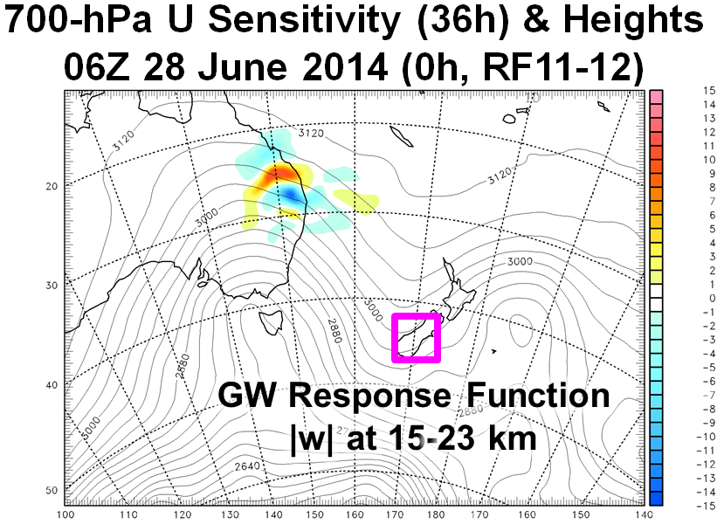
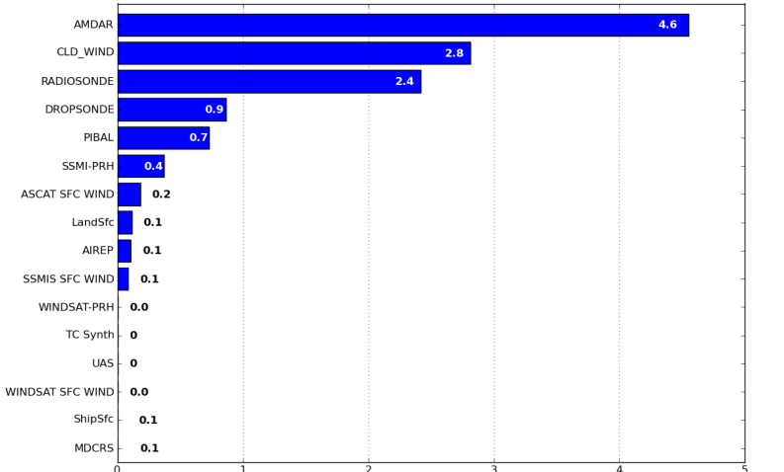
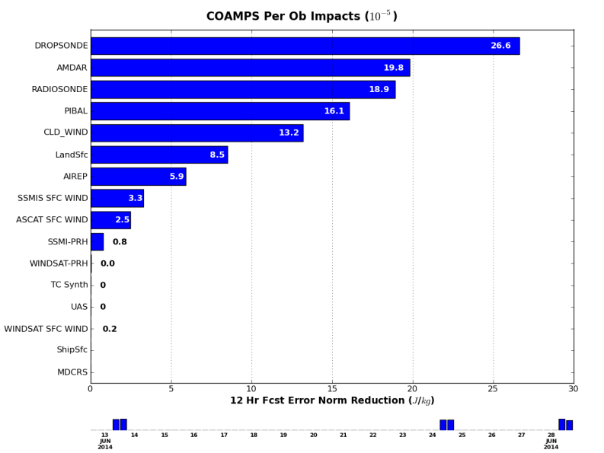
Observation Impact on Mountain Wave Launching
Total Impact
AMDAR
Sat. Winds
Radiosonde
Dropsonde
12 h Forecast Error Norm Reduction (J/kg)
Impact (Per Observation)
Dropsonde
AMDAR
Radiosonde
PIBAL
Sat. Winds
Adjoint highlights remote upstream sensitive regions important for MWs
Adjoint (model+DA) observation impact on 12-h forecasts during DEEPWAVE.
Targeted dropsondes have the largest impact on a per observation basis.
12 h Forecast Error Norm Reduction (J/kg)
C. Amerault

Slide 19
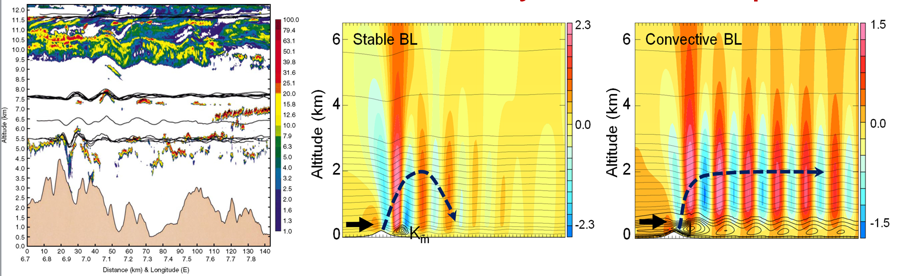
Lee Waves and Turbulence
DIAL Lidar (Mt. Blanc)
Vertical Velocity and Potential Temperature
Mountain lee waves are generally laminar though can be turbulent occasionally
Lee waves are sensitivite to the PBL characteristics (stable vs. convective)
Lee wave sensitive to land surface characteristics, diurnal cycle, upstream conditions (stability, moisture, winds)
Jiang, Doyle, Smith (JAS 2006); Smith, Jiang, and Doyle (JAS 2006); Jiang, Doyle, Wang, and Smith (JAS 2007), Jiang and Doyle (JAS 2008); Jiang, Smith, Doyle (JAS 2008)

Slide 20
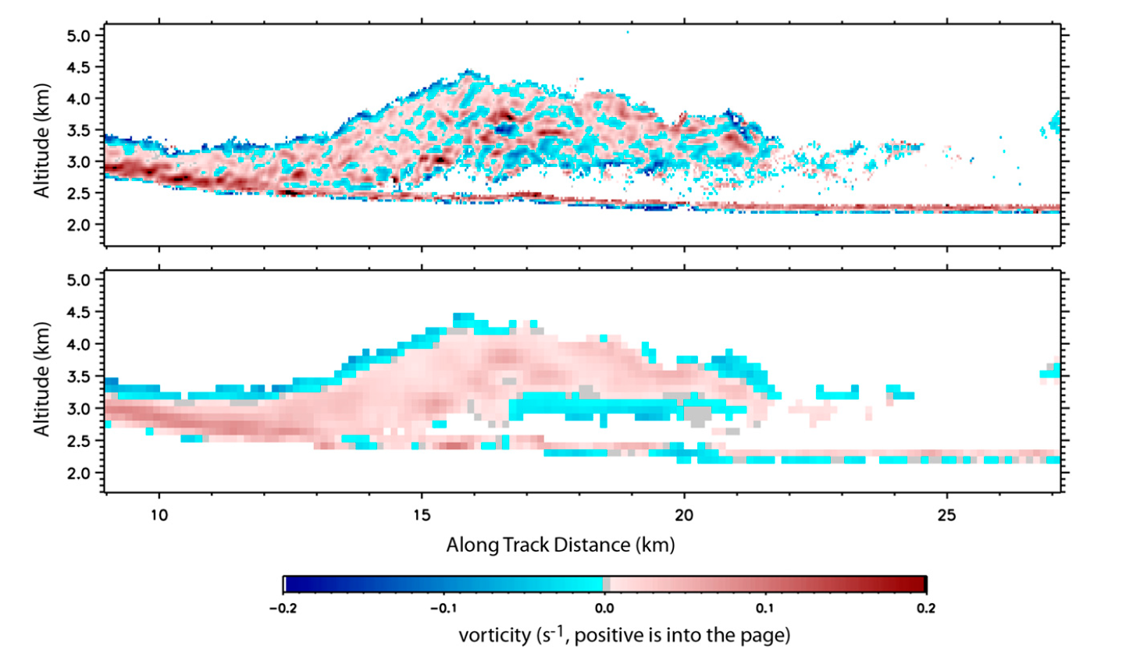
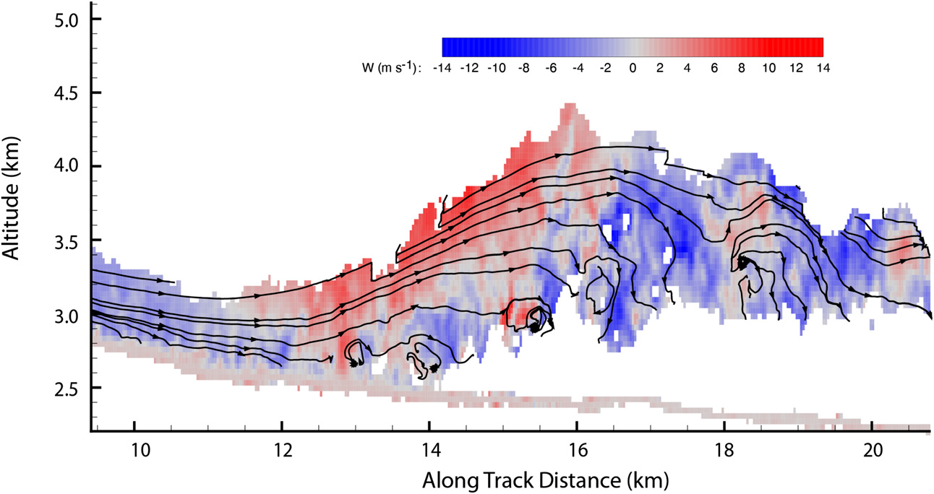
Rotors
Subrotor Vortices over the Medicine Bow Mountains
Vertical Velocity
Horizontal Vorticity
Horizontal Vorticity
(Filtered)
French et al. (2015)
Unique observations of subrotor vortices over the Medicine Bow Mtns

