Slide 1


Frontiers of Turbulence Prediction
Matthias Steiner
National Center for Atmospheric Research
msteiner@ucar.edu
Turbulence Impact Mitigation Workshop #3 5 – 6 September 2018, McLean, VA

Slide 2

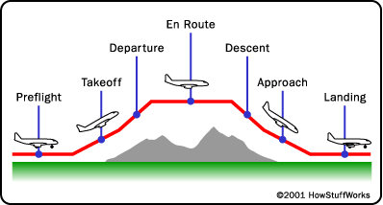
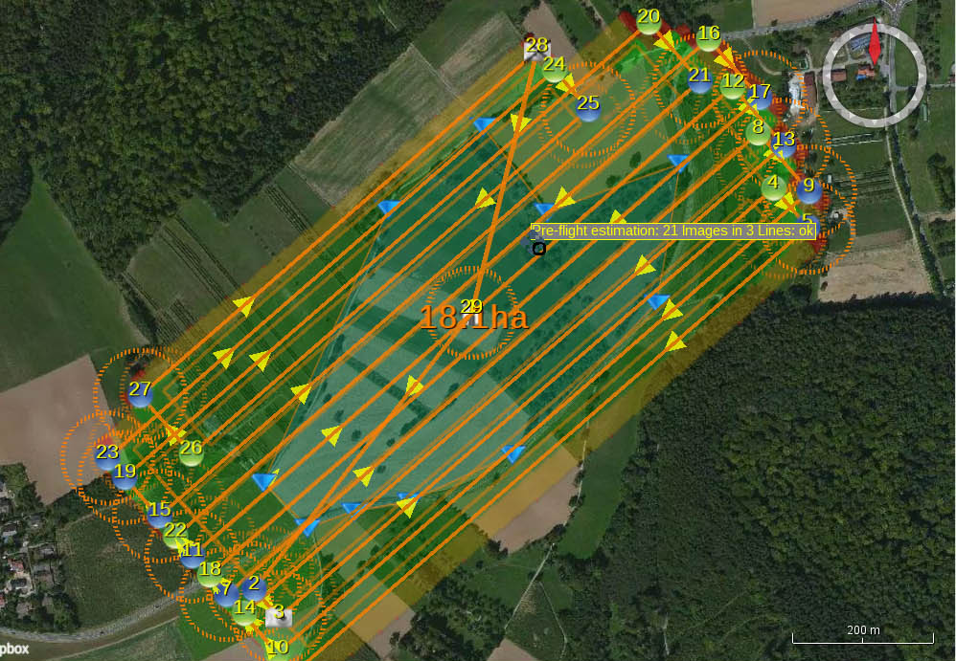
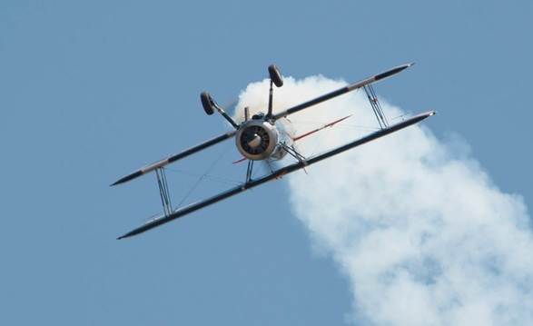
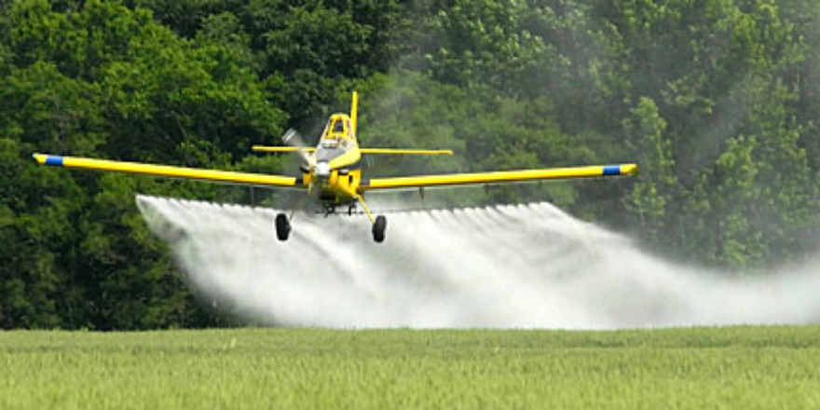
Typical Flight Patterns
Purpose of a flight may include
Delivery or retrieval of goods & people
Collection of information
Recreation
Notes:
Mostly focused on point-to-point flights, but there are other flight patters covering various altitude ranges
Every flight has a purpose/mission

Slide 3

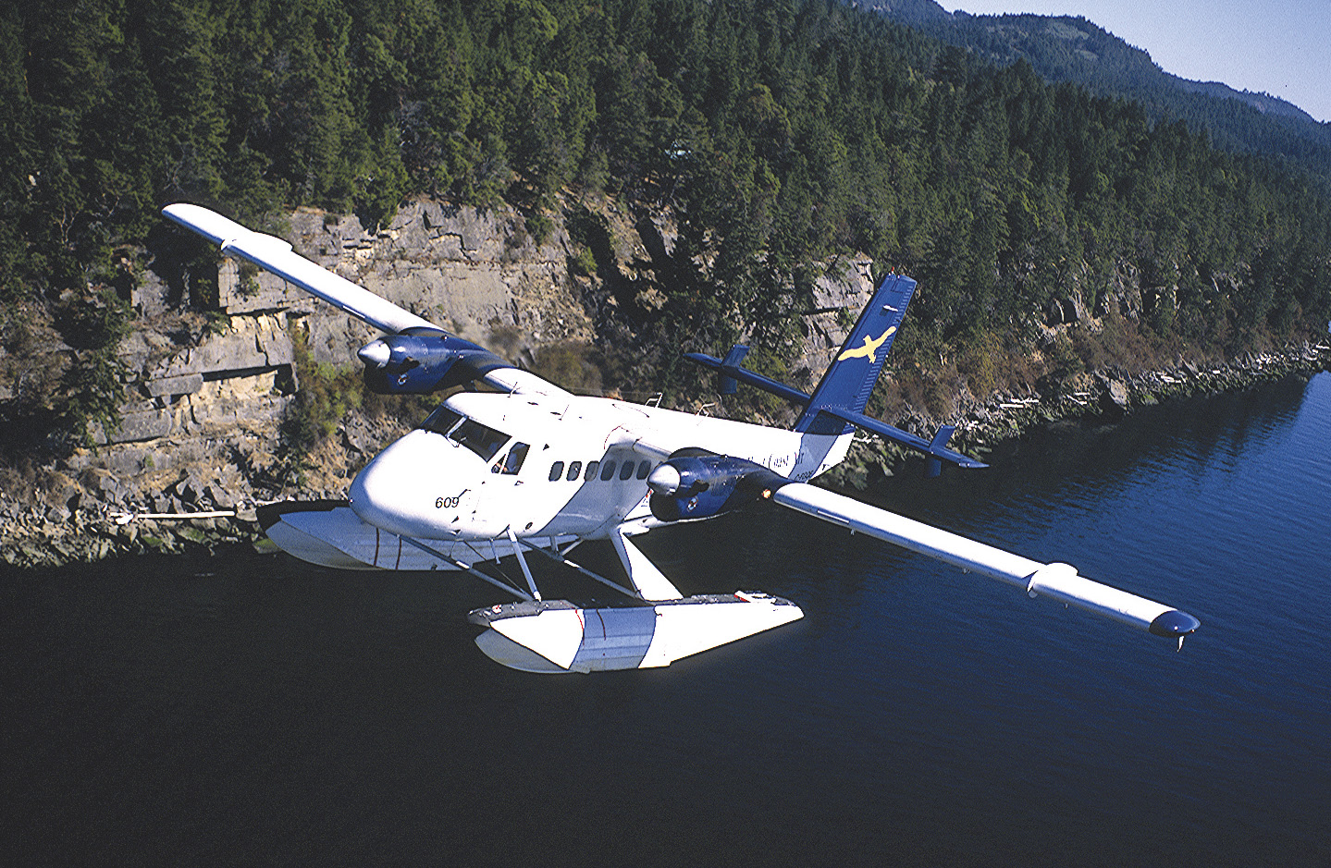
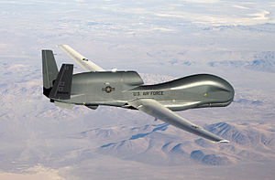
Today’s Air Transportation
 | Scheduled | On Demand
Manned
Unmanned
Notes:
Large scheduled transport category & on-demand business or general aviation flights
Defense & NOAA operations include on-demand large UAS

Slide 4
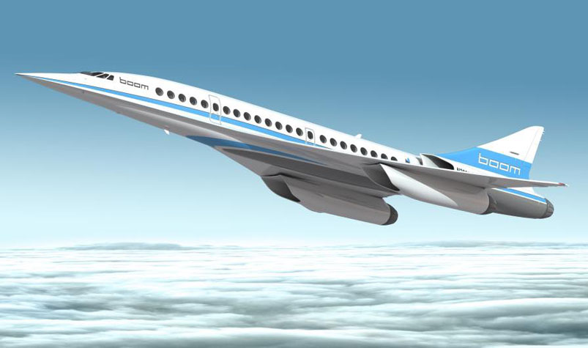
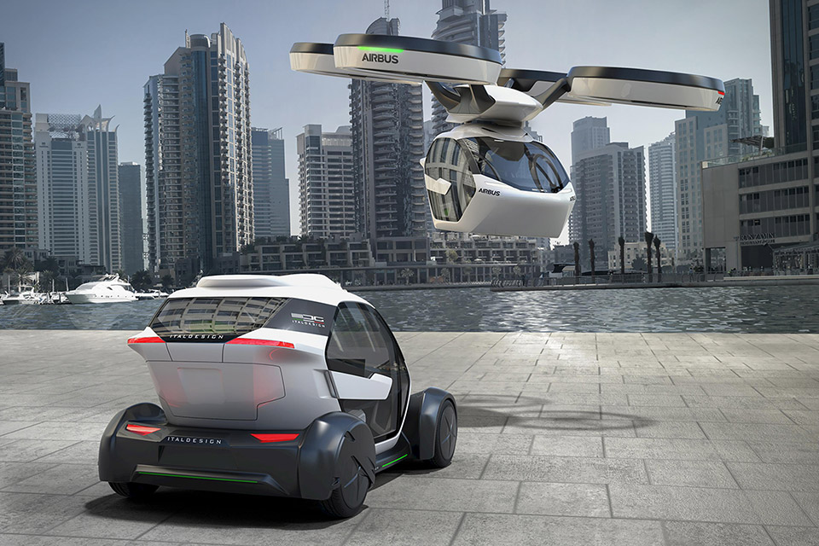
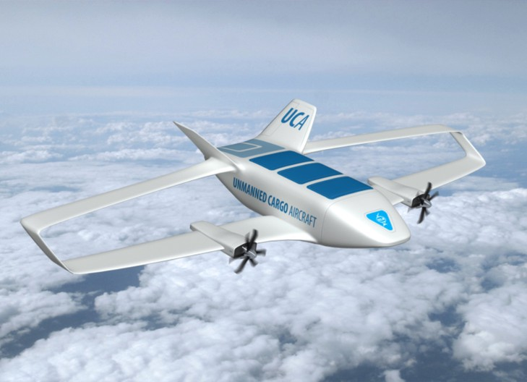
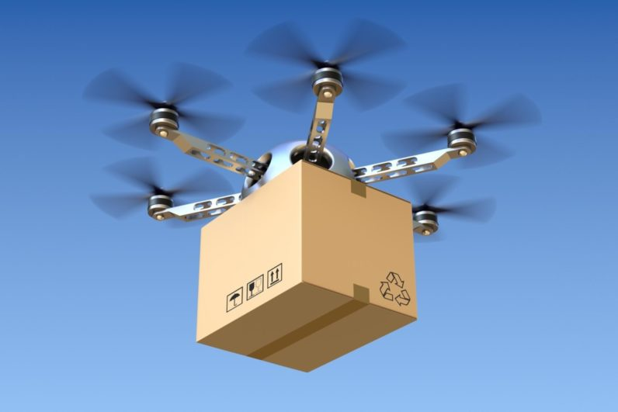
Future Air Transportation
 | Scheduled | On Demand
Manned
Unmanned
Emerging modes of transportation => new requirements
Space travel => takeoff, reentry & landing
Supersonic flight => cover higher altitudes
Shared & personal aerial rides => lower altitudes & urban environments
Unmanned aerial transport => micro weather for small drones
Pseudo satellite drones => cover higher altitudes, takeoff & landing
Notes:
Wide range of emerging modes of transportation that may yield new requirements for turbulence prediction

Slide 5
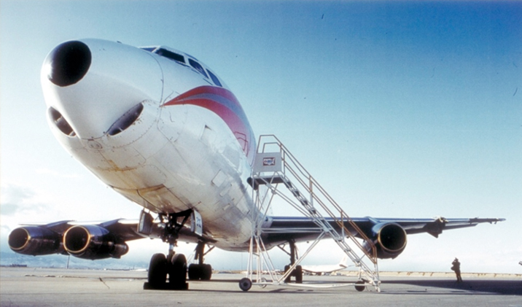

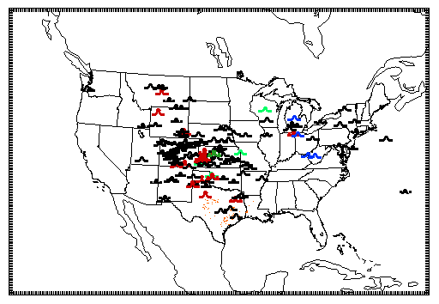

Turbulence Impacts on Operations
Turbulence affects
Safety (aircraft, people, goods)
Efficiency (separation, avoidance, workload, fuel burn)
Mission success (platform stability)
25 January 2012 16 – 20 UTC
Aircraft avoiding deep convection but encountering CIT
Notes:
Turbulence can impact operations/missions in various ways
Turbulence results from both natural (atmosphere, terrain) & man-made (aircraft, buildings) generation mechanisms

Slide 6
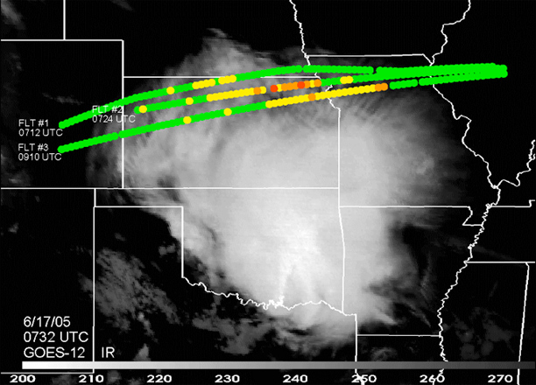
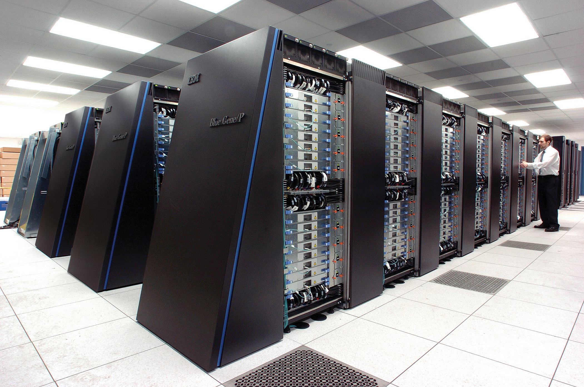
In situ, radar, lidar & satellite
Turbulence Prediction
Higher resolution, ensembles & probabilistic prediction
Process Understanding
Case studies
Validation & verification
Observations
Diagnosis & Prediction
Enhancement
Notes:
Observations of turbulence are absolutely essential!
- in situ include pilot reports (subjective), tapping into avionics or from radiosonde (objective) – acceleration from tabloids & iPhones
- remotely sensed include radar (NTDA) & satellite diagnostics (recognition of waves, etc.) – new Aeolus satellite for global wind observations
Prediction benefits from improved computational capabilities & better process understanding (e.g., low level turbulence)

Slide 7
3 km HRRR
25 m WRF-LES
Higher resolution to better resolve atmospheric processes
Diagnostic ensemble
& probabilistic hazard guidance

Slide 8

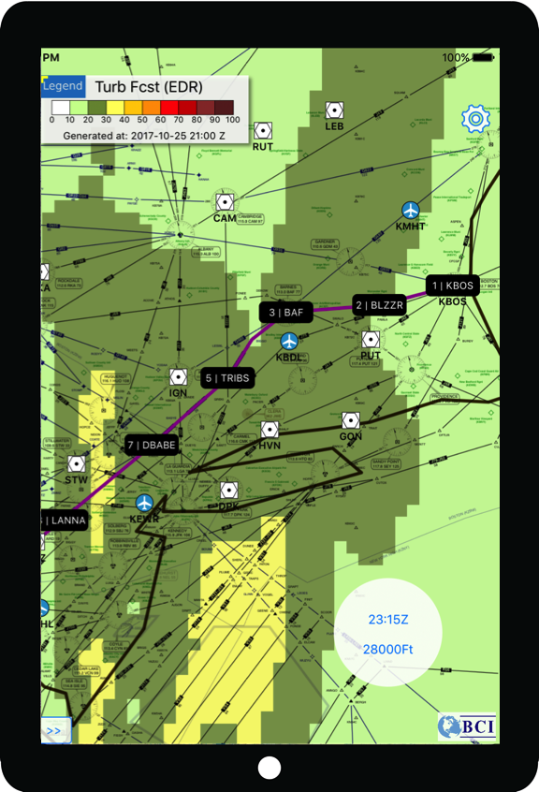
In situ, radar, lidar & satellite
Turbulence Prediction
Higher resolution, ensembles & probabilistic prediction
Process Understanding
Predictability & climate change
Case studies
Validation & verification
Observations
Diagnosis & Prediction
Enhancement
Wake turbulence
Prediction of wake vortex hazards near ground & aloft
Dissemination for Operational Use
Notes:
Observations of turbulence are absolutely essential!
- in situ include pilot reports (subjective), tapping into avionics or from radiosonde (objective) – acceleration from tabloids & iPhones
- remotely sensed include radar (NTDA) & satellite diagnostics (recognition of waves, etc.) – new Aeolus satellite for global wind observations
Prediction benefits from improved computational capabilities & better process understanding (e.g., low level turbulence)

Slide 9
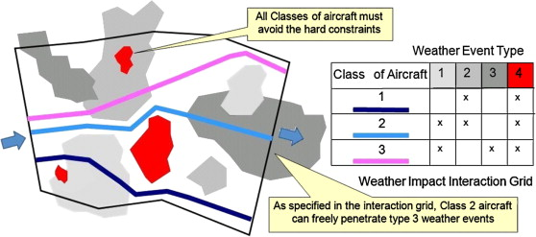
Dissemination for Operational Use
Use of Turbulence Information
Impact Translation
Operational Context
Mitigation Strategy
Go/no-go decision
Flight planning or execution
Aircraft separation
Runway, terminal or en route
Cabin management
Response to turbulence
Urban environment
Weather avoidance
Hard & soft constraints
Notes:
Need to understand response of aerial vehicle to turbulence & critical thresholds (especially for smaller & delicate aircrafts)
Need to combine & tailor information into actionable decisions

Slide 10

Smart decision support based on big data & data analytics
What-if scenarios for traffic management - record of past weather, air traffic, & other data - ability to search for “similar events” in past - ability to replay situation using different TMIs - ability to simulate conditions into future
Useful for training & real-time decision making

Slide 11
Dissemination for Operational Use
Use of Turbulence Information
Impact Translation
Operational Context
Mitigation Strategy
Go/no-go decision
Flight planning or execution
Aircraft separation
Runway, terminal or en route
Cabin management
Response to turbulence
Urban environment
Weather avoidance
Hard & soft constraints
Notes:
Need to understand response of aerial vehicle to turbulence & critical thresholds (especially for smaller & delicate aircrafts)
Need to combine & tailor information into actionable decisions

Slide 12
Key Points
New Requirements
emerging modes of transportation will need turbulence information - at higher & lower altitudes, including urban environments
Turbulence Observation & Prediction
opportunities for enhancing automated collection & sharing of turbulence data - improve coverage of oceanic airspace - beneficial sharing across aviation industry
increasing computational capabilities enable - higher resolution to better resolve atmospheric processes - use of ensembles to capture forecast uncertainty & probabilistic predictions
Weather Integration
characterization of weather impacts (translation) along flight paths - understanding response of aerial vehicle to turbulence & critical thresholds
enabling consistent flight/flow planning & execution through increased predictability
examination of what-if scenarios in real time yielding smarter decisions - supported by large amounts of data & data analytics
Story Telling
enhance quantification of turbulence impacts & benefits from better turbulence forecasts & use thereof
Notes:
Enhanced observations may include specialized field experiments
Dissemination enhancements include ADS-Wx, FIS-B, etc.
Sharing of data enhances situational awareness for everyone (may be thorny issue, also requiring standards, etc.)

