Slide 1
Remote Oceanic Meteorology Information Operational (ROMIO) Demonstration
Turbulence Impact Mitigation Workshop 3
Eldridge Frazier, WTIC Program, ROMIO Demo Team Lead
September 6, 2018
ROMIO Demonstration Team
Cathy Kessinger¹, Tenny Lindholm¹, Jim Olivo², Bob Barron¹, Gary Blackburn¹, Bill Watts³, Rocky Stone⁴, Steve Abelman⁵, Matthew DeRis⁶, Chad Gill⁷, and Dr. Antonio Trani⁸
¹National Center for Atmospheric Research (NCAR); ²Basic Commerce Industries (BCI); ³Delta Air Lines (DAL); ⁴United Airlines (UAL); ⁵American Airlines (AA); ⁶Panasonic Avionics; ⁷Gogo; ⁸Virginia Polytechnic Institute and State University

Slide 2
Remote Oceanic Meteorology Information Operational (ROMIO) Demonstration
Sponsored by the Weather Technology in the Cockpit (WTIC) NextGen Weather Research Program
Collaborative effort between FAA, weather research community, airlines, and airlines inflight entertainment communications (IFEC) providers
Develop and demonstrate operational strategies for use of rapidly updated satellite and model derived Cloud Top Height (CTH) and Convective Diagnosis Oceanic (CDO) information;
  On flight deck
  At Airline Operations Center (AOC) flight dispatch operations
  At Oceanic Air Route Traffic Control Centers (ARTCC)
  At Center Weather Service Units (CWSU)
Notes:
The Federal Aviation Administration (FAA) Next Generation (NextGen) Weather Technology in the Cockpit (WTIC) program is sponsoring this operational demonstration, called the Remote Oceanic Meteorology Information Operational (ROMIO) demonstration.
The ROMIO Demo is a collaborative effort between the FAA, the weather research community, the airlines; and airlines inflight entertainment communications (IFEC) providers.
The ROMIO demonstration will begin in spring of 2018 and continue for approximately 9 months. During the demonstration, feedback from pilots, AOC dispatchers and Oceanic ARTCC controllers will be solicited to ascertain the benefits associated with providing near real-time, rapidly updated graphical information on convective structure.
The Cloud Top Height and Convective Diagnosis Oceanic information will be provided to the flight deck, the airline operations center flight dispatch operations, the Miami, Houston, and Oakland and the center weather service units co-located with the aforementioned ARTCCs.

Slide 3
Objective
Operational demonstration to evaluate the feasibility of uplinking convective storm information to commercial aircraft flying routes over remote and oceanic regions for display on an electronic flight bag (EFB)
  Identify minimum meteorological information for remote and oceanic regions
  Conduct cost benefit analysis for both safety and efficiency

Slide 4
Domain for Storm Information Creation
Scanning area Geostationary Operational Environmental Satellite (GOES)-East (16) and GOES-West satellites
  Satellite mosaics are created at 15 min intervals using latest data available
  Provides outside shell of convective cloud top and anvil and not within the cloud
  Information communicate cloud structure with maximum altitude and where convective hazard associated with strong updrafts / downdrafts are located
Notes:
The ROMIO demonstration will use the NOAA GOES-East and GOES-West satellites to define the ROMIO demonstration domain
The domain for storm information creation is contained by the scanning area of the Geostationary Operational Environmental Satellite (GOES)-East and GOES-West satellites. Routes to be flown are between the continental United States (CONUS) and South America, Caribbean, Australia, and South Africa, among others. A select number of airline line check pilots will participate in the demonstration. The ROMIO demonstration will begin in spring of 2018 and continue for approximately 9 months. During the demonstration, feedback from pilots, AOC dispatchers and Oceanic ARTCC controllers will be solicited to ascertain the benefits associated with providing near real-time, rapidly updated graphical information on convective structure.

Slide 5
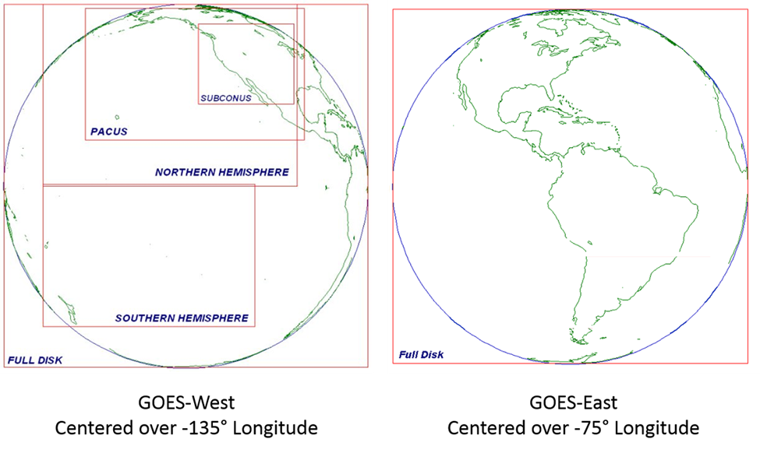
GOES-West Sector Sub-Domains
GOES-East Full Disk Scan Domain
Coverage Domain -180°W to -20°W Longitude and -50°S to 75°N Latitude
Notes:
National Center for Atmospheric Research (NCAR) has a Terascan satellite receiver that reads the GOES-West data directly from the satellite while the GOES-East data are provided by the University Corporation for Atmosphere Research (UCAR) Unidata program. The GOES-West receiver and associated servers are maintained by NCAR Research Applications Laboratory (RAL). The GOES-East receiver and associated servers are maintained by Unidata with data flowing to Research Applications Laboratory (RAL) via their Local Data Manager (LDM). The GOES-East satellite was recently replaced with a new, state-of-the-art satellite, called GOES-16, that represents a significant advance in capability over the previous satellite and the current GOES-West satellite. The new GOES-East scans the full hemisphere (i.e., also called full disk) at 15 min intervals, a significant improvement over the 3 hr interval of the old satellite, and thus simplifies the processing needed for that satellite. The GOES-West satellite uses the old technology and scans particular sectors (or sub-domains) at regular intervals following a pre-determined sequence. For GOES-West, the sectors are: the full disk, the sub-CONUS, the Pacific US (PACUS), the Northern Hemisphere, and the Southern Hemisphere. These scanning sectors are shown in Figure 1. Further, in areas only covered by the full disk scan, the ROMIO system performs an extrapolation of the storms within the full disk scan to 1hr and 2 hr to provide an estimated storm position. The replacement for the current GOES-West satellite, called GOES-17, was successfully launched on 1 March 2018 and is expected to be operational near the end of the ROMIO demonstration.

Slide 6
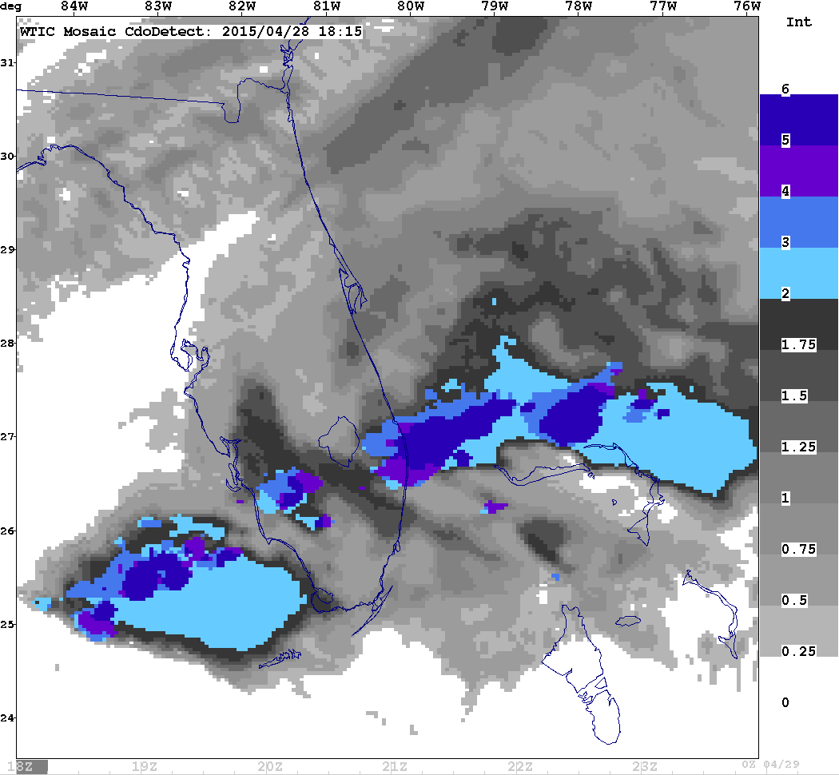
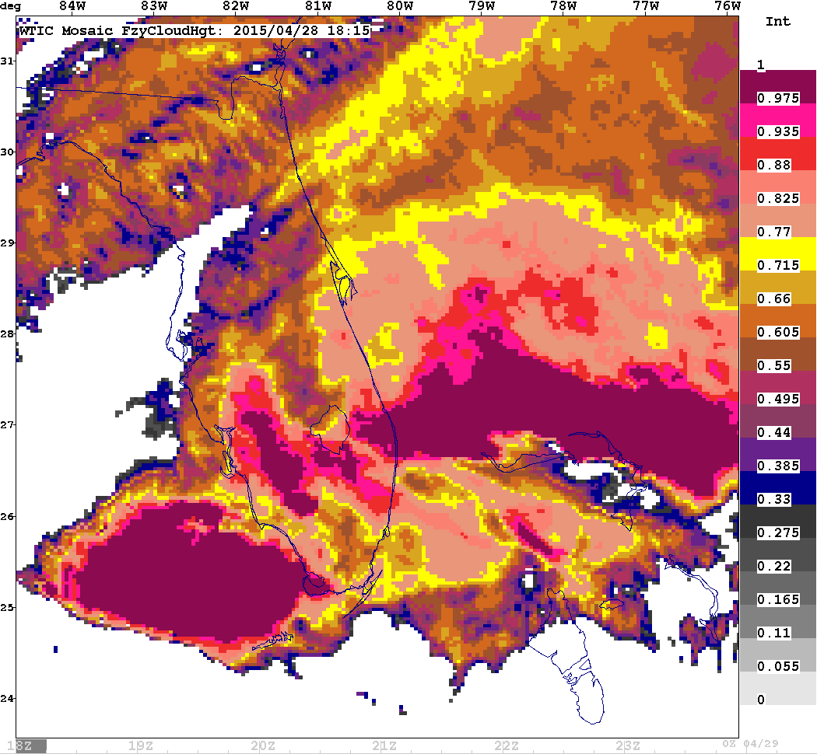
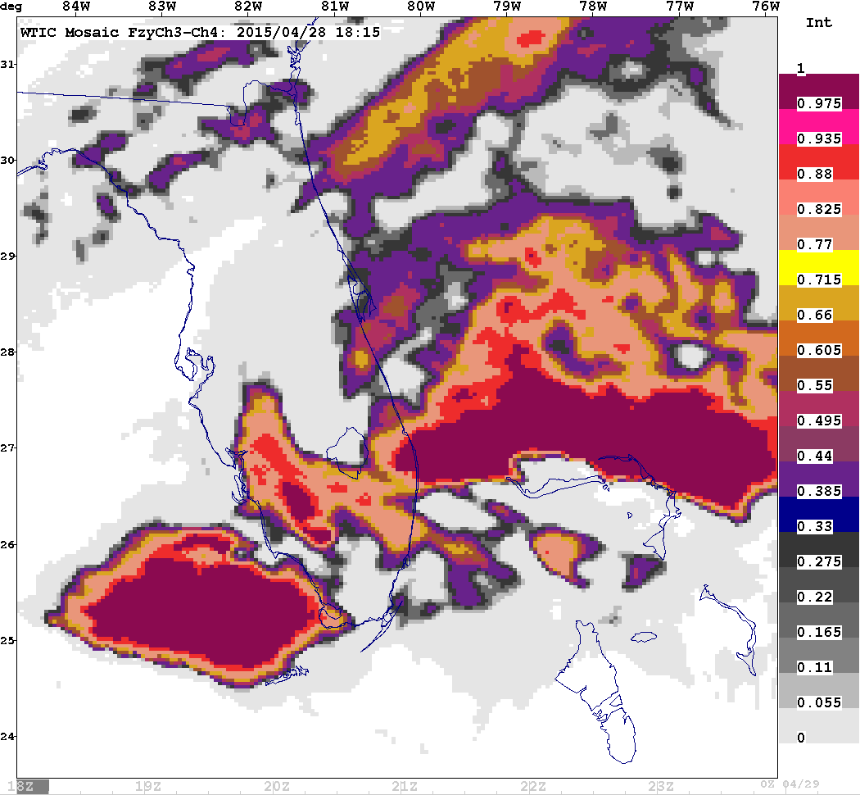
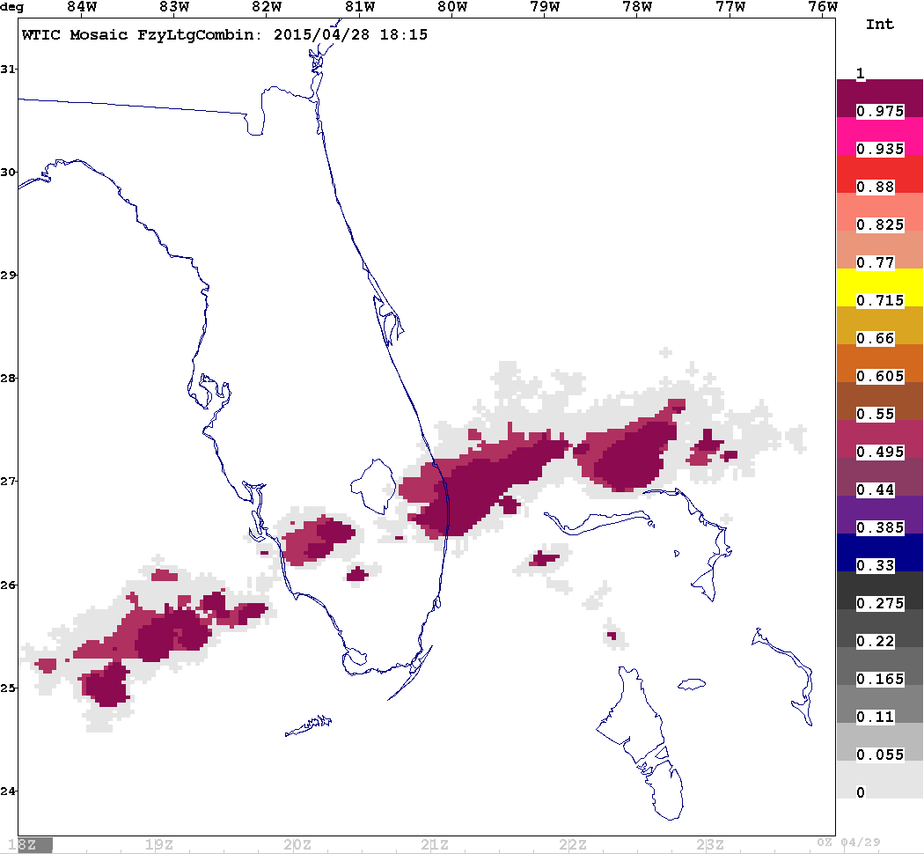
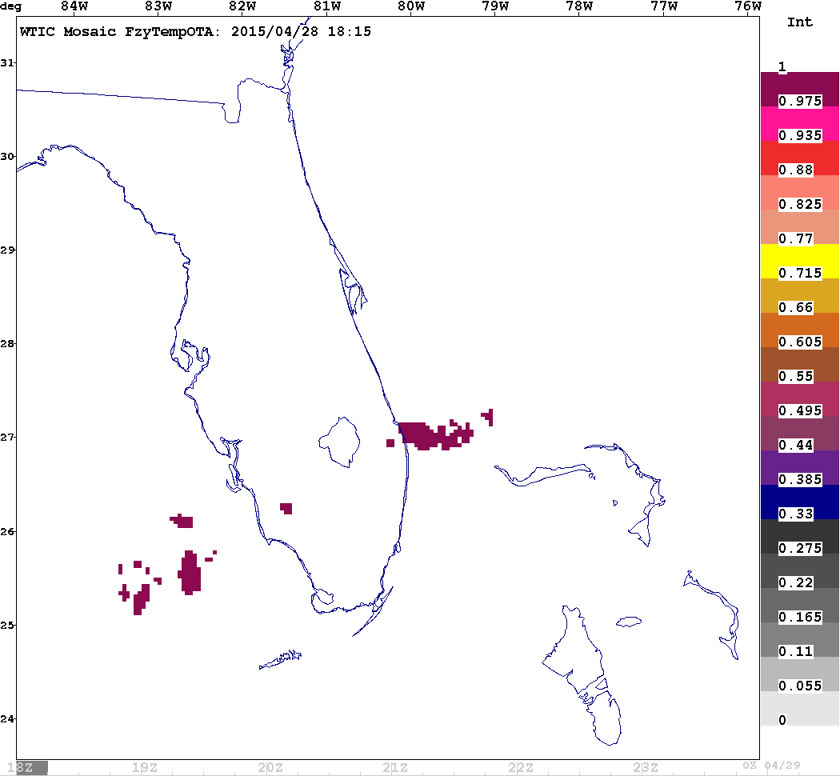
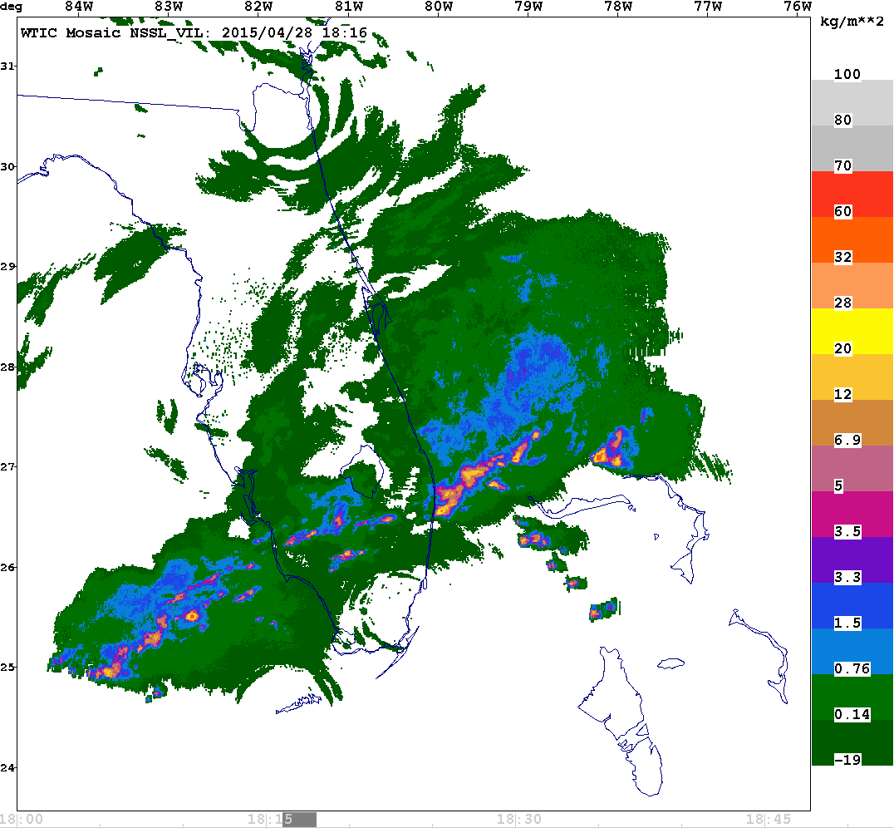
CTH / CDO Example and Inputs
CDO values >2 indicate convective hazard exists
Cloud Top Height
Global Convective Diagnosis
Convective Diagnosis Oceanic
Combined Lightning
15, 30, 60 min accum
Overshooting Tops
Input Interest Fields after Membership Function Applied
Weights =1 or =3 for Combined Ltg
NSSL Mosaic Vertically Integrated Liquid

Slide 7
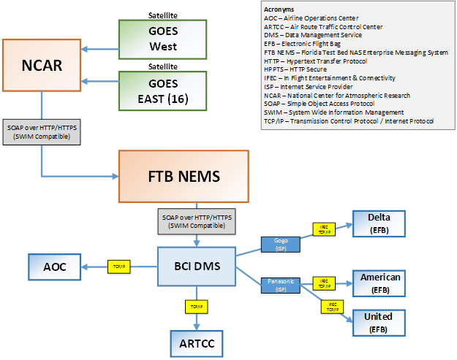
ROMIO Demo Communications

Slide 8
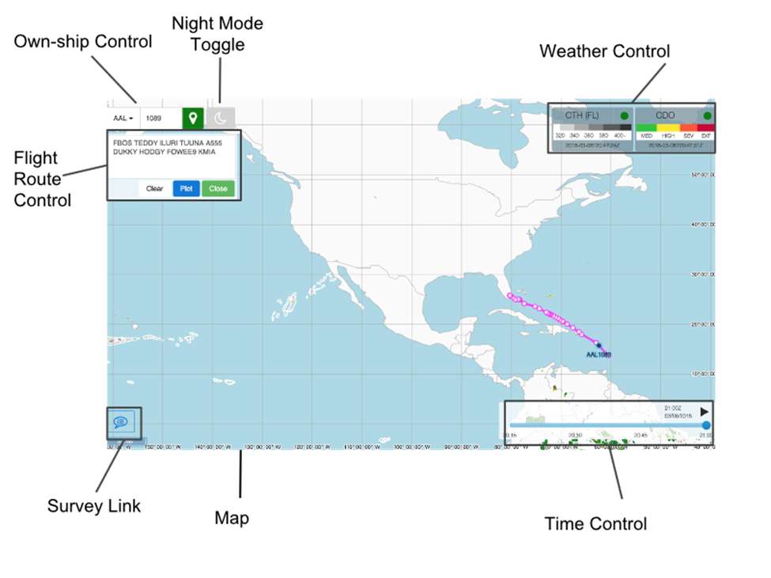
ROMIO Viewer

Slide 9
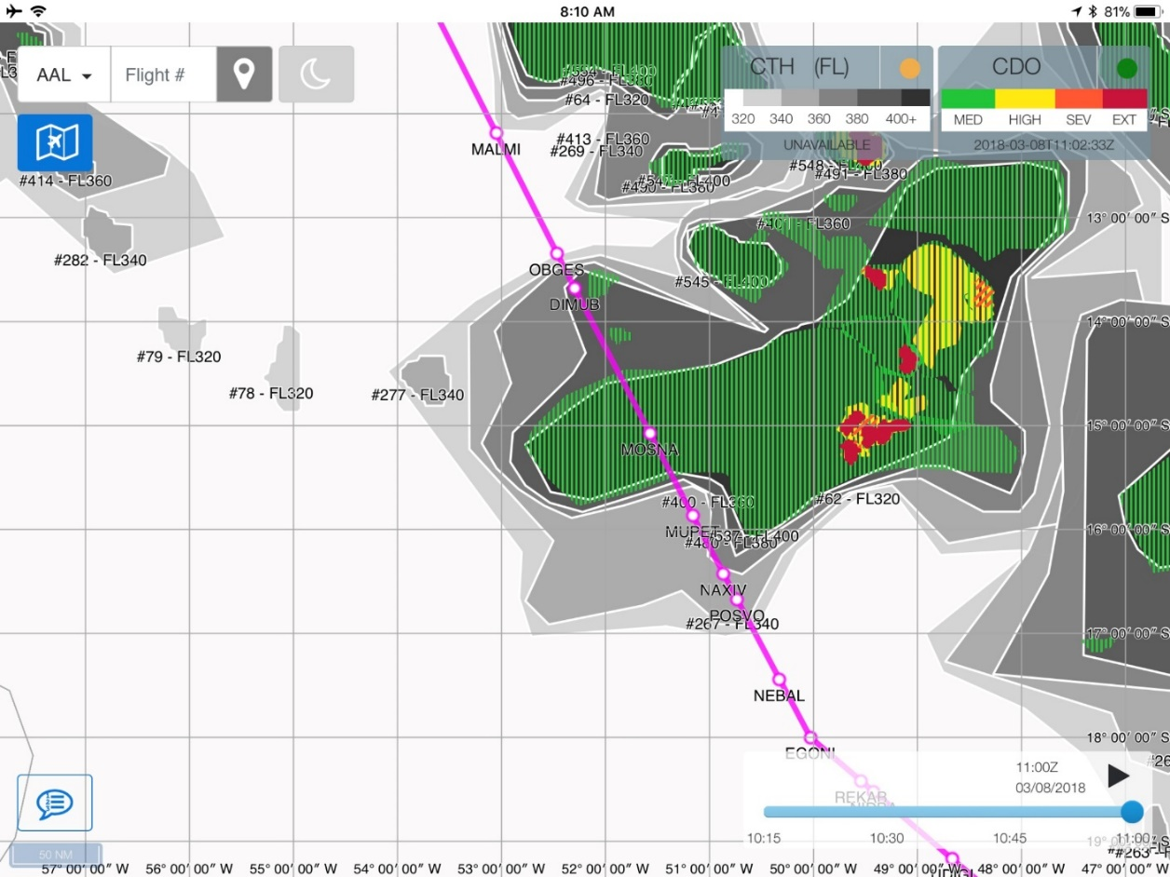
ROMIO Demo, UAL 845-7, Chicago – Sao Paulo 3-7/8
“Although CDO displayed medium convection, we didn’t encounter any storms that required deviation. However, the information was useful, as we did encounter light turbulence throughout the area depicted as having moderate convection. The CDO information allowed me to pre-brief our flight attendants to plan on being seated while we were in this area, and it worked very well for this purpose. The CTH product seemed to be displaying tops accurately.”
Notes:
I flew last night (3-7/8) from Chicago-Sao Paulo viewing the ROMIO products. They were very useful! I had a chance to compare them to the WSI PilotBrief Optima information we currently have.
First comment is that the ROMIO information were mostly available. I always thought that we were concerned about bandwidth due to cost, but when the Wi-Fi system is relatively low bandwidth, it matters for reception that the information uses low bandwidth. There were several times during the flight where I didn’t have the bandwidth available to download WSI PilotBrief Optima information (such as their SATrad information), but the ROMIO informations were working fine. There were also several times when there was no Wi-Fi available, and no updating was possible from any source. Some of these outages lasted 30-45 minutes.
I only went through one area of depicted convection on ROMIO. See the attached picture. Although CDO displayed medium convection, we didn’t encounter any storms that required deviation. However, the information was useful, as we did encounter light turbulence throughout the area depicted as having moderate convection. The CDO information allowed me to pre-brief our flight attendants to plan on being seated while we were in this area, and it worked very well for this purpose.
The CTH information seemed to be displaying tops accurately.
There was one instance when the display only had information on it when I touched the screen. If I tried to pan and zoom, it worked, but as soon as removing my finger from the display, the information went blank. This only occurred once, and after I exited and reentered the app, it worked fine.
I will provide another report on ROMIO performance after completing my return flight tonight.

Slide 10
Initial Comments on the Surveys
27 pilot responses received so far
Overall, the feedback seems positive (see the following slides)
High marks for ROMIO in the following areas:
  Situational awareness (74%)
  Monitoring weather along the route (74%)
  Timely weather information (67%)
  Cabin crew coordination (81%)

Slide 11
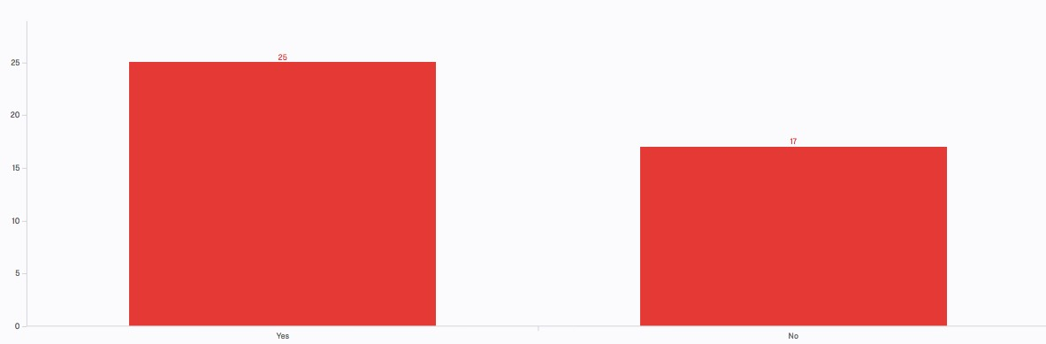
60% of pilots deviated or changed altitude to avoid weather in the surveyed flights
Pilot Responses
60% of pilots deviated or changed altitude to avoid weather in the surveyed flights
40% of the flights involved no weather deviation
Weather deviation distances varied from 5 to 25 nautical miles

Slide 12
60% of pilots deviated or changed altitude to avoid weather in the surveyed flights
Pilot Responses
60% of pilots deviated or changed altitude to avoid weather in the surveyed flights
40% of the flights involved no weather deviation
Weather deviation distances varied from 5 to 25 nautical miles

Slide 13
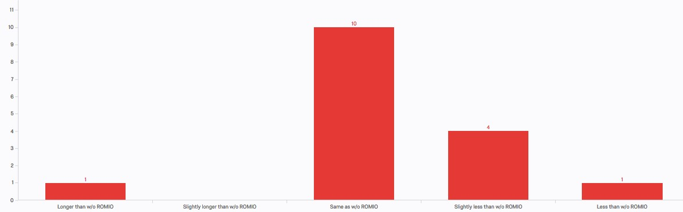
63% of pilots judge the time spent on ROMIO-induced deviations is about the same as with current systems
Pilot Responses
63% of respondents judge the time spent on ROMIO-induced deviations is about the same as with current systems
31% judge less time with ROMIO

Slide 14
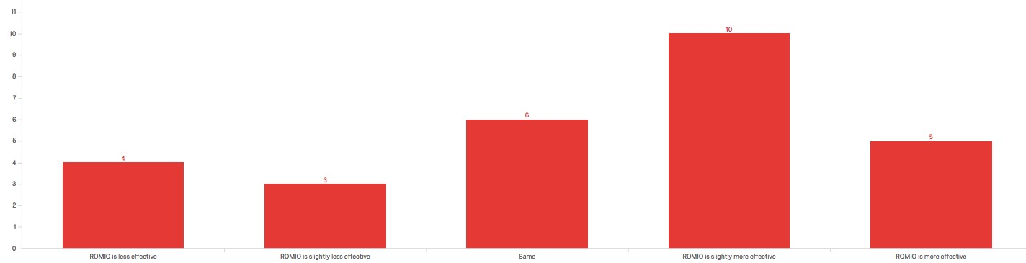
54% of pilots consider ROMIO to be more effective in making deviation or flight level changes
Pilot Responses
54% of respondents consider ROMIO to be more effective in making deviation or flight level changes
21% judge ROMIO to the be the same
25% judge ROMIO is less effective than the current system

Slide 15
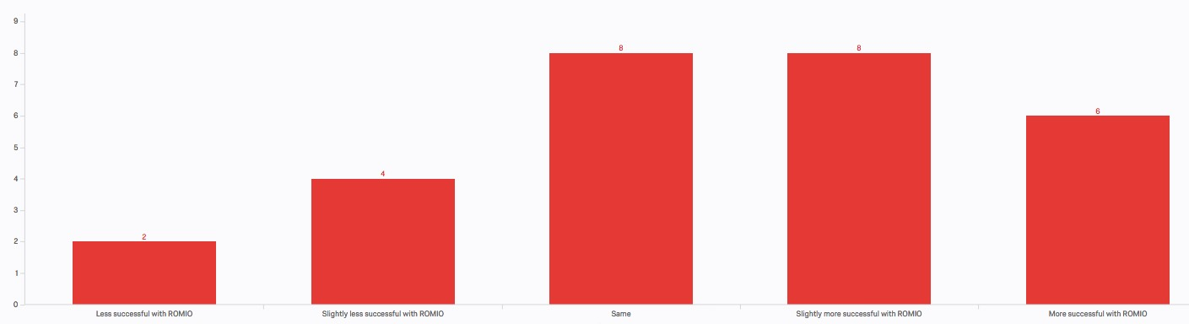
54% of pilots consider ROMIO to improve ability to accomplish task goals
Pilot Responses
54% of respondents consider ROMIO to improve ability to accomplish task goals
31% judge ROMIO to be the same to accomplish tasks goals
15% consider ROMIO information to decrease the success in accomplishing task goals

Slide 16
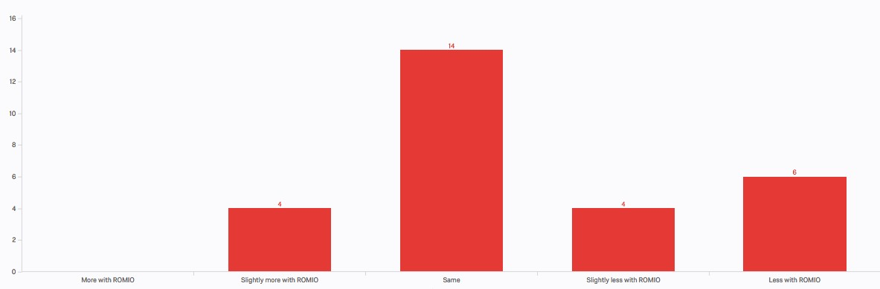
36% of pilots consider ROMIO to induce less stress and irritation compared to the current system
Pilot Responses
36% of respondents consider ROMIO to be induce less stress and irritation compared to the current system
50% judge ROMIO to be the same as using the current system
14% consider ROMIO information to increase slightly the stress and irritation compared to the current system

Slide 17
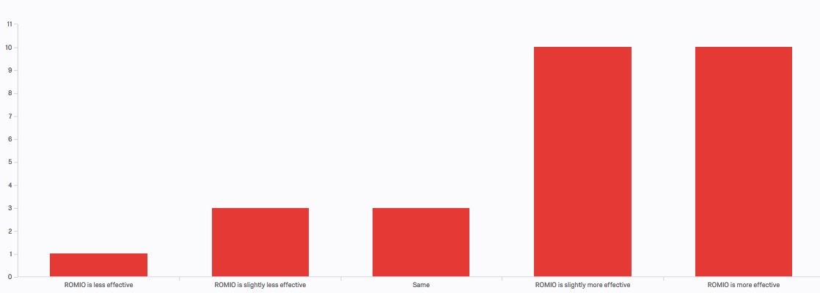
74% of pilots consider ROMIO to improve situational awareness compared to current system
Pilot Responses
74% of respondents consider ROMIO to improve situational awareness compared to current system
11% judge ROMIO provides the same situational awareness
15% consider ROMIO information to decreases situational awareness

Slide 18
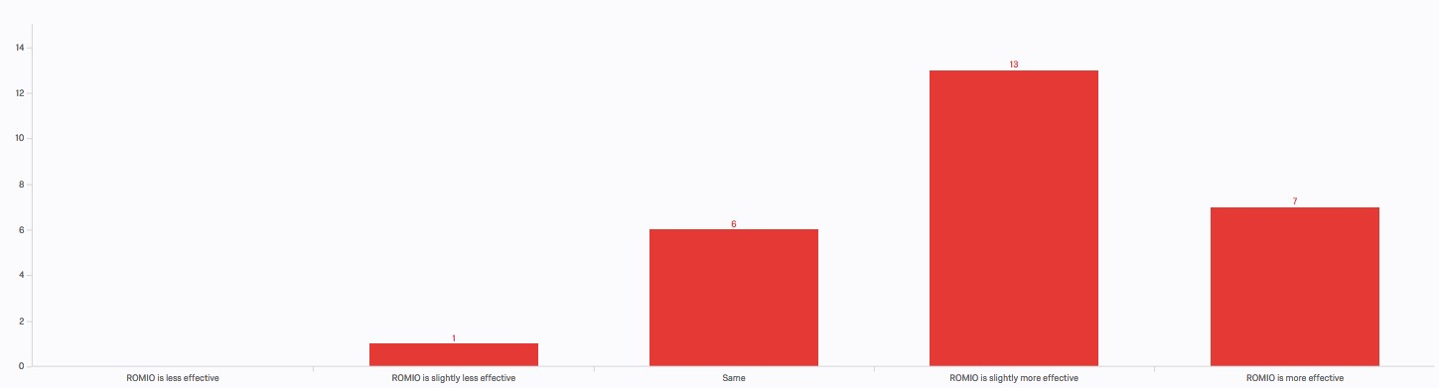
74% of pilots consider ROMIO to improve monitoring weather along the route compared to current system
Pilot Responses
74% of respondents consider ROMIO to improve monitoring weather along the route compared to current system
22% judge ROMIO provides the same weather monitoring ability
4% consider ROMIO to decrease weather monitoring ability

Slide 19
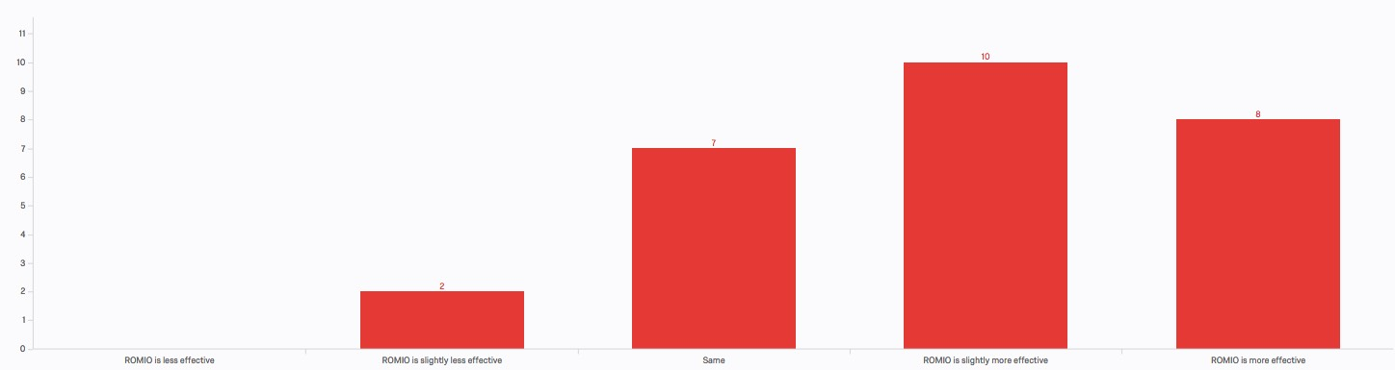
67% of pilots consider ROMIO information to improve timely weather information compared to current system
Pilot Responses
67% of respondents consider ROMIO to be better at providing timely weather information compared to current system
26% judge ROMIO provides the same at providing timely weather information
7% consider ROMIO to decrease the provision of timely weather information

Slide 20
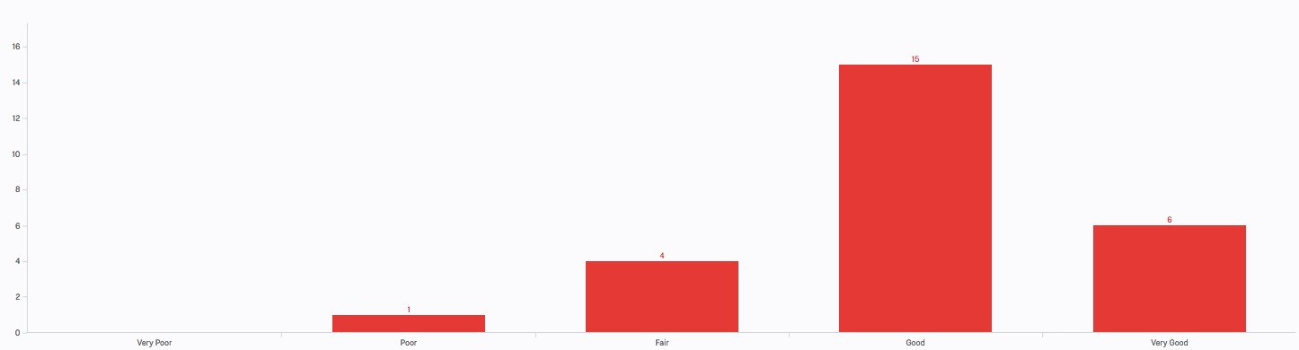
81% of pilots consider ROMIO to improve cabin crew coordination compared to current system
Pilot Responses
81% of respondents consider ROMIO to improve cabin crew coordination compared to current system
15% judge ROMIO provides the same cabin crew coordination
4% consider ROMIO to decrease coordination with cabin crew

Slide 21
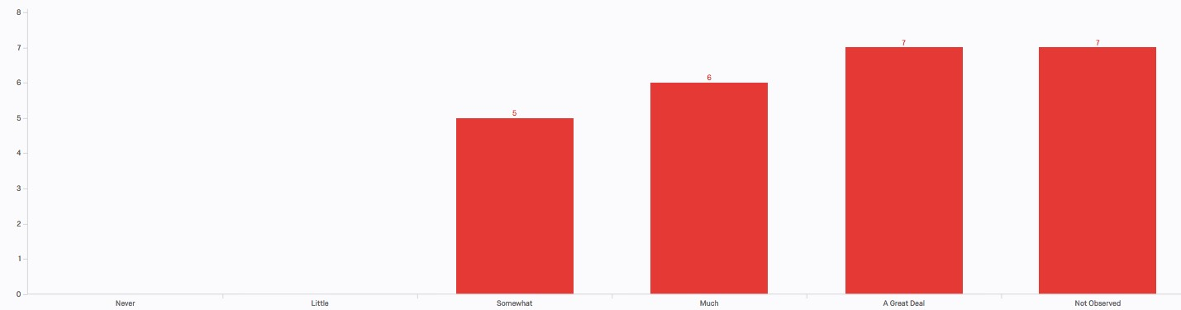
72% of pilots consider ROMIO CTH information to be consistent with their observations
Pilot Responses
72% of respondents consider ROMIO CTH information to be consistent with their observations
28% judge ROMIO CTH information is somewhat consistent with observations
28% of pilots could not make observations

Slide 22
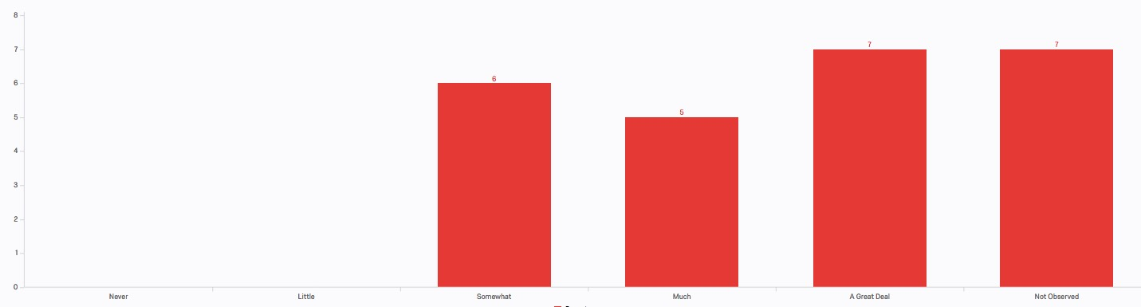
67% of pilots consider ROMIO convective weather location to be consistent with their observations
Pilot Responses
67% of respondents consider ROMIO convective weather location to be consistent with their observations
33% judge ROMIO CTH information is somewhat consistent with observations
28% could not make observations

Slide 23
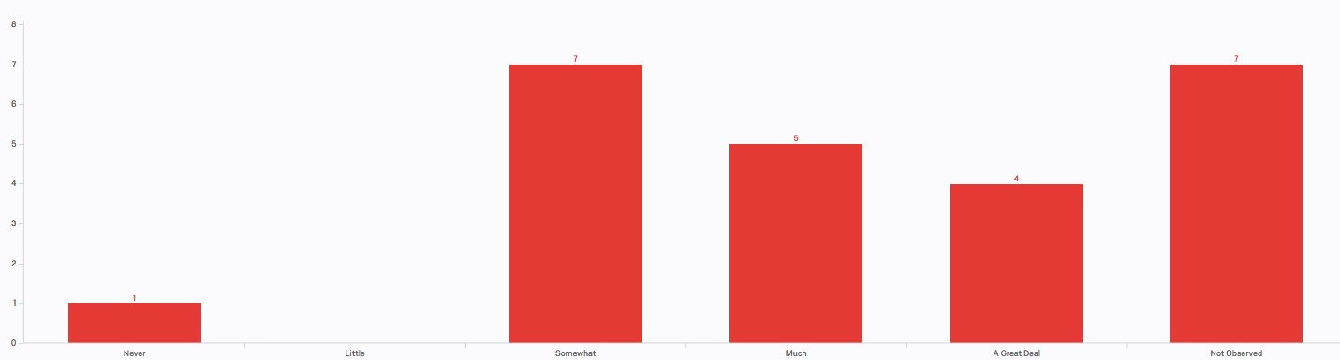
53% of pilots consider ROMIO convective weather lateral extend of clouds to be consistent with their observations
Pilot Responses
53% of respondents consider ROMIO convective weather lateral extend of clouds to be consistent with their observations
47% judge ROMIO convective weather lateral extend of clouds is somewhat consistent with observations
29% could not make observations

Slide 24
ROMIO Issues
Limited area of coverage
Takes long time to load information
Missing weather events that were visible out the window
Delta’s Flight Weather Viewer (FWV) had a more complete feature set
Extra waypoint created that required the pilot to delete it
Not as helpful as the FWV application
The lateral boundaries were greater than what was observed; required to verify with the FWV to get a true picture
ROMIO showed wider areas in red; required comparison with other capabilities to decide the actual avoidance maneuver

Slide 25
Thank You
Eldridge Frazier, ANG-C61, eldridge.Frazier@faa.gov, 202-267-2790

