Slide 1
Increasing Adoption of Weather & Turbulence Observations
Tim Rahmes – The Boeing Company
Rocky Stone – United Airlines, Chief Technical Pilot, Surveillance
Nathan Polderman – United Airlines, Sr Manager, Meteorology & Turbulence Mitigation Strategy
September 6, 2018

Slide 2
Agenda
Scope & concept of operations
Recent progress
Current availability from Boeing
*Some* Analysis of observations
Use at United Airlines & future outlook
Q&A

Slide 3
Scope & Concept of Operations

Slide 4




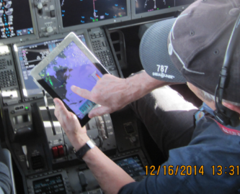
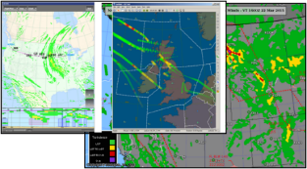
Concept of Operations & Information Flow
Generate meteorological data to support airline world-wide operations
Scope of this talk today
Aircraft
Weather & turbulence reports
Meteorological
Observations
Pilot apps
Airlines
Value-added services:
Formatting
Information selection
Aggregate aircraft reports
Better information of
weather & turbulence
Dispatcher applications
3rd Parties (e.g. National Weather Services, ANSPs, IATA, industry, service providers, research, academia)

Slide 5
Recent Progress

Slide 6
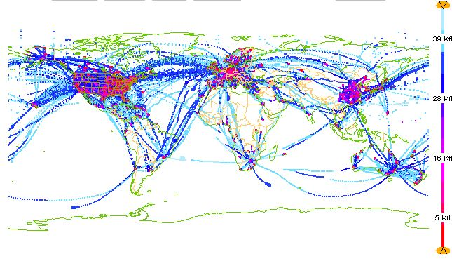
Current AMDAR Coverage
gap
gap
https://sites.google.com/a/wmo.int/amdar-news-and-events/newsletters/volume-10-october-2015

Slide 7
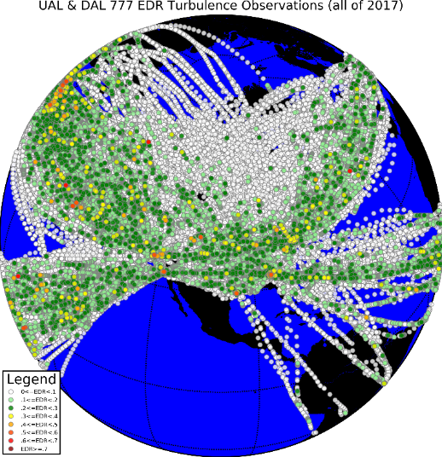
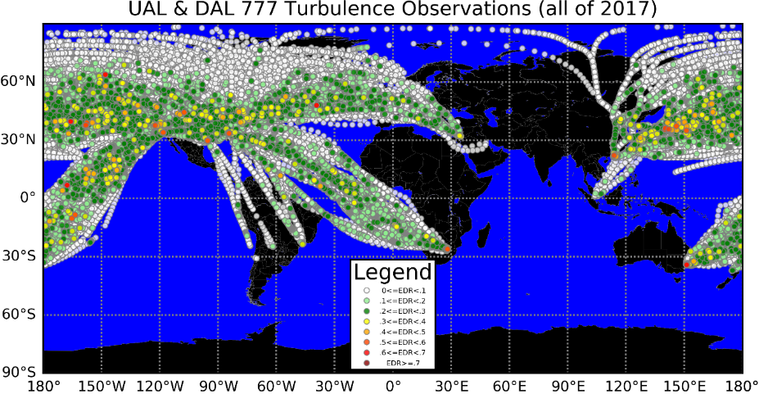
From FAA Presentation - January 2018, AMS
As a result of the EDR Tech Transfer collaboration, Boeing is now able to offer the EDR algorithm as an option to their customers, including UAL and DAL
  B777: installed on 777-300ERs and 777-200LRs thus far
  B787: installing on all UAL 787s
  B737MAX: installing all UAL 737MAX aircraft [** New Update! **]
The reported data from UAL and DAL routes greatly expands the geographic coverage over the Arctic and Southern Hemisphere
Courtesy of UAL and DAL

Slide 8
Current Availability from Boeing

Slide 9
Boeing Model Current Availability
Boeing offers an airplane option applicable to:
777-200/-200LR/-300/-300ER/Freighter/-8/-9
787-8/-9/-10
737-7, 737-8, 737-8200, 737-9, 737-10
The content includes: observation date and time, aircraft identification, flight number, departure, destination, latitude, longitude, altitude, static air temperature, wind direction, wind speed, icing, and mean/peak eddy dissipation rate (EDR) turbulence, and provisions for humidity & cloud properties on certain models.
If interested: Please contact Boeing to request incorporation of the new aircraft weather and turbulence reporting option.

Slide 10
April 24, 2018: The 3 Boeing models reporting for UAL
787
737
777

Slide 11
Analysis of Observations
(this is a start!)

Slide 12
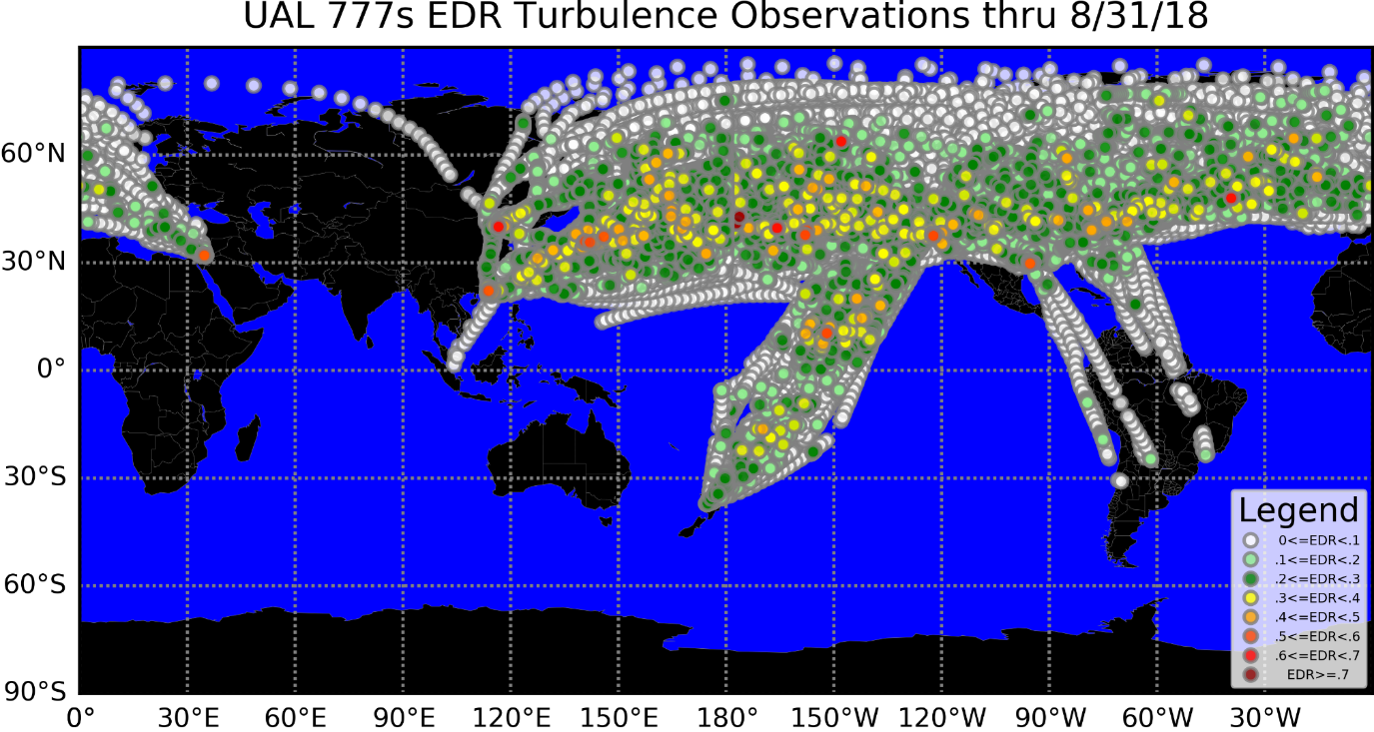
UAL 777 (362367 observations)
Moderate
Turbulence
(yellow)
Severe
Turbulence
(red)
Light
Turbulence
(green)

Slide 13
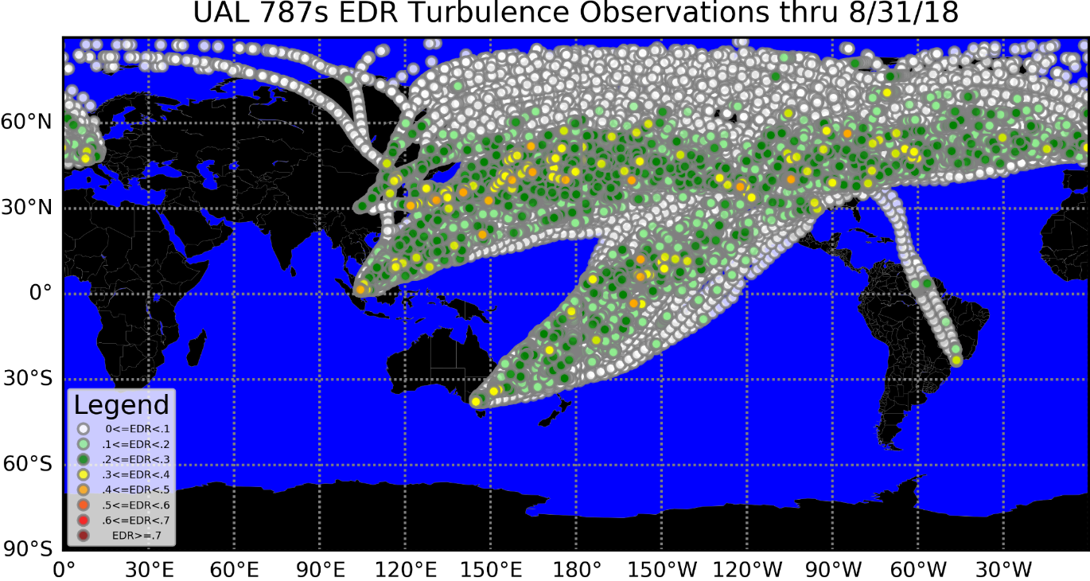
UAL 787 (214956 observations)
Moderate
Turbulence
(yellow)
Light
Turbulence
(green)

Slide 14
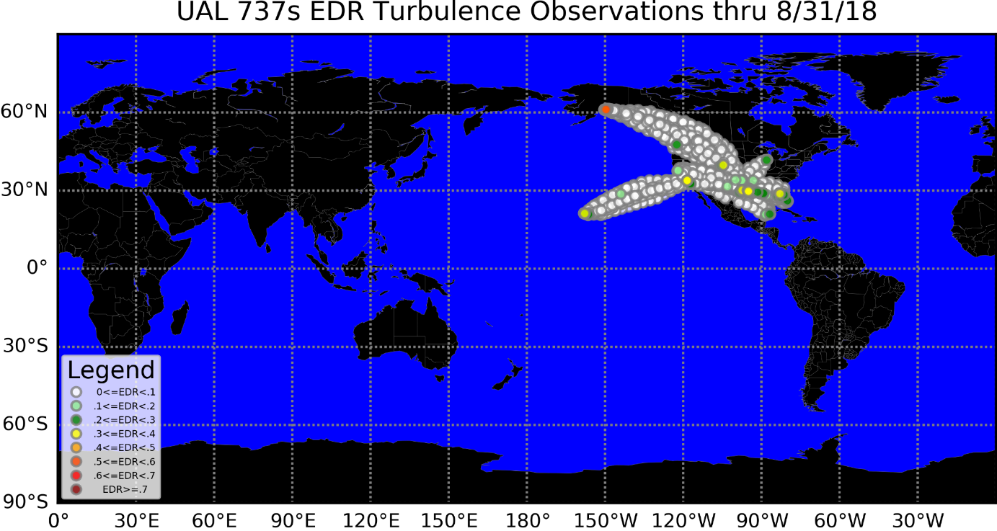
UAL 737MAX Observations
Just Starting!

Slide 15
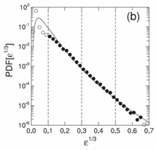
Methodology for analysis of the reported EDR (per RTCA DO-370)
Customers expect verification of installed software for correctly reporting the appropriate values (winds, temperature, icing, EDR turbulence, etc.)
Post-installation analyses over many flights (perhaps thousands of individual observations) help evaluate an aircraft implementation.
Statistical analysis of the reported EDR using a probability distribution function (PDF) derived from a histogram of the EDR can be used to help verify that the results are reasonable.
The binned EDR data over a period of time can indicate problems with the algorithm performance.
Note that the exact distribution of the data will be affected by an aircraft’s operation, including but not limited to:
  Altitude
  Geography
  Season, time-of-day
  Logic for periodic and threshold reporting
  Operator’s weather and turbulence avoidance culture and procedures
[adapted from Sharman, et al., 2014, Fig. 10]

Slide 16
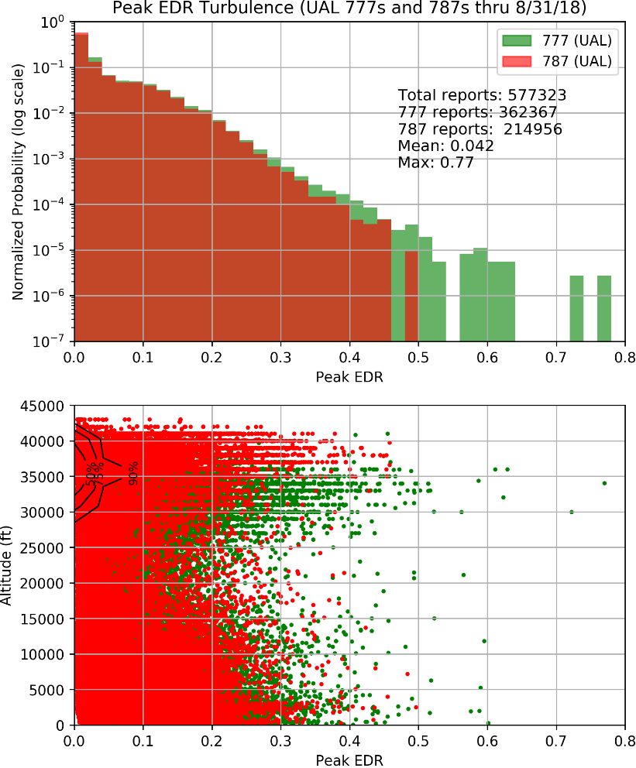
Turbulence Performance Results
At this time, we see reasonable agreement between UAL 777s and 787s.
It will be interesting to revisit once both of UAL’s 787s and 777s are over 1 million observations (in 2019)
We don’t expect anything too different from what NCAR has seen on 737/757/767s for many years.
But, keep in mind the operational altitude differences of 777 vs 787 [see next slides]

Slide 17
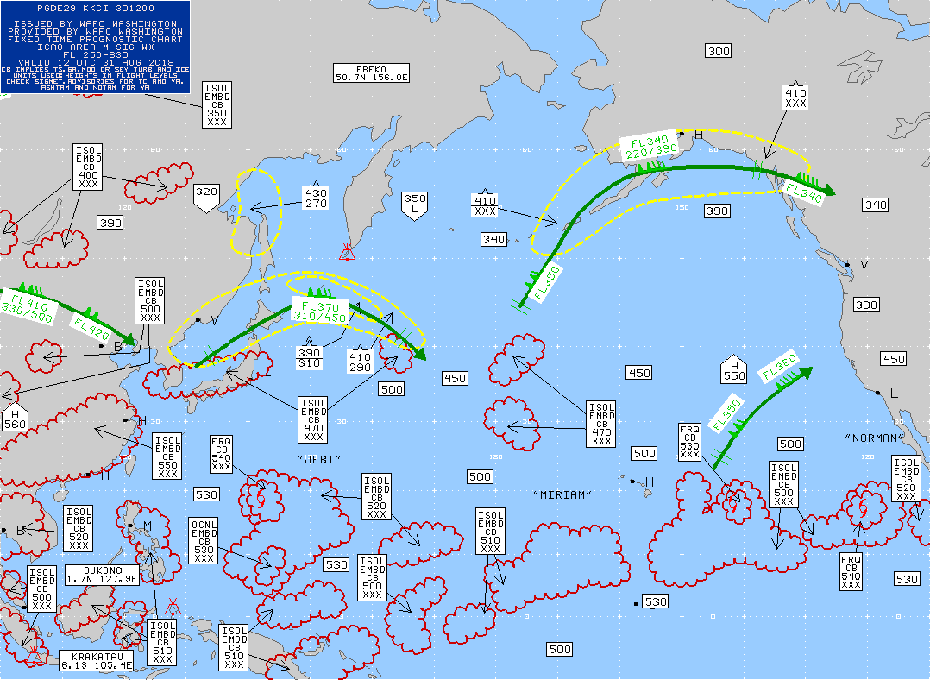
Reminder: Tropopause levels vary with latitude
Example: Below tropopause range is FL300-FL500+ (boxes in High Level SigWx)

Slide 18
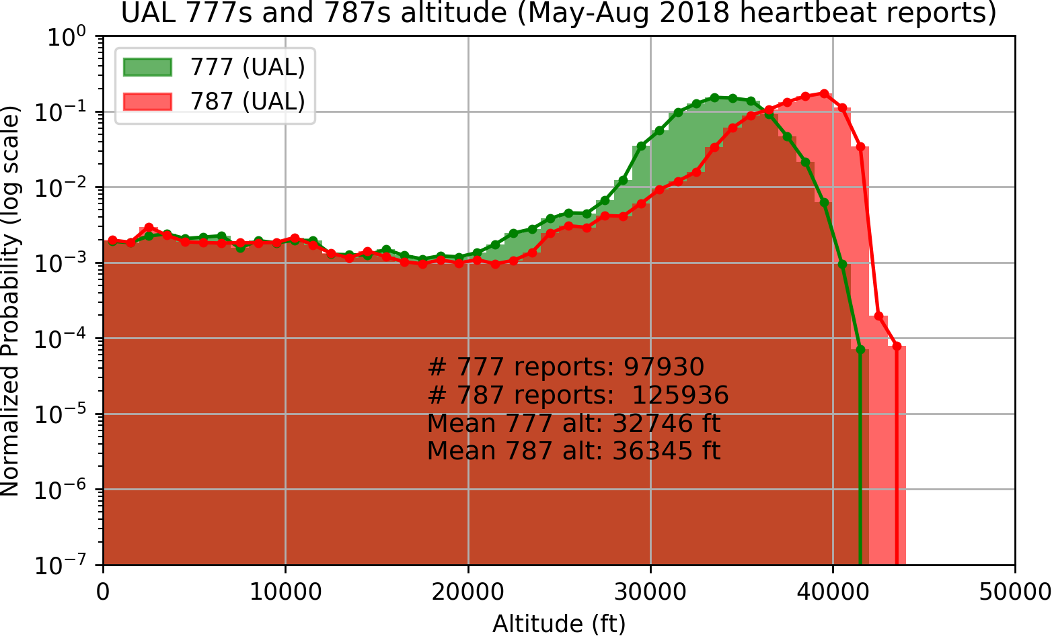
Operational Altitude
Design altitude for 787s and 777s are different
In time, we’ll see if 787 operations in lower stratosphere make a statistical difference for reported EDR magnitude.

Slide 19
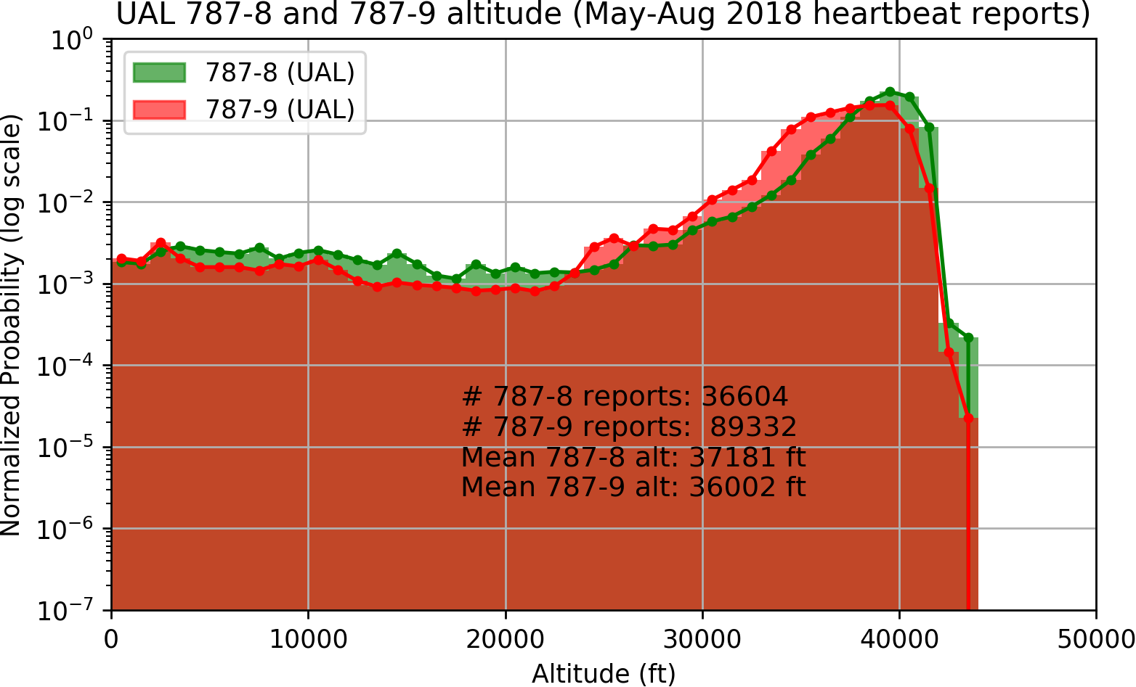
Operational Altitude
UAL notes the differences between 787-8 and 787-9 operational altitude is also worth mentioning

Slide 20
Use at United Airlines & future outlook

Slide 21
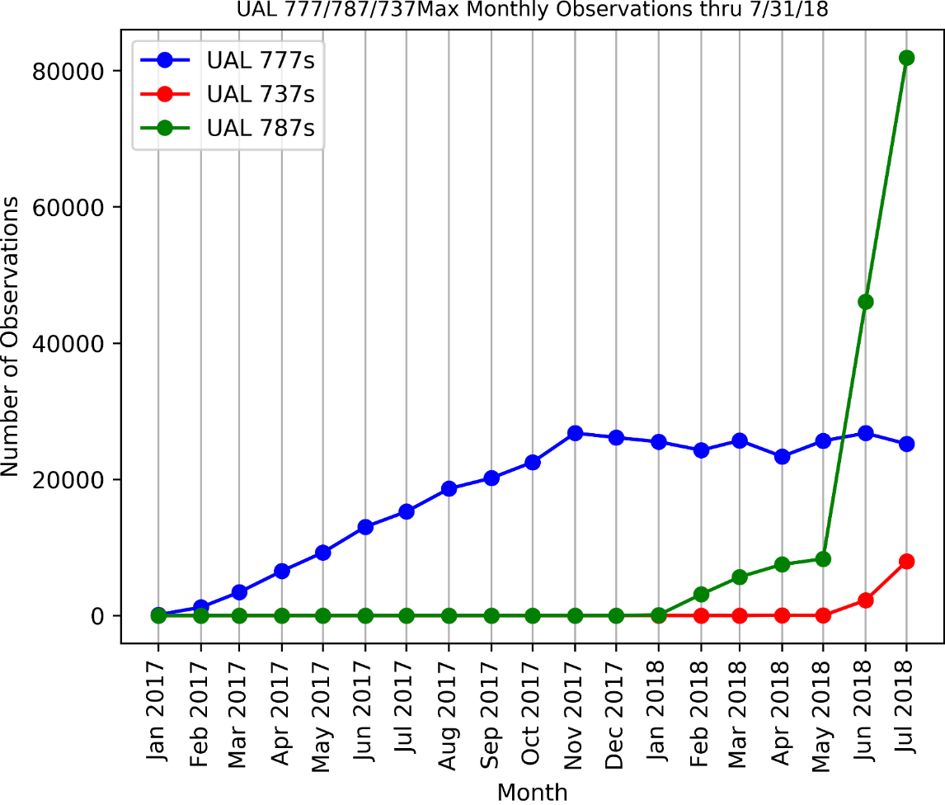
Monthly UAL 777, 787, and 737Max Observations
Rapid Growth
June-July
UAL uses:
Flight deck
Dispatch
Analysis
737s just
starting

Slide 23

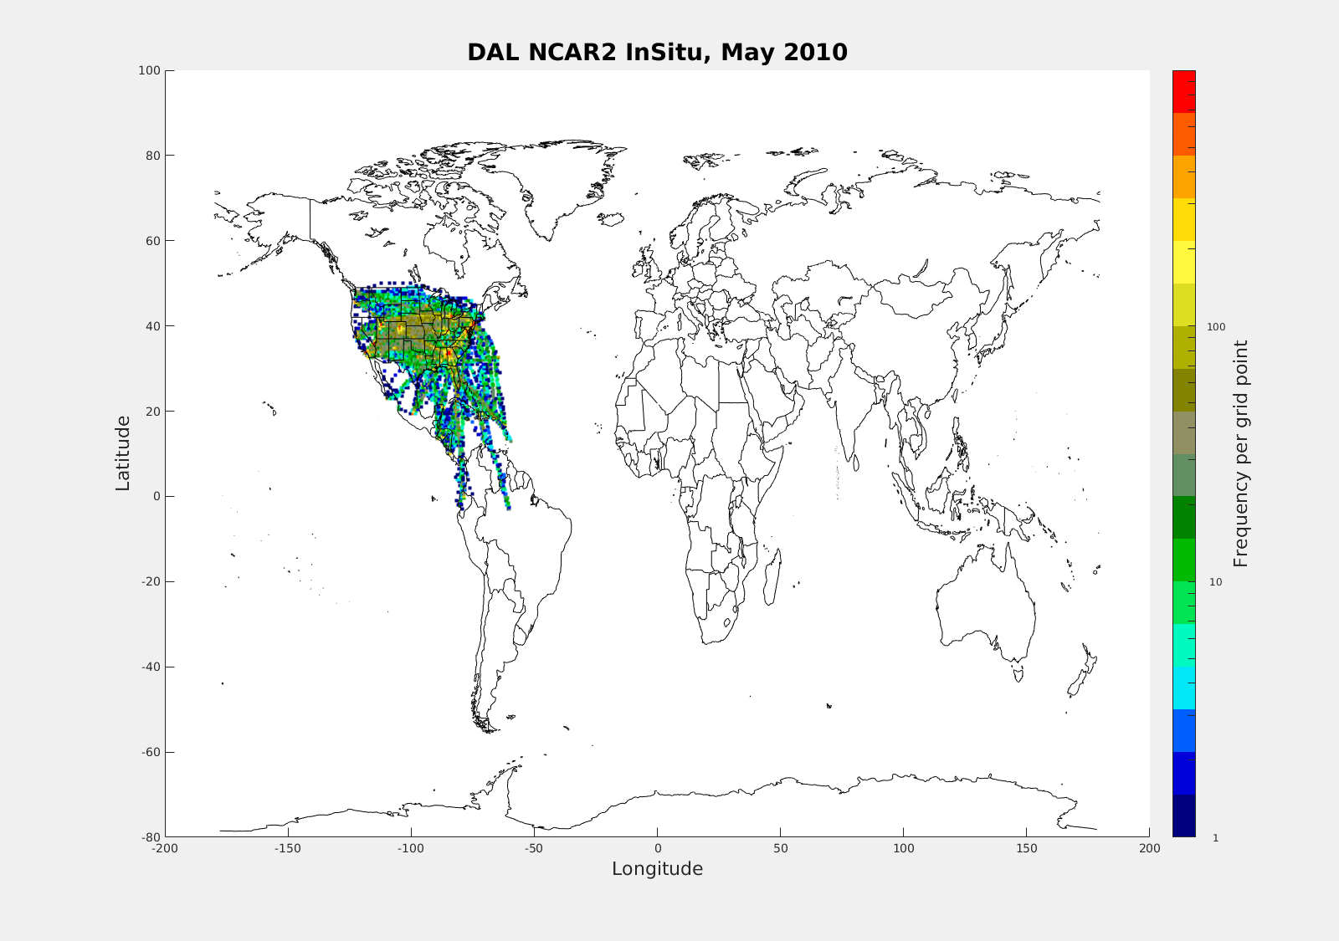
Automated In situ Turbulence Detection
Government-Industry Collaboration Success
Updated
FAA Slide
Global Delta Airlines EDR Observations
2010-2018
U.S. Carriers: >1,100 equipped aircraft (as of 8/27/2018)
DAL: ~364 (B-737/767/777, A-320/330)
UAL: ~57 (B-777/787/737MAX)
SWA: ~710 (B-737)
Foreign carriers joining program
  Qantas, Lufthansa/Swiss Air, Air Lingus, Air France, etc.
DEN

