Slide 1
Turbulence Avoidance Modeling
Developing Predictive Models of Pilot Behavior in Response to Turbulence Encounters
Rafal Kicinger and Christina Bittle
Turbulence Impact Mitigation Workshop 3, 5-6 September 2018, Mclean, VA

Slide 2
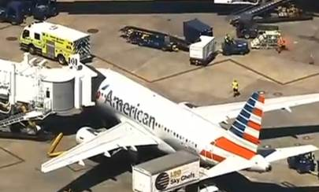
Motivation
Turbulence impacts flight operations
  Discomfort for passengers
  Temporary loss of aircraft control
  Aircraft damage
  Injuries, or even deaths, of passengers and flight attendants
  and Air Traffic Control (ATC)
  Increased controllers’ workload as pilots request altitude changes
  Reduced airspace utilization when air traffic controllers “close” the airspace
  When compared to convection, is adds another layer of complexity
  It cannot be physically observed by pilots and controllers
  Different types of aircraft can be affected differently by the same atmospheric conditions
“American Airlines officials say five passengers were injured on a flight from Grenada to Miami after the plane encountered some unexpected turbulence.
American's Flight 982 landed at Miami International Airport shortly before noon Thursday without incident. Five passengers were taken to a hospital for minor injuries.”
Source: ABC News, Oct 1, 2015

Slide 3
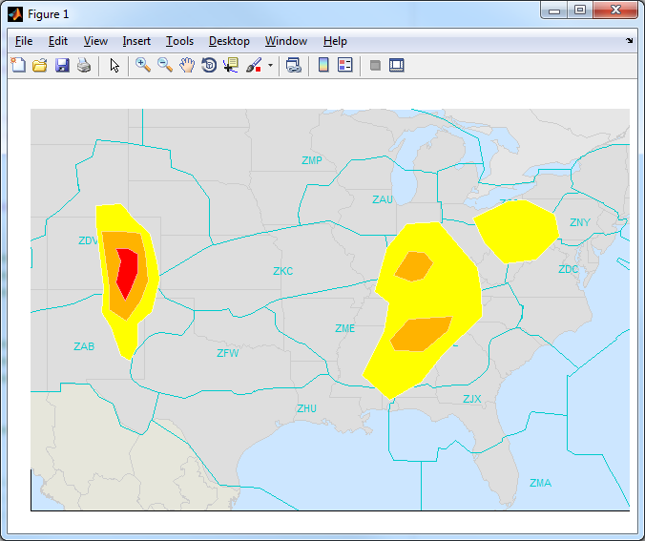
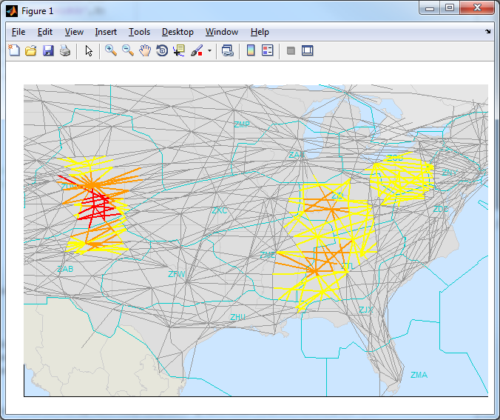
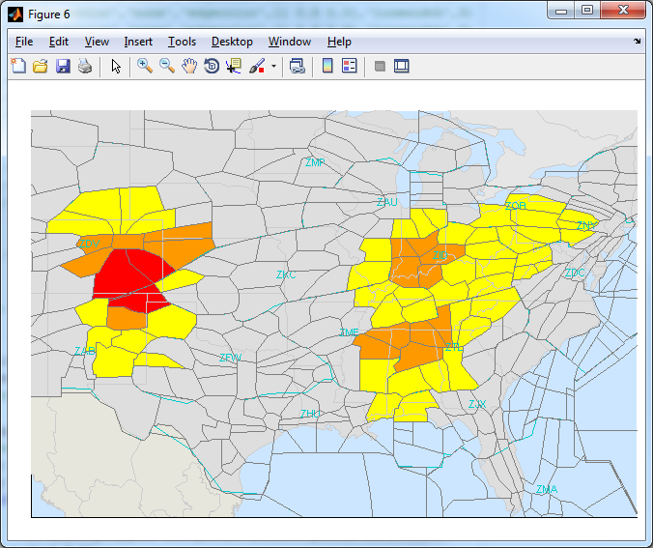
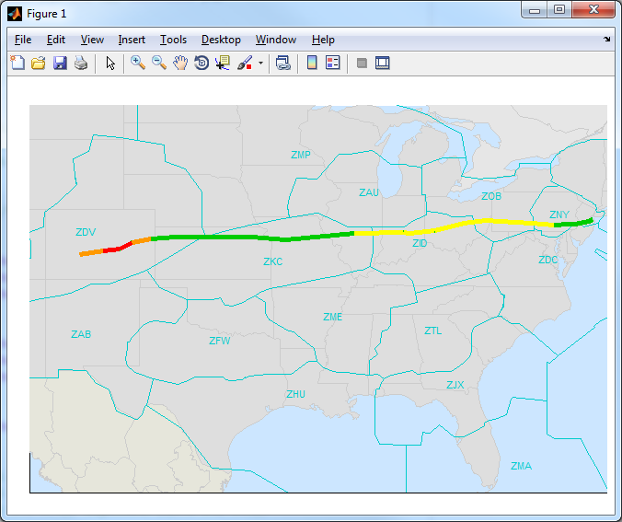
Objectives
Turbulence avoidance
regions
Aircraft type/weight class specific avoidance regions
  Develop a predictive turbulence translation technique relating pilots’ behavior to encountered turbulence and providing
  Automated and consistent interpretation of turbulence information relevant for operational decision making
  Depictions of actionable turbulence constraints
  Shared situation awareness of turbulence impacts to stakeholders
Route Impacts
Sector Impacts
Flight Level Impacts
Flight Trajectory Impacts

Slide 4
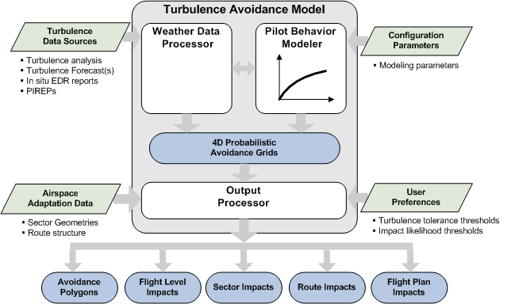
Turbulence Avoidance Model (TAM) Overview

Slide 5
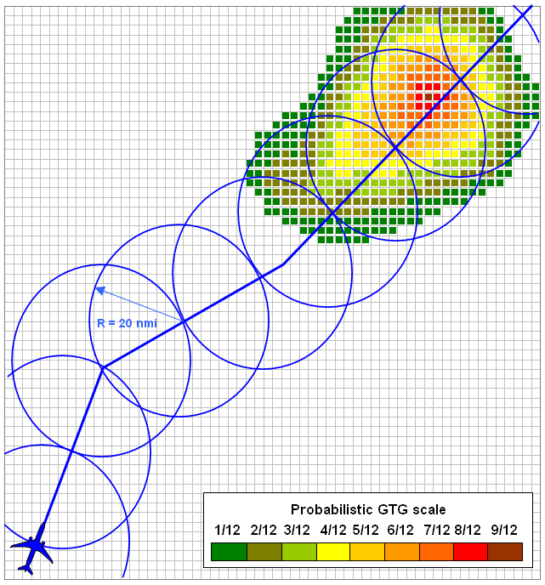
Prior Work
Turbulence Impact Analysis and Modeling
  Part of weather impact and weather translation NRA projects for NASA Ames in collaboration with NCAR (Sharman)
  Initial formulation of turbulence impact models based on limited datasets (Krozel, Klimenko)
  TAM Phase 1
  Needs and benefits analysis for the FAA in collaboration with AvMet
  Development of initial turbulence encounters repository
  Stakeholder surveys to determine operational needs and shortfalls
  Initial concept of use development
  TAM Phase 2
  Analysis of accuracy and consistency of turbulence information
  Development of refined pilot behavior models
  Validation of TAM outputs
No Response
Descended
Climbed
Re-routed

Slide 6
Pilot Behavior Analysis: Approach
Classifying pilot’s response based on in situ EDR reports
Δt^{buf}: Time buffer for maneuver detection
  Detect and quantify pilot responses behavior to turbulence encounters
    Focus on altitude change events, or lack thereof, when encountering turbulence of given intensity
    Scope limited to cruise phase of a flight
  Develop statistical approach for identifying best predictors for pilot responses
    Size of local spatiotemporal neighborhood in the vicinity of a turbulence encounter
    Sample estimator
  Develop parameterized representations of pilot behavior models that can be stratified based on
    Aircraft weight class
    Region
    Airline policy/tolerance to turbulence encounters
Altitude change event at t₀
Classifying pilot’s response based on gridded GTGN vicinity values
R^{vic} x R^{vic} x z^{vic x} Δ t^{vic} :
Size of the spatiotemporal vicinity around turbulence encounter location
Turbulence encounter with intensity exceeding a threshold value event at t₀

Slide 7
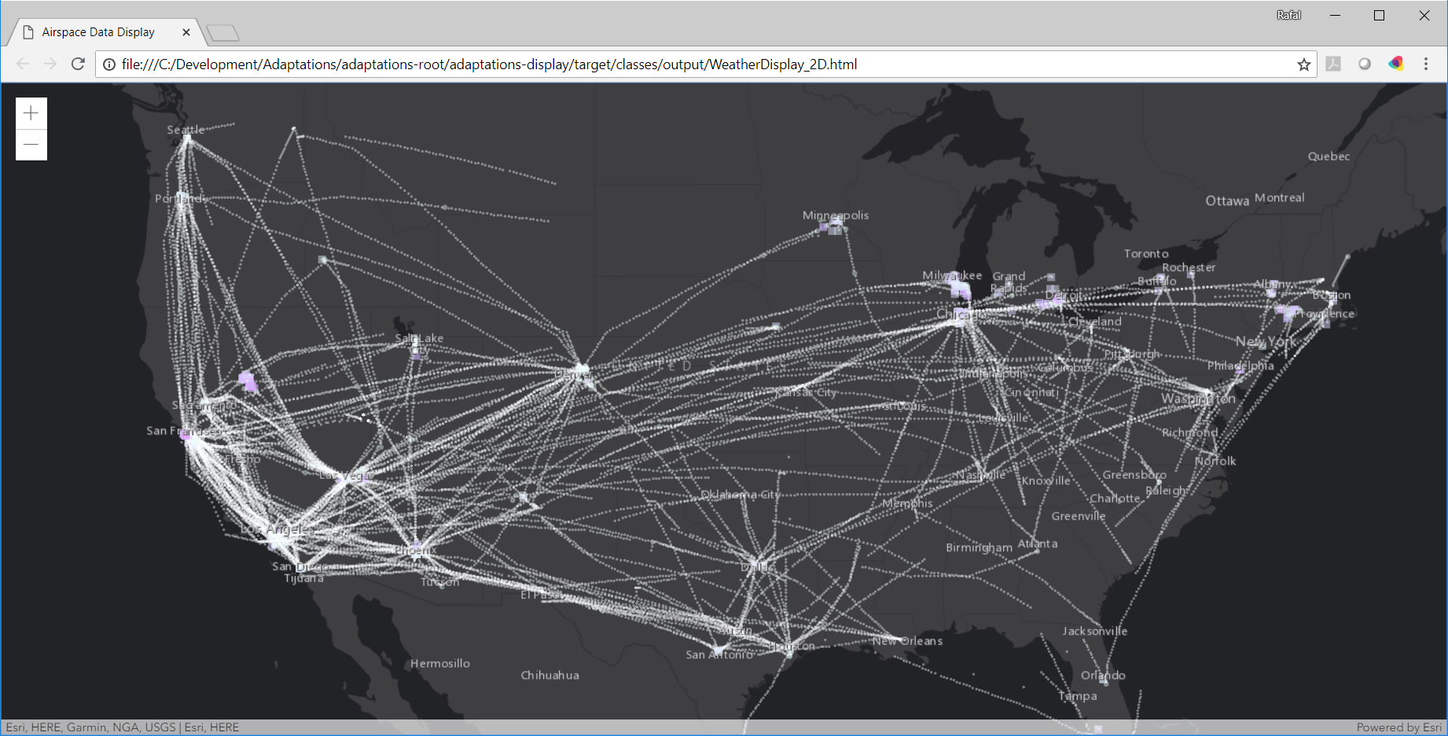
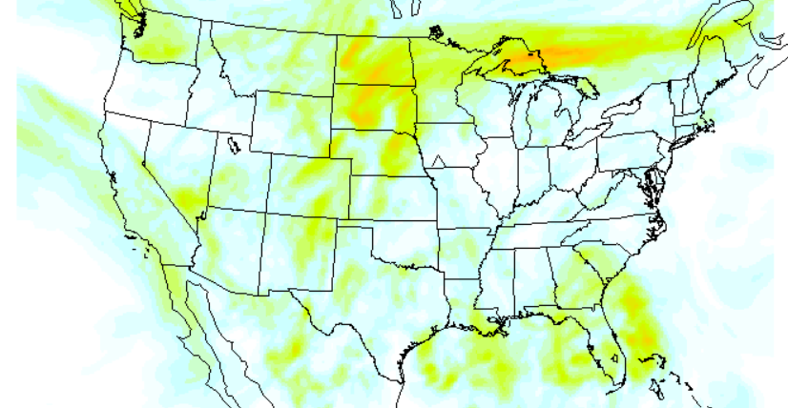
Pilot Behavior Analysis: Data Sources
In situ EDR data from a major US airline
1+ year of in situ EDR reports, 200,000+ EDR reports per day
Each report includes peak and median EDR values, position, time, ACID, origin and destination airports
  About 12% of these reports are non-interpolated (i.e., contain actually observed values
Graphical Turbulence Guidance Nowcast (GTGN) from NCAR
2+ years of gridded EDR nowcast data spanning the entire CONUS
Updated every 15 minutes
Altitude range from surface to FL500

Slide 8
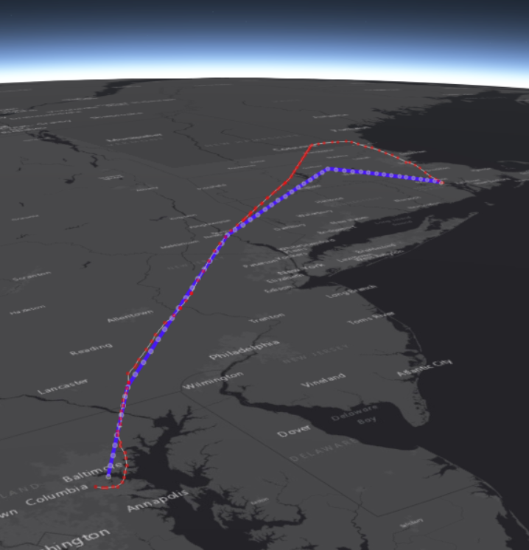
Pilot Behavior Analysis: Data Cleansing and Trajectory Matching
In situ EDR data is processed and matched into trajectories:
Each trajectory corresponds to an individual flight leg (origin-destination pair)
Invalid trajectories (minimum number of EDR reports, minimum number of non-interpolated EDR reports) are filtered out
Matching flight track data from FAA SWIM are identified for each extracted EDR trajectory to address position report issues
Correct position data are determined for all non-interpolated EDR reports based on SWIM flight track data and used in the analysis
Matched flight track from FAA SWIM
Trajectory extracted from a time series of in situ EDR reports

Slide 9
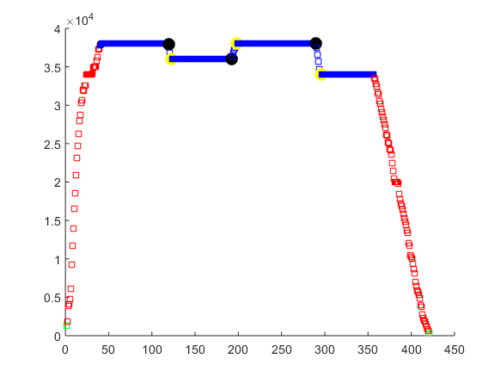
Pilot Behavior Analysis: Cruise Phase and Altitude Change Identification
Beginning of cruise phase detected
Altitude change start locations detected
Matched SWIM track data are used to identify:
Cruise phase for each flight
Altitudes changes, if any, occurring during the cruise phase
  Start and end locations identified from track data
  Magnitude of altitude change also computed
Identified altitude change events are subsequently added to the repository for analysis
End of cruise phase detected
Altitude change end locations detected

Slide 10
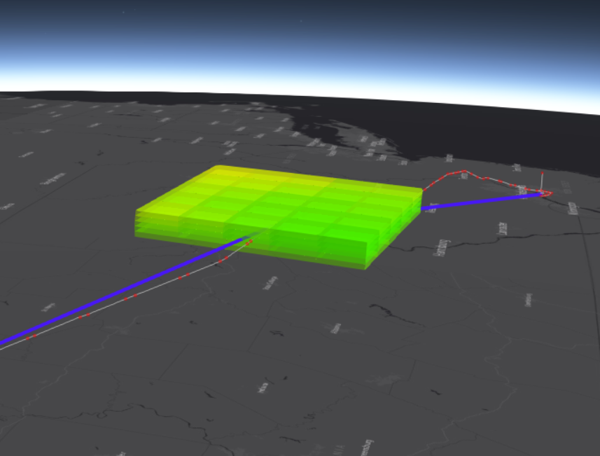
Pilot Behavior Analysis: Turbulence Encounter Identification
Turbulence encounter identification relies on spatiotemporal vicinity filters defined for each cruise phase track data point:
    Lateral dimensions (distance in km from the analyzed track data point)
    Vertical dimensions (number of flight levels above and below the analyzed track data point altitude)
    Temporal dimensions (time window around the analyzed track data point time)
Analysis includes varying sizes od the spatiotemporal vicinity filter and sample estimator to determine best predictors for altitude change
Lateral dimensions of the vicinity filter
Vertical dimension of the vicinity filter
Spatiotemporal vicinity filter around flight track point from which GTGN values are extracted

Slide 11
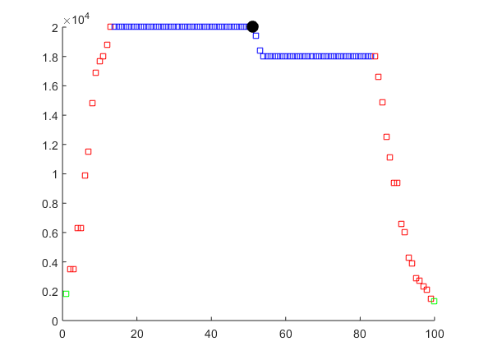
Pilot Behavior Analysis: Response vs Non-Response Identification
Non-interpolated in situ EDR report
Identified altitude change event
Two methods used depending on the turbulence data source:
  In situ EDR data:
      Time interval of size t centered at a non-interpolated in situ EDR report.
      Altitude change events, if any, in that time interval are attributed to this turbulence encounter
      Peak EDR value determines the magnitude of the encountered turbulence
  GTGN data:
      Time interval of size t defined for each cruise phase track point
      Magnitude of the encountered turbulence determined by a sample estimator using the sample extracted from the spatiotemporal filter
  Encounters with similar turbulence magnitude are binned together and the frequency of altitude changes attributed to this encounter is computed
Time interval for attributing altitude change events, if any, to a turbulence encounter with a given intensity

Slide 12
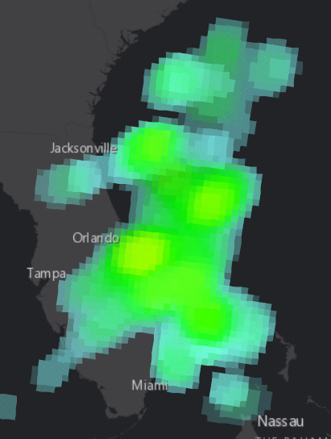
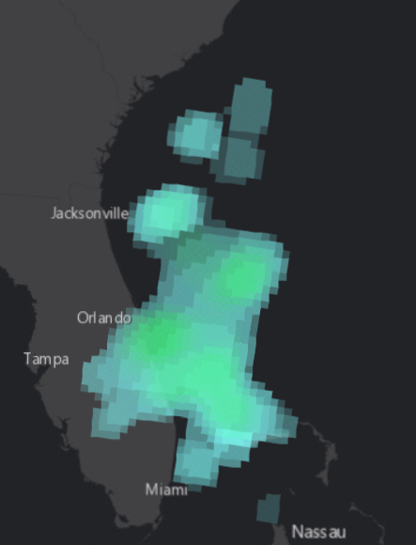
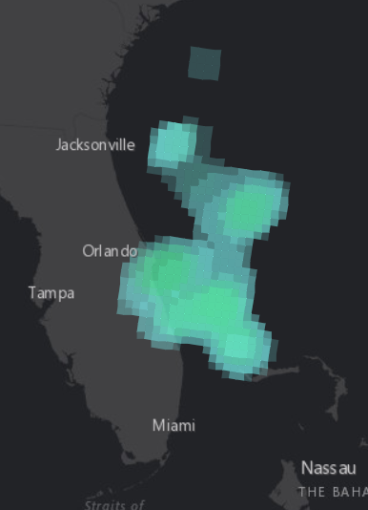
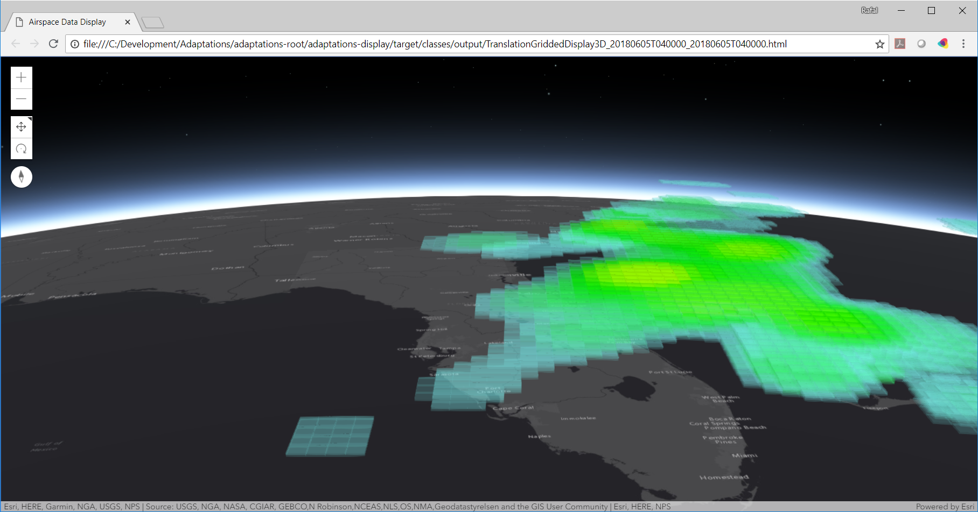
4D Turbulence Avoidance Grids
Best predictors and spatiotemporal filters* used to compute 4D turbulence avoidance grids based on derived pilot behavior models
  Grids defined for each aircraft weight class
4D avoidance grids define common baseline for defining derived turbulence translation outputs
  Avoidance polygons
  Route impacts
  Flight plan impacts
A set of parameters is provided to adjust derivation of translation outputs
  Likelihood of altitude change
  Dwell time
Small aircraft grid
Large aircraft grid
Heavy aircraft grid
3D view of the small aircraft avoidance grid illustrating vertical extent
* Analysis in progress in evaluating and validating TAM predictors for derived pilot behavior models

Slide 13
Summary
Developed a concept of TAM, a turbulence translation technique aimed at providing automated and consistent interpretation of turbulence information relevant for operational decision making
Developed a methodology for analyzing pilot behavior in response to turbulence encounters
    Core component of TAM
Conducted analysis of in situ EDR data and GTGN data to develop models of pilot behavior in response to turbulence encounters
    Tens of thousands of flight trajectories processed
Developed a proof of concept TAM implementation to support analysis, display, and validation of turbulence translation outputs
Next steps:
  Evaluation and validation of pilot behavior models
  Stakeholder feedback on TAM concept and generated turbulence translation outputs
  Documentation of research results

Slide 14
Acknowledgements
This research was funded by the FAA Aviation Weather Research Program (AWRP) under contract DTRT57-12-D-30003, “Aviation Weather and Wake Turbulence.” The guidance of our FAA Technical Monitors, Tammy Flowe and Warren Fellner, is greatly appreciated.
We also acknowledge help from Steve Abelman, Bob Sharman, Julia Pearson, Julie Prestopnik, Robert Lee, and a major US airline for sharing in situ EDR data for analysis.

Slide 15
Contact Information:
Rafal Kicinger
Metron Aviation, Inc.
E-mail: Rafal.Kicinger@MetronAviation.com
Phone: 703 234 0771

