Slide 1
IATA Global Turbulence Database Development
Flight Operations Efficiency
Flight Operations Efficiency
Flight Operations Efficiency
Katya Vashchankova, Head, IATA MET Program
Turbulence Impact Mitigation Workshop, 2018

Slide 2



Current problem with turbulence data: Too little shared
Airline C
Airline B
Airline A
PIREPs
Automated Turbulence
Report
Automated Turbulence
Report
ATC
Airline OCC
Provider X
Current limitation: Too often the case with aircraft flying through turbulence
All 3 aircraft will hit the same turbulence because the data is too often not shared by ATC, nor between airlines or different solution providers
All available data needs to be shared to mitigate turbulence encounters globally
Airlines have requested IATA to be the global turbulence data consolidator
Notes:
True for both tactical and post-flight analysis

Slide 3




Why IATA?
Experience
Portfolio of global data sharing programs for the airlines:
- DDS, CDD, FRED, ACMG, GADM
Global
Global outreach and critical mass
Neutrality
Neutral third party to protect airlines interests – governed by the airlines
Technology
Vendor agnostic solution
Notes:
BSP 370 airlines, on-time settlement rate of 99.999, 236Bl
Fuel reporting and emissions Database 250 airlines

Slide 4

IATA’s role is to facilitate ground-to-ground
turbulence data sharing amongst airlines
Automated Turbulence
Report
IATA’s Role
IATA Global Turbulence Database
(simple real-time data deidentification , security and aggregation)
Ground Server (either airline, or SITA/ARINC/ or airline’s third party
Airline Operation Control Center (ground server) for operational use***
Airline requests data from IATA database
Ground-to-ground data transfer to IATA
IATA sends data back to airline ground server
IATA’s role is to receive existing airline data from ground servers, consolidate data into one database (managed by a specialized, IATA contracted database vendor), and
upon request provide the data back to airlines via ground-to-ground transfer
***Airlines are free to decide how to use the data operationally with their existing dispatch or airborne alerting tools
Notes:
Types of data, promoting NCAR EDR as strong position on data ownership rights

Slide 5
Progress to date
Global Turbulence Study created to validate the need
Regional workshops held in DOH, BJS, SIN, MIA, LON to validated the concept and create a base set of requirements
Buy-in from multiple airlines globally to start build phase
Request for Proposal released to industry in Jan 2018 to build the IATA Turbulence Data Exchange Platform
Snowflake Software selected as partner to build platform
IATA Turbulence Advisory Group established

Slide 6










Highly Collaborative Development
IATA Turbulence Advisory Group:

Slide 7
Platform Implementation Timeframe
Development kick off workshop held in June 2018 in London with 12 major Airlines represented
Jul – Dec 2018: Minimum Viable Product (MVP) operational platform delivered
Jan 2019: Show and tell workshop & soft launch
Feb 2019: Integration & Operational trials with 24/7 support
Feb – Sept 2019: Minor releases based on Operational Trials
Q3 2019: Final show and tell workshop prior to Full launch
Dec 2019: Full launch

Slide 8
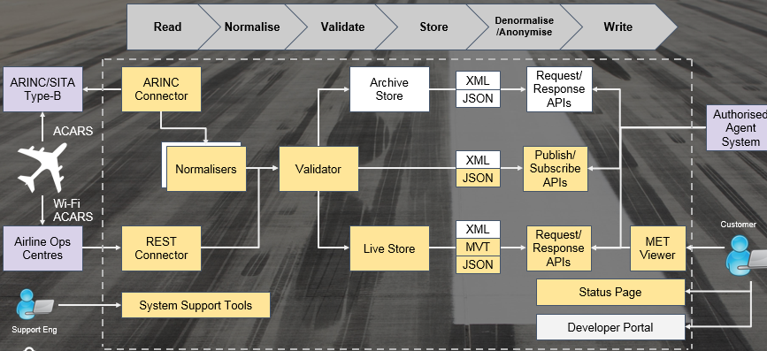
Platform Architecture and Functionalities Developed to Date
Highly Secure
Anonymized Data
Full logging & audit
99.9% Availability
Highly Scalable
24/7 Monitoring
30 seconds for data throughput

Slide 9
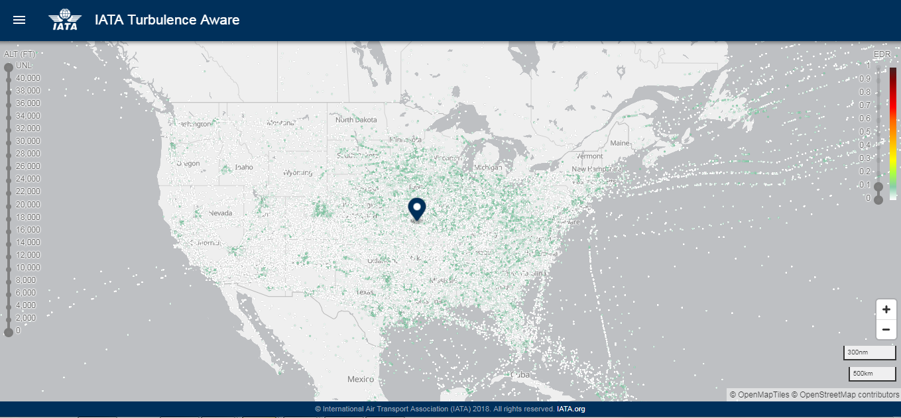
Platform Functionalities Developed to Date
Basic turbulence viewer

Slide 10
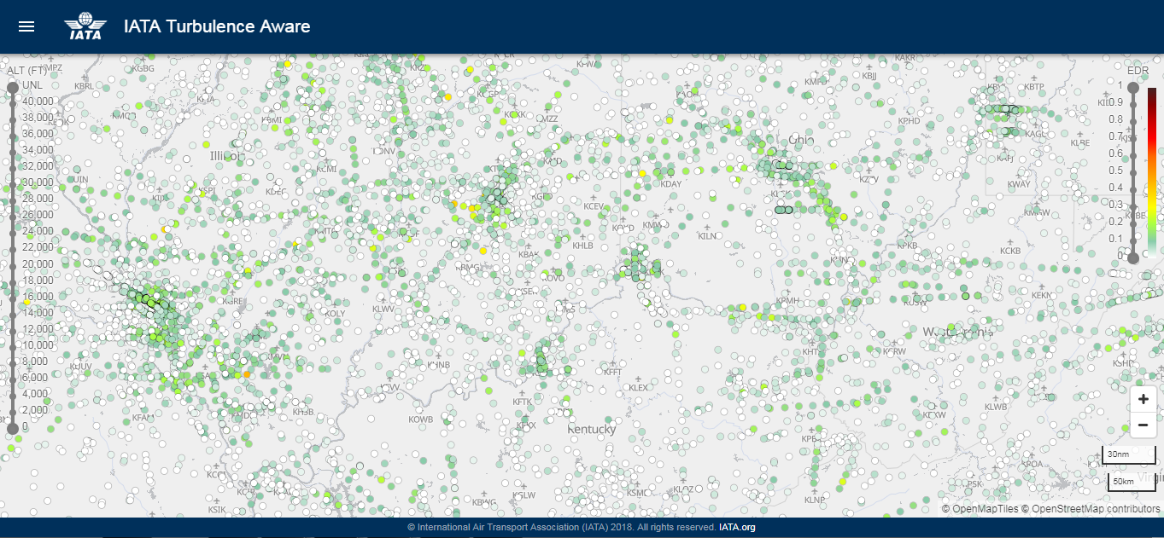
Platform Functionalities Developed to Date
Color coded EDR reports

Slide 11
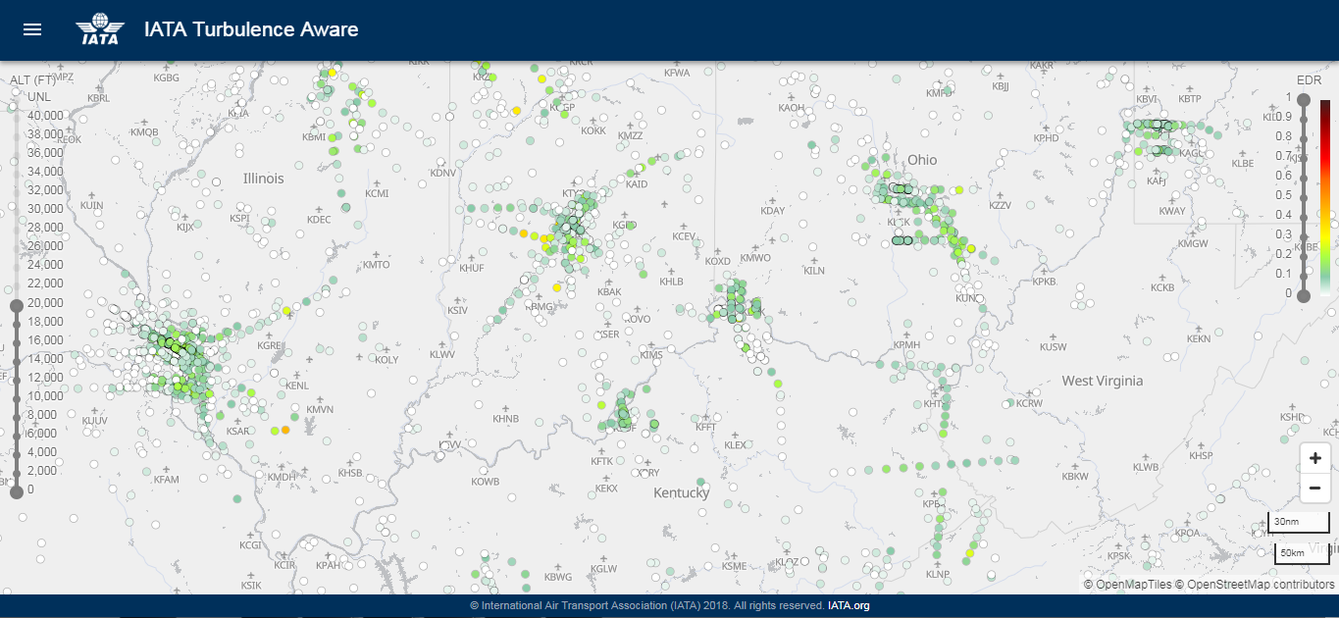
Platform Functionalities Developed to Date
Altitude slider

Slide 12
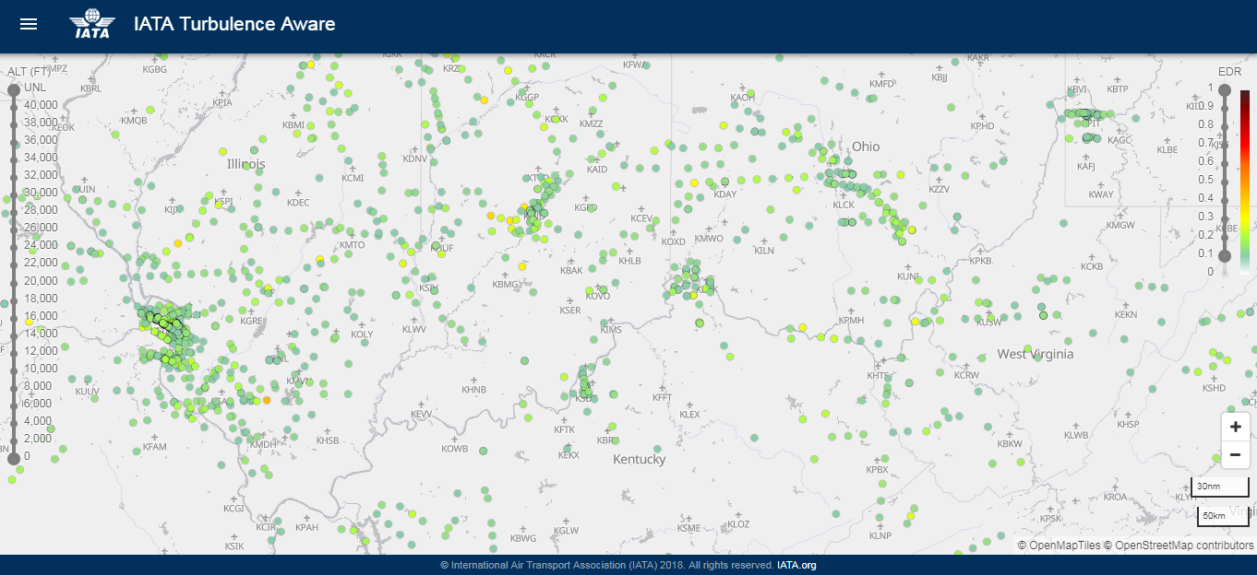
Platform Functionalities Developed to Date
Turbulence intensity slider

Slide 13
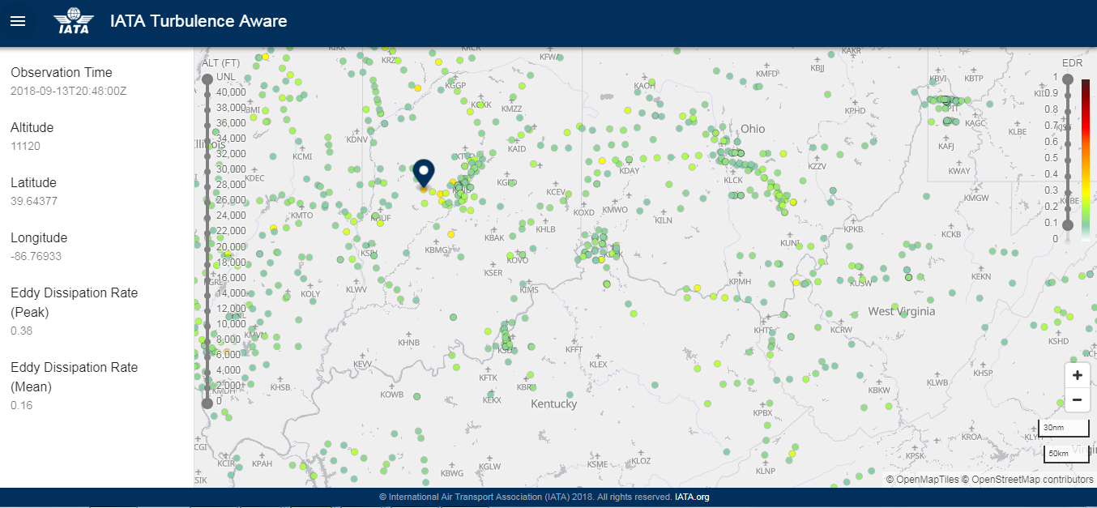
Platform Functionalities Developed to Date
Detailed report

Slide 14
AREAS OF FOCUS in 2018
  Turbulence Data Sharing Platform Development
  Outreach to the airline community to encourage the adoption of reporting technology globally (i.e. critical mass):
    Implementation guidelines on how to implement turbulence reporting capability on the aircraft
  Outreach to technology solution providers to encourage the development of cost-effective turbulence reporting solutions while respecting airlines’ data ownership rights

Slide 15
  Thank you. Questions?

