Slide 1
Forecasting C&V
The Limits of Science
Tom MacPhail Dec 18, 2013

Slide 2
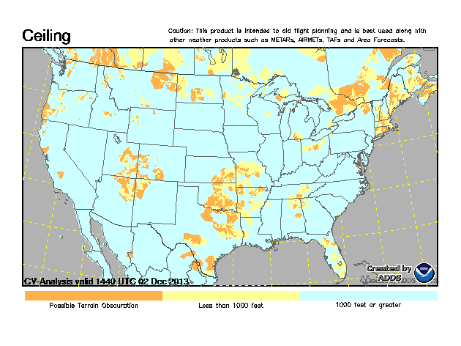
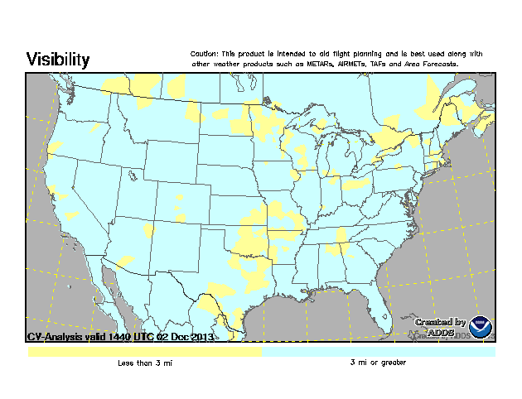
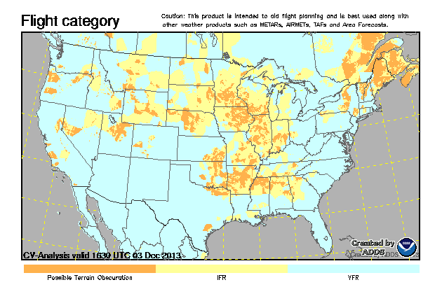
CVA Gridded Product (ADDS)
CVA algorithm underlies HEMS Tool C&V display

Slide 3
The Problem
The output of numerical weather models in gridded weather elements such as C&V is slowly improving. However, the state of C&V science exploited today, and in the foreseeable future, to produce C&V analyses (CVA) may present an unacceptable risk when used for more than flight planning and making “no go” decisions

Slide 4
CVA Characteristics
Collects real-time METAR and SPECI observations from approximately 2000 observing points
Displays output on a 5km X 5km grid (NWS NDFD grid)
Grid points where no METAR exists are assigned C&V values based on “nearest neighbor” interpolation improved by satellite identification of clear areas
Algorithm updates every 5 minutes to capture incremental changes (SPECIs) between hourly METARs
Grid does not extend to offshore areas

Slide 5
CVA Characteristics (cont’d)
Reliability of the interpolated grid values decreases with distance from a METAR report
Reliability is further diminished for areas where terrain or other localized influences dominate
CVA can resolve discreet C&V values but output is categorized to avoid perception of greater skill than the product has been shown to deliver
CVA has a “Precautionary Use Statement” that highlights the product’s intended purpose and characteristics
In 2011, CVA was approved for operational use as a supplementary product for flight planning purposes only

Slide 6
CVA Precautionary Use Statements
This product is for flight planning purposes only and should always be used in combination with ceiling and visibility (C&V) information from official sources such as METARs, AIRMETs, TAFs and Area Forecasts. CVA (Ceiling and Visibility Analysis) is intended to aid situational awareness with a quick-glance visualization of current C&V conditions across an area or along a route of flight. CVA derives C&V for areas between METAR stations so may, as a function of distance from a METAR, misrepresent actual conditions. See the Help Page for additional information on CVA use and limitations.
Cautionary Note to CVA Users The skill of METAR and satellite observations declines with distance from the nearest METAR station, and in variable terrain. VFR pilots and IFR pilots who are not fully proficient and fully equipped for flight under IFR conditions should use increasing caution as distance from the nearest METAR station increases and in areas of variable terrain. CVA is a current, real-time analysis only. It does not represent a forecast, nor can it be used to infer a forecast.

Slide 7
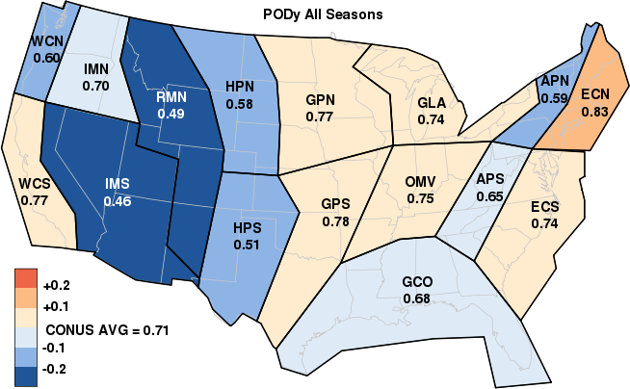
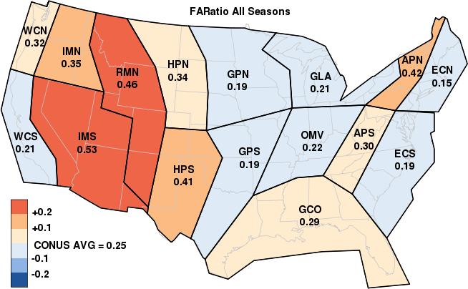
CVA Performance
(QA Report: NCVA Product, Jan 28, 2010)

Slide 8
QA Report Key Conclusions
CVA adds significant value to flight planning by:
  Effectively detecting IFR events and reducing risk throughout the airspace (PODy = 0.71)
  Effectively reducing false alarms of IFR events, resulting in more efficient use of the airspace (FARatio = 0.25)
  Capturing incremental changes every 5 minutes
  Performing at least as well as the NWS’s Weather Depiction Analysis (though one-to-one comparison is difficult)
“Derived” grid point reliability decreases rapidly with distance from a METAR; more so in areas where diverse orographic influences prevail

Slide 9
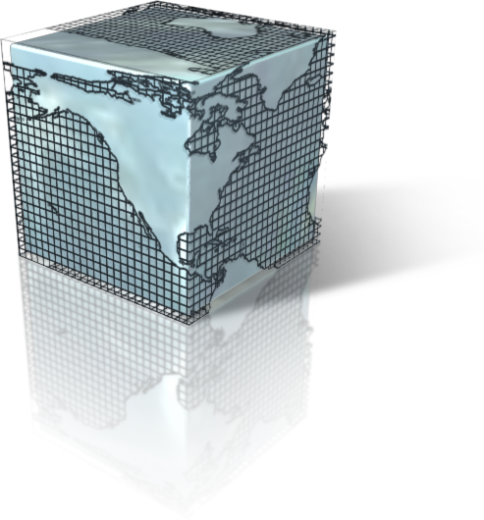
CVA Grid Methodology
A single C&V category value is calculated for each grid point where no weather report exists using the CVA algorithm
Any C&V or categorical variation within the boundaries of this grid box is not resolved; only one value or category is displayed per box
Derived grid points tend to be algorithmically “smoothed” and their accuracy decreases with distance from an initializing data point(s)

Slide 10
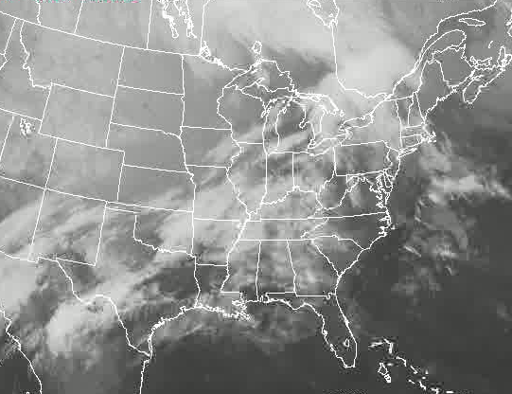
Fluid vs. Discreet
The atmosphere behaves fluidly; even discontinuities along fronts are “fluid” at sufficiently high resolution
Gridding creates discreet, artificial boundaries based on the defined grid size/shape

Slide 11
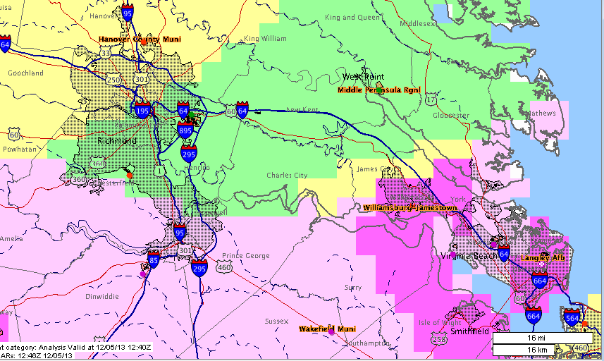
HEMS Display on 12/5/2013
METAR
METAR
METAR

Slide 12
Digitizing a “Fluid”
C&V rarely exhibits abrupt changes over time and space (depending on resolution) but rather changes gradually
The reliability of gridded depictions of “fluid” weather is dependent on:
  Availability of input data used to create the grid
  Temporal/spatial resolution at which the grid is displayed
  The degree to which the algorithm used to derive grid values can accurately represent physical processes
CVA grids represent “ground truth” only at METAR points and are derived with degraded reliability as distance from a METAR increases

Slide 13
Initializing Data Density is Critical
Numerical grids at 3-5KM resolution approach the scientific and computational limits of what can be reliability displayed using today’s METAR network
More (spatially and temporally) initializing data is needed to support reliable, higher resolution grids
  AWRP is sponsoring research to determine the feasibility of harvesting FAA weather camera visual imagery in Alaska
  More real-time data also needed from airborne sensors, highway sensors/cameras, vehicle systems, etc.
  More data supporting higher resolution grids that are updated more often consume bandwidth and computational resources

Slide 14
Additional Grid Challenges
Assessing the quality of derived data relies on indirect methods which themselves are “derived”
Comparing advanced gridded products to legacy human-drawn products is an “apples to oranges” proposition which is often relegated to a qualitative approach
Scale matters; Weather grids facilitate overlays on maps but a course weather grid on top of a much higher–resolution map leads to erroneous perceptions about the resolution of the weather data

Slide 15
Mitigating Grid Limitations
Thresholds: Grid display is typically limited to a defined value range
  HEMS Tool displays LIFR, IFR, MVFR, VFR & Terrain Obsc (TO)
  CVA is further “degraded” to only IFR, VFR & TO
Frequent updates: 5-minute for HEMS Tool and CVA
Historical trending: 3-hr loop back on the HEMS Tool
Addition of uncertainty information
Restrict product use and/or place product characteristic information on the display

Slide 16
Final Thoughts
Rules and policies for the production and use (including required quality) of automated grids is not fully resolved
  Is HITL/HOTL required for regulatory weather information?
  What differentiates regulatory products from planning guidance?
Depending on above, state of C&V science may be inadequate to support unrestricted use of the HEMS Tool
Overlaying today’s coarse weather grids on higher resolution navigation maps is problematic

Slide 17
Questions or comments?

