Slide 1
Safety Risk Management (SRM) Process Overview
Presented by: Everette C. Whitfield
Date: December 18, 2013 v0.2

Slide 2
Agenda
Introduction
System Overview
Hazard Analysis Process
  Describe System
  Identify Hazards
  Analyze Risk
  Assess Risk
  Treat Risk
Close
  Action Items
  Next Step

Slide 3
Objective
SRM
  A methodology applied to all NAS changes
  Ensures hazards are identified
  Ensures an unacceptable risk is mitigated and accepted prior to making change
A NAS change is any change to or modification of
  Airspace
  Airports
  Aircraft
  Pilots
  Air navigation facilities;
  Air traffic control (ATC) facilities
  Communication
  Surveillance, navigation and supporting technologies and systems
  Operating rules
  Regulations, policies, and procedures; and
  People who implement, sustain, or operate the system components

Slide 4

AWD Safety Risk Analysis Phases
Phase I
Phase II
Phase IV
Phase V
Does it affect the NAS?
Could this introduce safety risk into the NAS?
Is Risk level Acceptable
Risk level acceptable documented in SRMD
Change Proposed
Further safety analysis conducted
Yes
Yes
No
No
No
Phase I
Phase III
No further analysis necessary
Risk level Unacceptable documented in SRMD
No further safety analysis necessary
Decision documented in SRMDM
Note: Reference Phase V, mitigations initiatives can
change previously "Unacceptable" threats to "Acceptable"

Slide 5
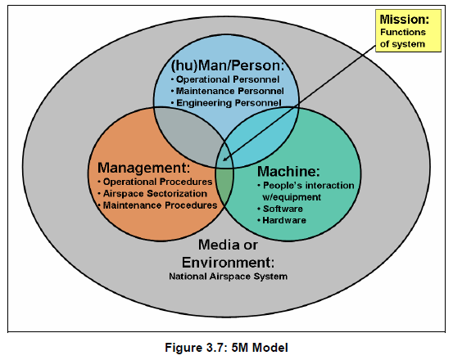

Slide 6
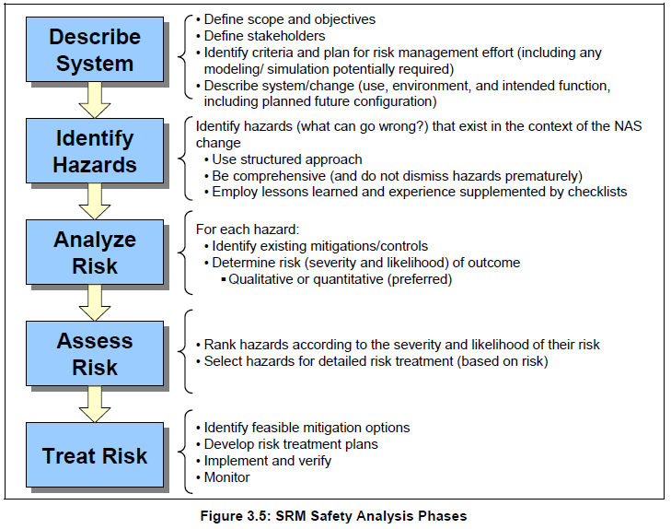

Slide 7
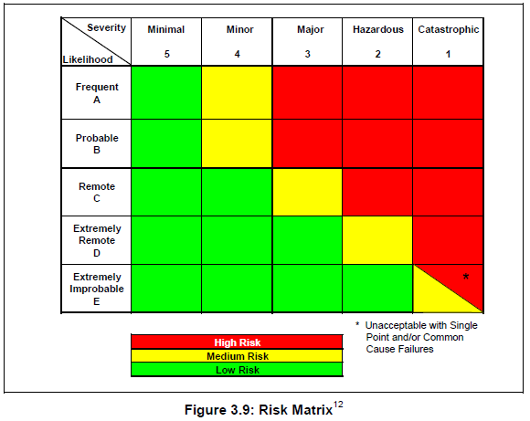

Slide 8
QUESTIONS?

Slide 9


