Slide 1
HEMS-related Aviation Weather R&D
Steve Abelman Dec 18, 2013

Slide 2
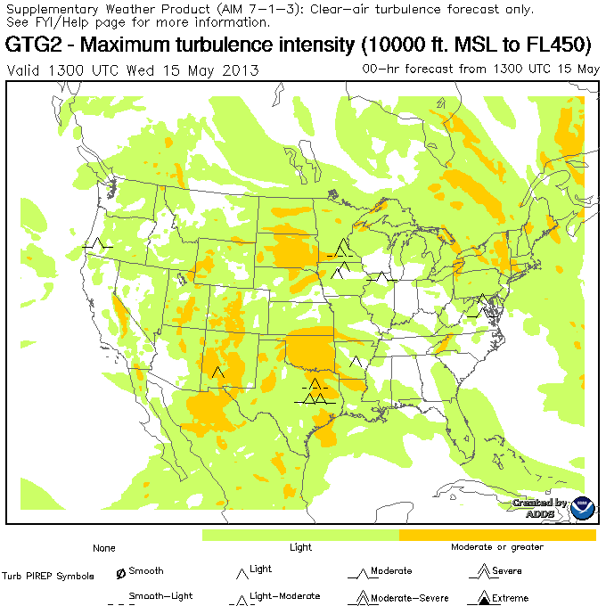
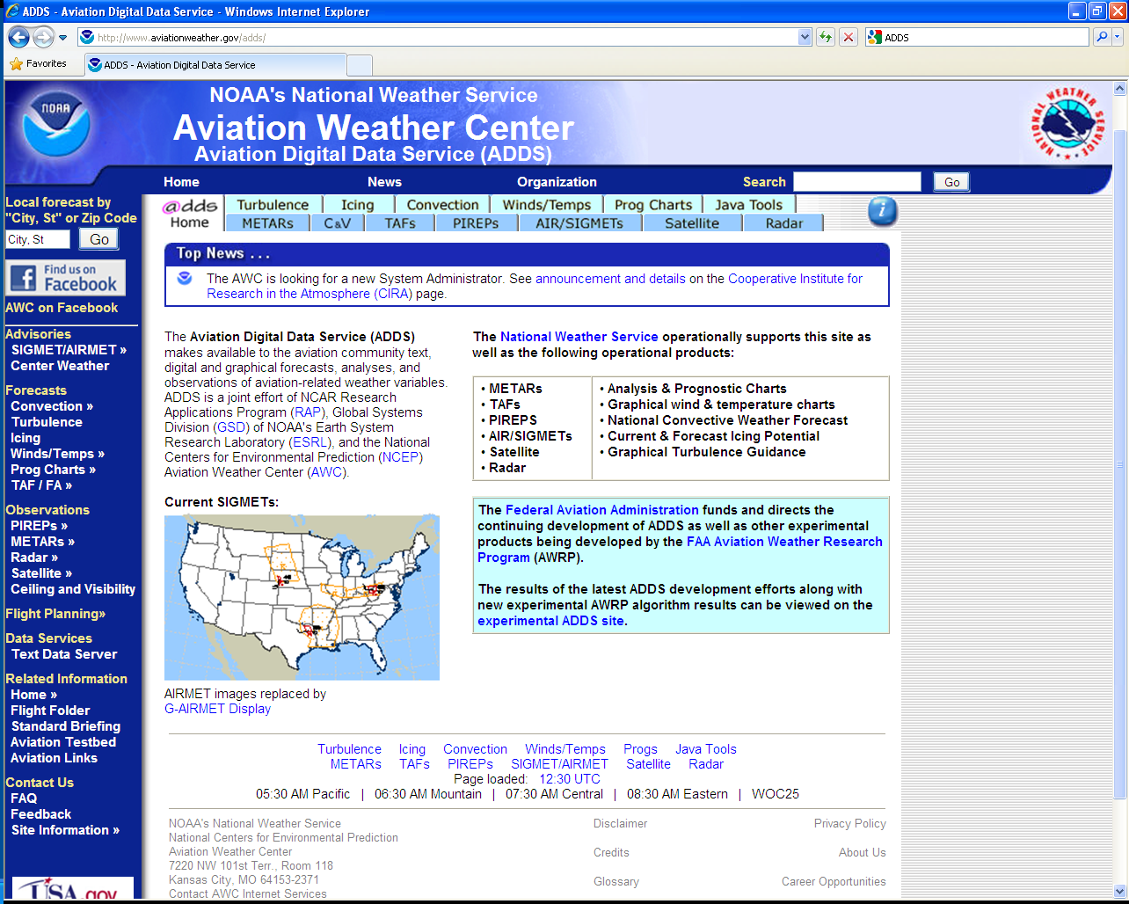
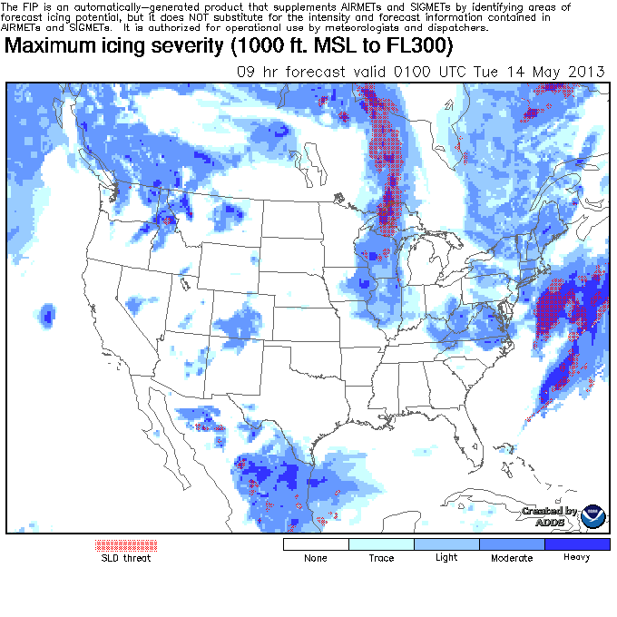
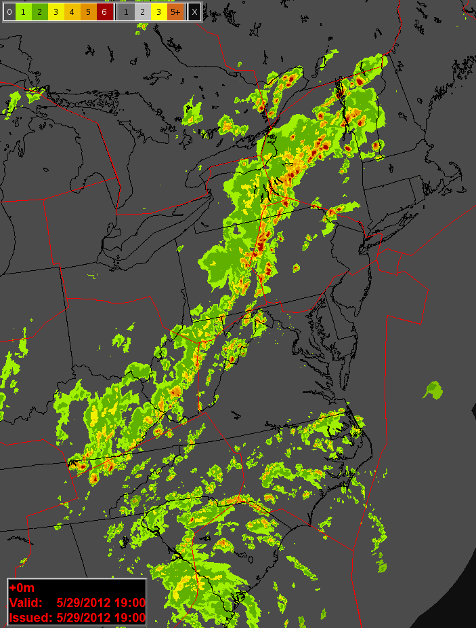
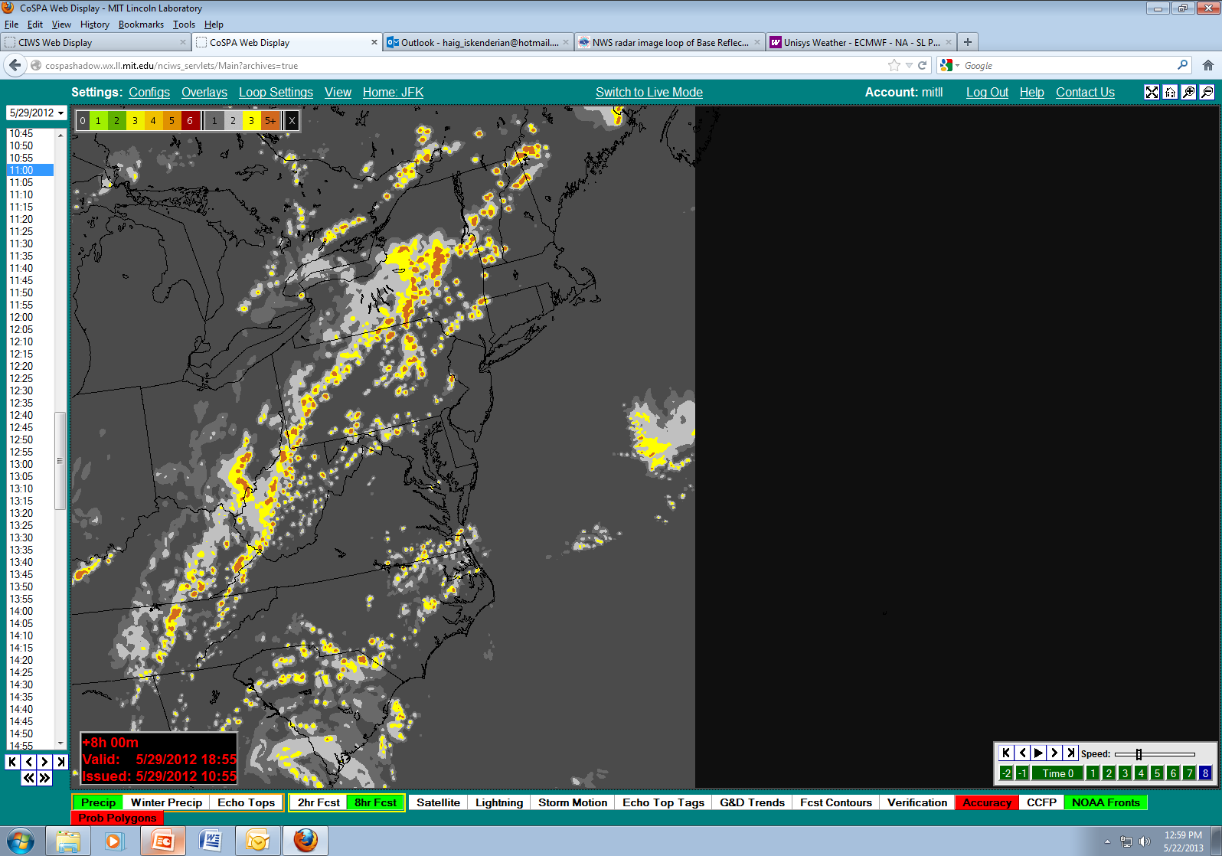
Aviation Weather Research Program
  Applied research to minimize NAS weather impacts by:
    Meeting specific NextGen Operational Improvements
    Mitigating weather-related safety and/or efficiency issues
    Evolving weather information contained in today’s legacy capabilities to meet emerging NextGen requirements, often in collaboration with the NWS

Slide 3
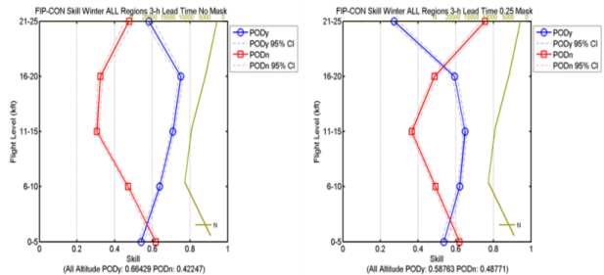
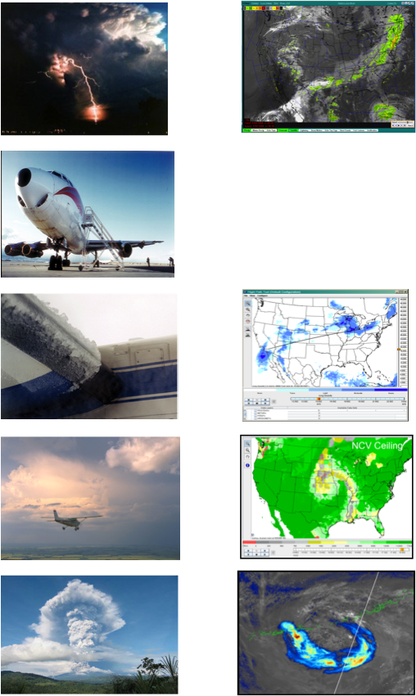
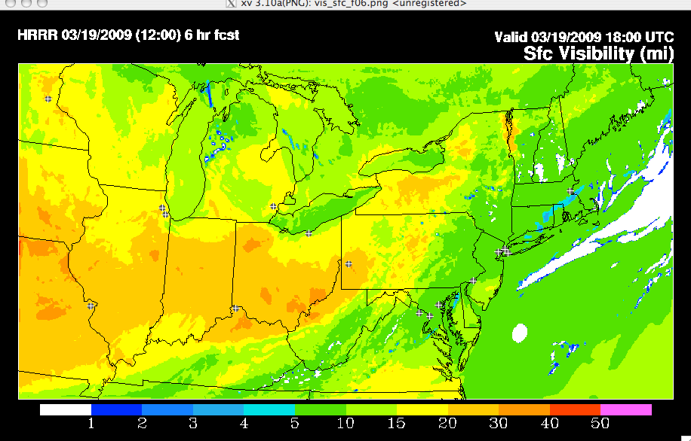
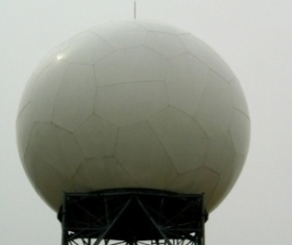
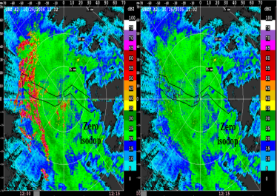
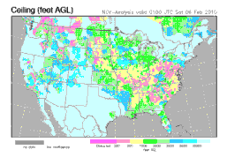
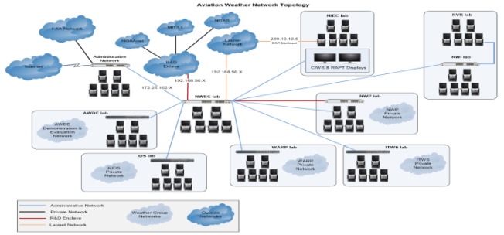
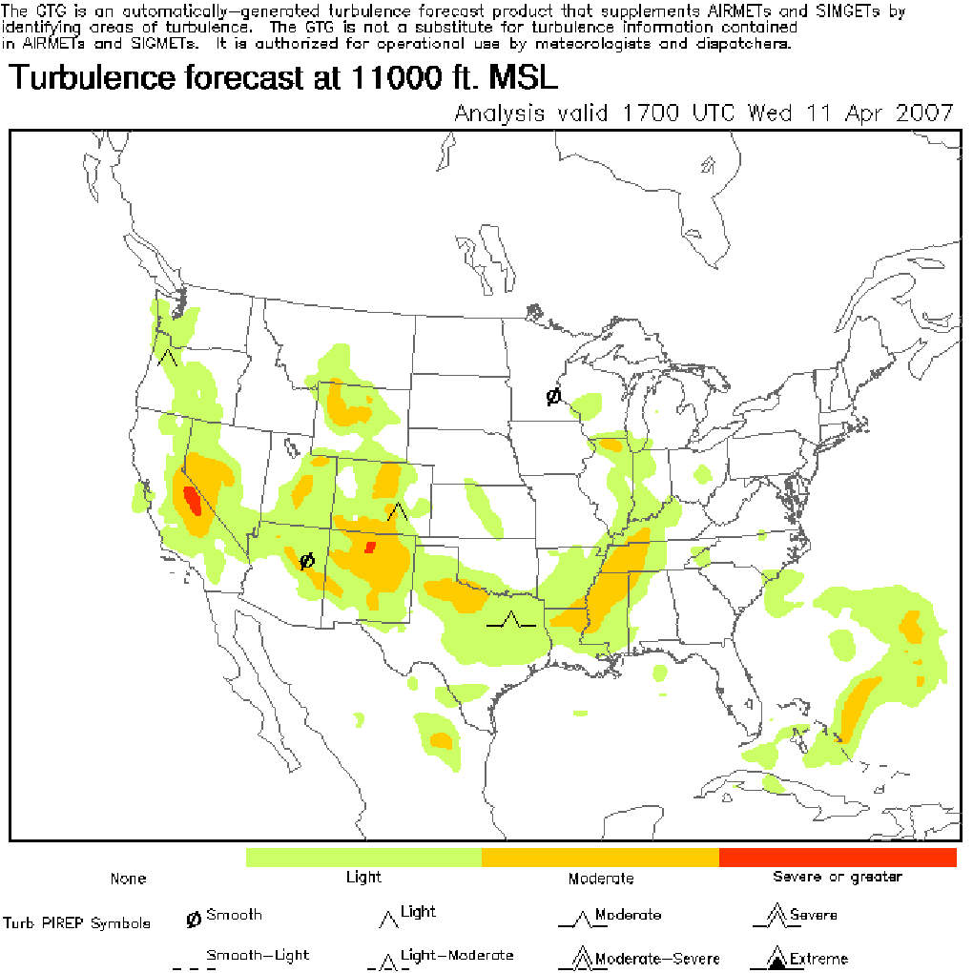
Aviation Weather Research Program
Wx Hazard
Wx Information
Conv. Storms
Quality Assessment
Turbulence
Modeling
In-Flight
Icing
Radar
Techniques
Ceiling &
Visibility
Volcanic Ash
Evaluation
Notes:
3

Slide 4
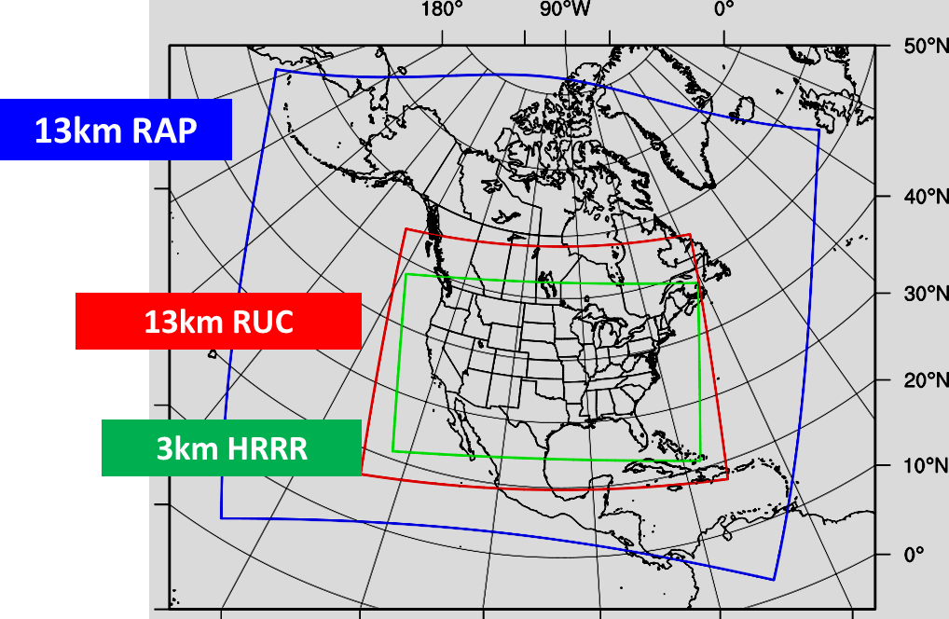
Numerical Modeling
Why?
Improve operationally available (at NWS) model resolution and refresh rates to enhance nowcasts and forecasts of aviation hazards including in-flight icing, turbulence, convective storms, and ceiling & visibility
What Has Been Accomplished?
3km, High Resolution Rapid Refresh (HRRR) model running at NOAA ESRL
Implementation of WRF-RAP (13km hourly forecast including AK,) operational at the National Weather Service (NWS)

Slide 5
MD&E: What’s Coming?
Research targeting 0-24 hour high-resolution, rapid refresh ensembles to support probabilistic forecast products as well as a global model with 1-2km resolution and 5-10 minute refresh rate
Improvements in model forecasts (resolution, accuracy, coverage, probabilistic) of aviation specific weather hazards

Slide 6
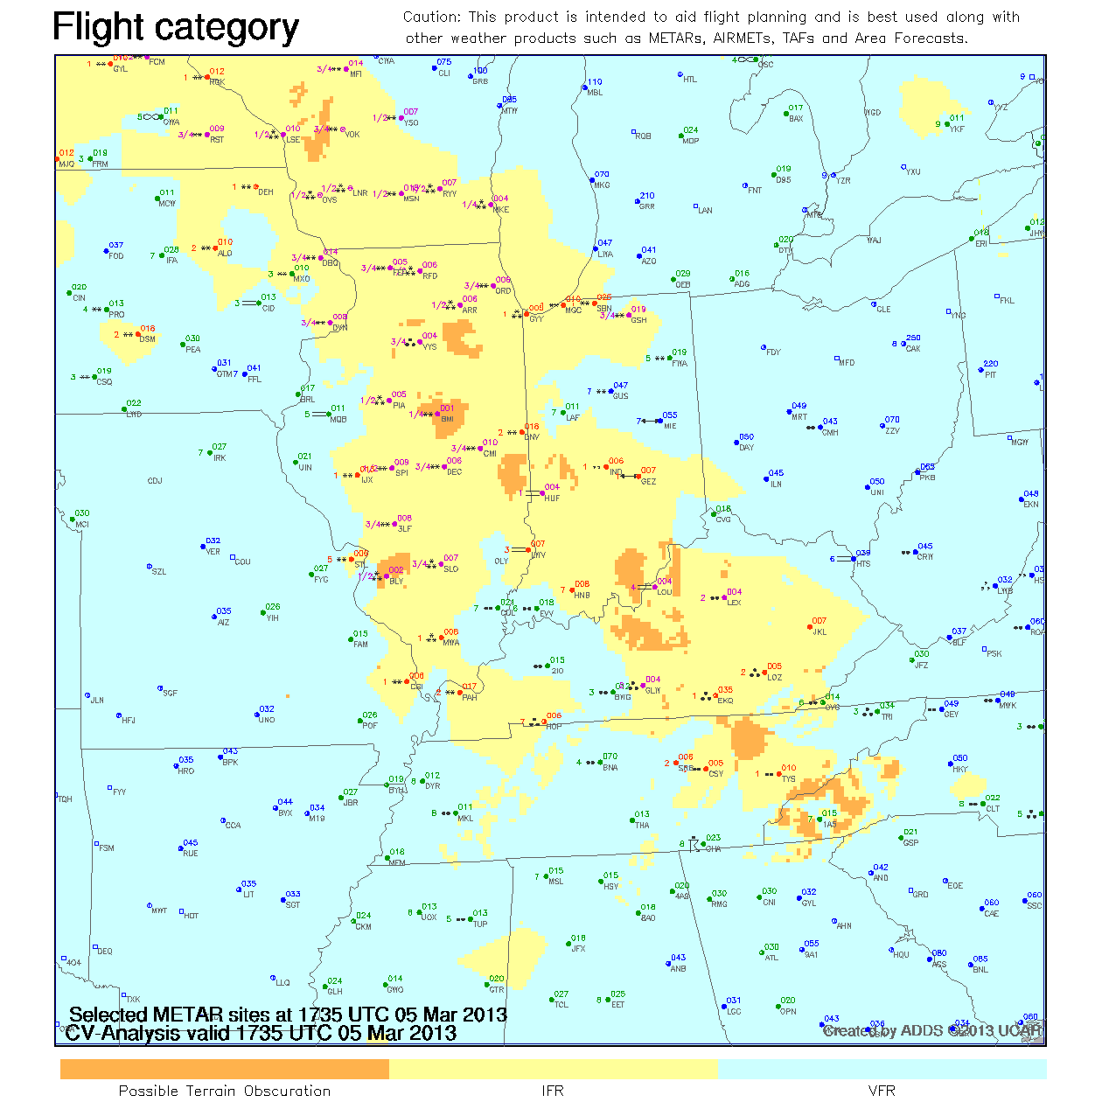
C&V
Why?
To produce advanced C&V detection and forecast algorithms that can mitigate the safety, capacity and efficiency impacts of low ceilings and visibility in the NAS
What Has Been Accomplished?
Operational implementation of CVA on ADDS in 2012
New focus on exploitation of “non-traditional” data sources to improve gridded C&V analyses over data sparse regions

Slide 7
C&V: What’s Coming?
  AK-CVA Feasibility Assessment and Concept of Operations leading to an experimental prototype
  Display enhancements to the HEMS Tool
  HEMS Tool migration to operational ADDS

Slide 8
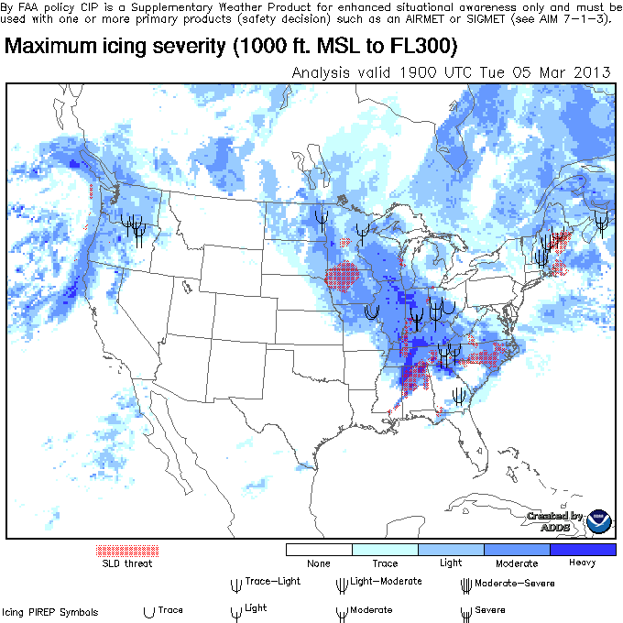
In-Flight Icing
Why?
To produce advanced in-flight icing detection and forecast algorithms that can mitigate the safety, capacity and efficiency impact of aircraft icing on the NAS
What Has Been Accomplished?
Enhancement to operational CIP and FIP on ADDS to enable use of WRF-RAP delivered to AWC and implemented operationally
CIP-FIP high-resolution algorithms to AWC for operational testing & validation
Using Alaska HRRR model data and polar-orbiting satellite to enhance development of Icing Product Alaska

Slide 9
In-Flight Icing: What’s Coming?
Aircraft-specific icing severity estimates (MICRO)
  Hi-res, in-flight icing diagnosis and forecast that contains frequently-updated fields of liquid water content, drop size distribution, and temperature
Icing Product Alaska (IPA); forecast and a diagnosis of icing over Alaska
Bug fixes, upgrades, and minor logic fixes to CIP/FIP Hi-Res required after testing and validation by AWC
Evaluation NEXRAD dual-polarization and assessment of the feasibility of its use for icing diagnoses and forecasts

Slide 10
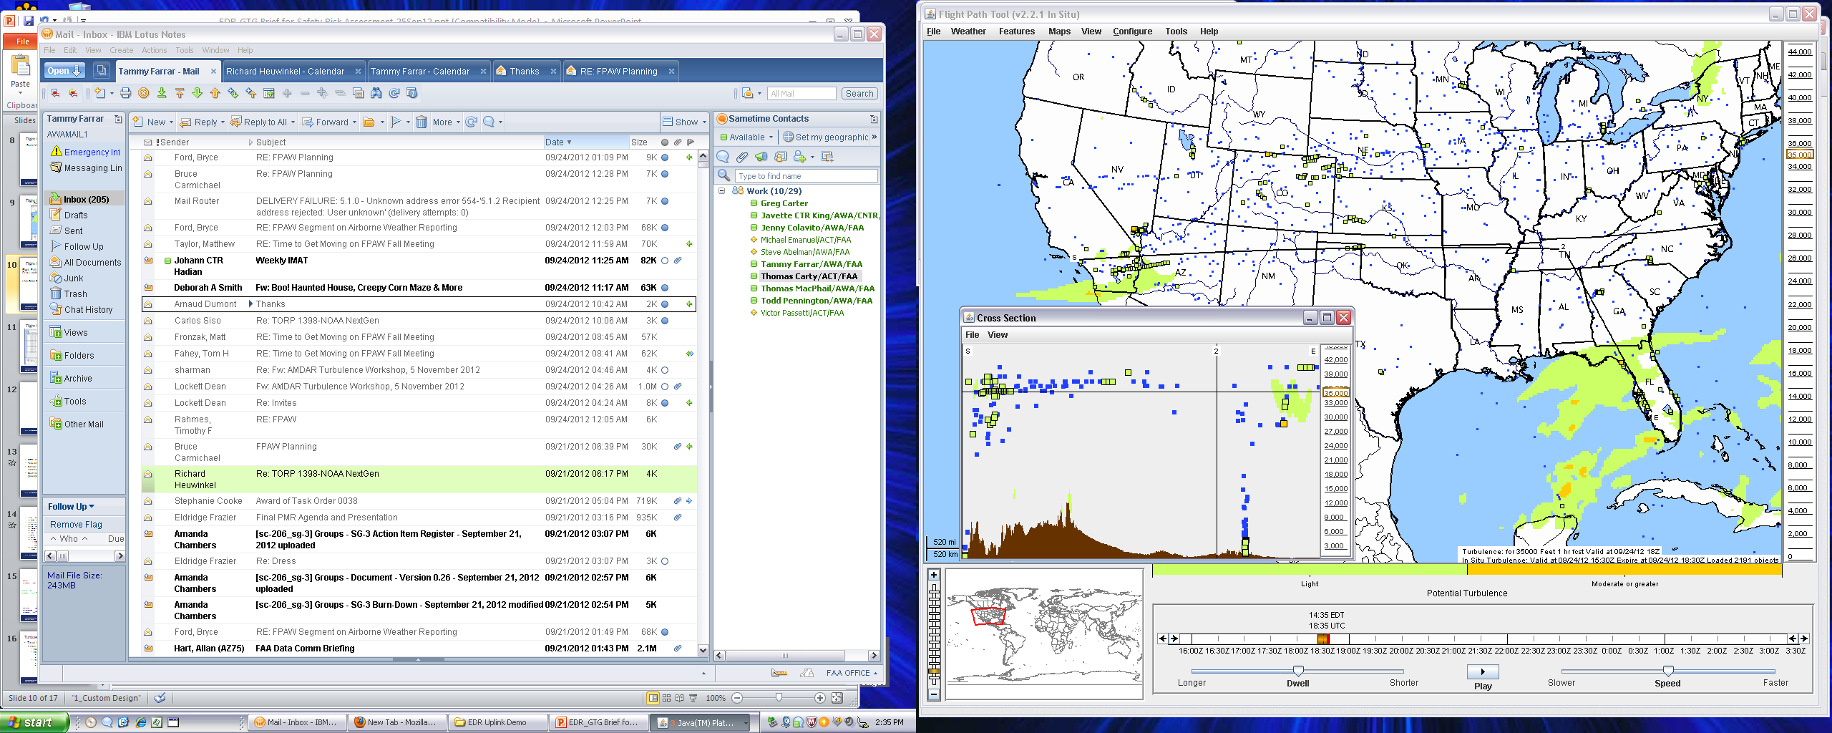
Turbulence
Why?
To produce advanced turbulence detection and forecast algorithms that can mitigate the safety, capacity and efficiency impact of turbulence on the NAS
What Has Been Accomplished?
Graphical Turbulence Guidance (GTG) in operational use on ADDS
Deployment of in situ Eddy Dissipation Rate (EDR) turbulence detection algorithm
In response to an NTSB recommendation, completed study simulating results of DIA wind gust event using higher resolution numerical weather prediction models

Slide 11
Turbulence: What’s Coming?
Improved turbulence observation capabilities for strategic and tactical use
Expanded GTG nowcast/forecast capabilities to include mountain wave and convectively induced turbulence for all flight levels surface to FL 450
Development of an operational capability to remotely sense turbulence (i.e., with satellites and radar)

Slide 12
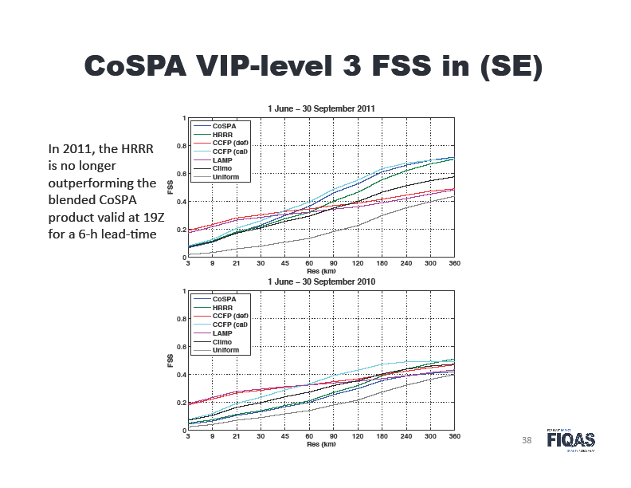
Quality Assessment (QA)
Why?
To provide an independent assessment of weather product quality in an operational context w/comparison to other forecasts and to provide verification and validation of transitioning AWRP products
To conduct ongoing R&D on enhanced verification methodologies and tools
What Has Been Accomplished?
CoSPA 2011 Evaluation
Further VRMC development w/turbulence
Study on alternate turbulence observation data sets for GTG3 evaluation
Validated CALIPSO satellite data for CIP/FIP evaluations
Completed FCI enhancements paper and further VRMC development w/turbulence
Completed CIP/FIP Hi-Res Evaluation

Slide 13
QA: What’s Coming?
GTG3 Evaluation in progress
CIP/FIP MICRO Evaluation – 02/2014
CoSPA Uncertainty Measures Evaluation – 02/2014
Alaska Icing Diagnosis Algorithm – 08/2014

Slide 14
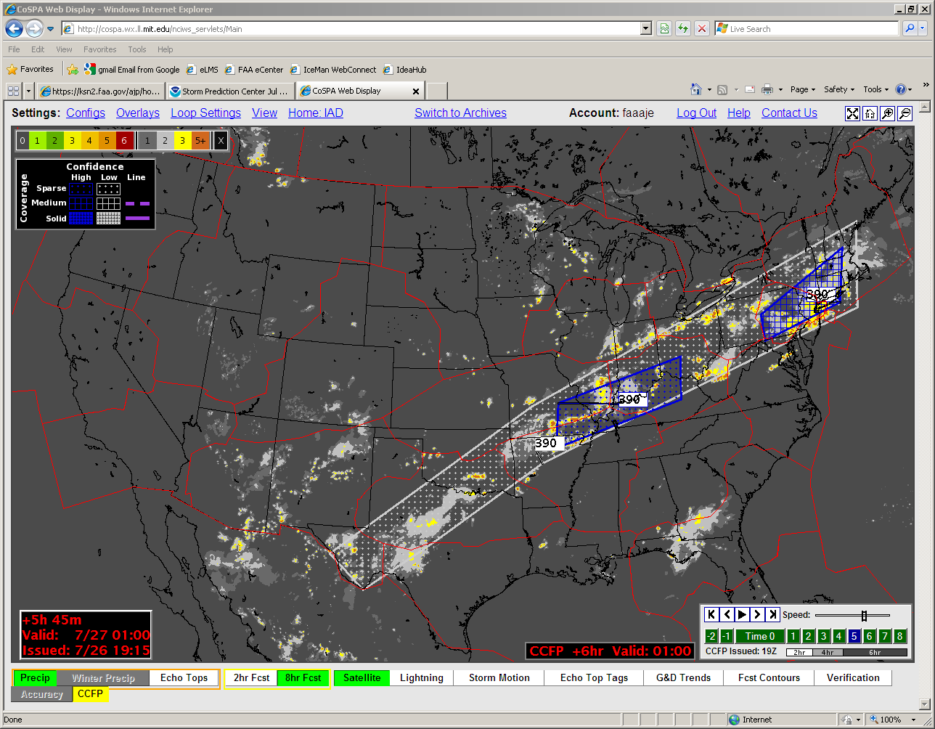
Wx Uncertainty
Why?
To determine NAS users’ and operators’ understanding of uncertainty inherent in all weather information and to understand how they apply that understanding to decision making
What Has Been Accomplished?
MIT Lincoln Labs, NWS Aviation Services Branch and NASA Ames coordination to evaluate how they incorporate uncertainty into weather products
Survey of TRACON, ARTCC, tower and ATCSCC personnel to understand their comprehension of weather uncertainty and current use of probabilities
Completed FAA-funded research study on “Understanding Convective Weather Forecast Uncertainty Needs of ATM”

Slide 15
Wx Uncertainty: What’s Coming?
Baseline for future weather products that will create a common understanding of weather uncertainty and establish best practices for the application of uncertainty information to operational decisions and decision-making processes

Slide 16
In addition:
AVS receives a portion of AWRP funding and prioritizes it’s own activities (in collaboration with AWRP). Initiatives include:
  High Ice Water Content
  TAIWIS
AWRP will continue to work collaboratively with NWS on ADDS enhancements and improvements
The Research, Engineering, & Development Advisory Committee (REDAC) has tasked AWRP and WTIC to review accident and incident statistics to evaluate AWRP initiatives

Slide 17

Questions?

