Slide 1
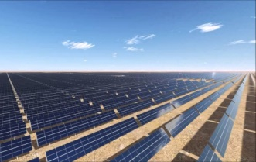
Wind Resource and Energy Assessment
a Consultant’s Perspective
October 19th, 2020
Philippe Beaucage, PhD
Lead Research Scientist

Slide 2
Wind Resource Analysis
1. Acquire Monitoring Stations and Site Information
2. Data Validation and Analysis
5. Model the Wind Resource Spatial Distribution
3. Estimate the Long-Term Wind Speed at Monitoring Stations
4. Extrapolate the Wind Speeds to Hub Height
6. Estimate the Energy Production and Uncertainty
Notes:
Let me start by showing the different steps in a wind resource analysis, basically after having monitored the wind resource for a year or more.
The end goal of a wind resource analysis is to accurately estimate the energy production and uncertainty, typically the P50 (average) and the P90/P95/P99 (uncertainty)

Slide 3
Typical Contributions to Energy Risk
Notes:
This is perhaps not news to all of you, as of course estimating wind resources has always been a challenge and a significant source of uncertainty in energy production estimates. This pie chart shows a typical breakdown of the contributions to the uncertainty of wind projects, with the familiar categories of wind measurement, long-term climate correction or MCP, wind shear, wind flow and wake modeling, and non-wake plant losses. It shows that most of the uncertainty is related in one way or another to the characterization of the resource. The largest single category is often wind flow. But it is difficult to reduce the overall uncertainty without addressing most of these factors.

Slide 4
Industry Challenges with Wind Flow Modeling
Spatial resolution must be ~50 m or better over a domain ~25 km or larger
Must simulate a wide range of atmospheric conditions
High-fidelity models require much more runtime and expertise than simpler models
Time is limited
→ clients expects a wind resource analysis in 2-3 weeks
Clients are limited in what they can spend
→ on the order of $1000-$5000 for wind flow model outputs
Notes:
Typical wind plant capacity in North America is on the order of 100 MW. In France on the other hand, wind farms have only a few turbines very close to a single mast and in flat terrain. In Brazil the wind farms are even larger than in the US and are frequently located in moderate to complex terrain.

Slide 5
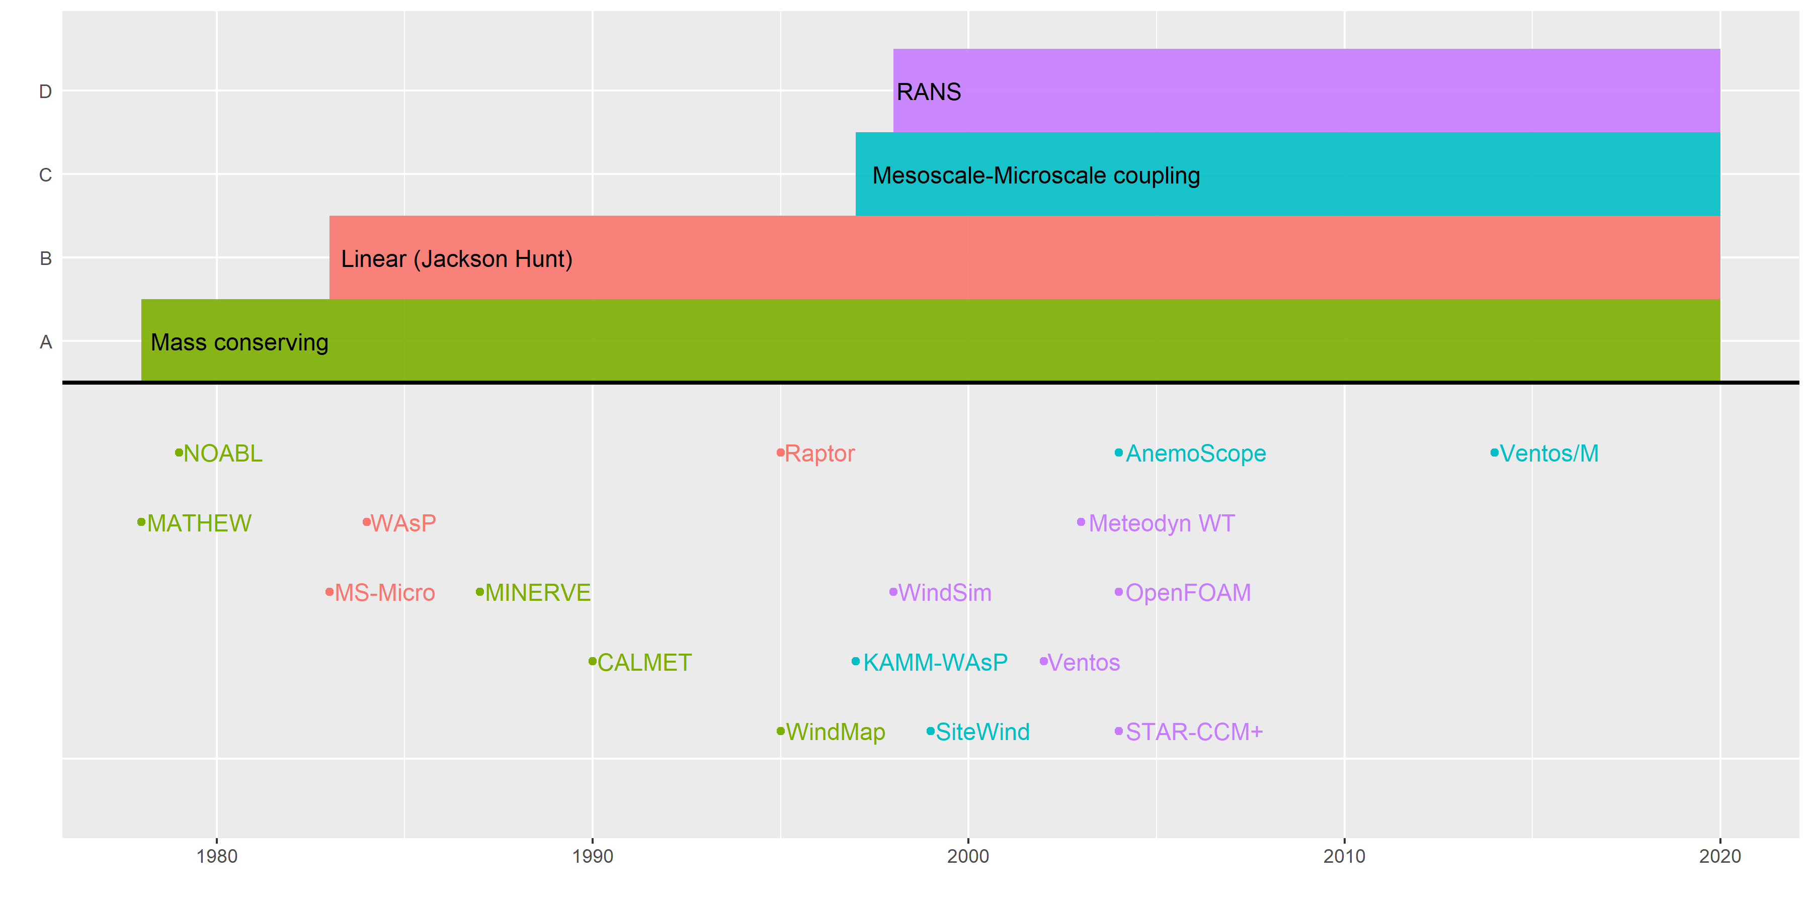
History of Commercial Wind Flow Models
Notes:
A wide variety of models have been developed reflecting – available computing power – the developer’s understanding of the physical processes most relevant to wind energy. Although there are exceptions, most models are physics-based and are built around a discretization of the Navier-Stokes equations
Generally speaking, coupled mesoscale-mass consistent models as well as CFD/RANS models are popular in North America. In Europe, CFD/RANS models are prevailing although WAsP may be used in simple terrain.

Slide 6
Fidelity Level of Wind Flow Models
LES = Large Eddy Simulations
CFD = Computational Fluid Dynamics
RANS = Reynolds-averaged Navier-Stokes
Coupled
mesoscale –
LES
(e.g. WRF)
Coupled mesoscale –
CFD/RANS
(e.g. Ventos/M)
Coupled mesoscale –
mass-consistent (e.g. Sitewind)
CFD/RANS (e.g. OpenFOAM)
Linear (e.g. WAsP)
Notes:
As I’ve shown, there’s a broad range of wind flow models currently used for bankable energy production report (aka energy yield assessment).
There are no standards, national or international, for wind flow modeling but the IEC 61400 – 15 is in progress.
Cost-benefit analysis is required.
→ By relying on WRF LES, is it going to lead to 10% or 0.1% improvement in accuracy or reduction of uncertainty for the wind flow modeling?

Slide 7
Example of a Validation of Wind Flow Models
UL’s internal validation at 9 sites mostly in North America and Spain
Linear
RANS
Coupled mesoscale
and mass-consistent
Taken from Michael Brower’s presentation at EWEA WRA conference in 2013
Notes:
We do perform “backcast” studies every couple of years. Things have improved over the last 10 years. But the validation of wind flow models is limited and different for each company

Slide 8
How can we do better?
Better understanding of model errors
Running higher fidelity models
Coupled mesoscale & CFD/RANS model → no time dimension
Coupled mesoscale & LES model → with time dimension
Use high fidelity models to develop/inform improved reduced order models
Improved physics parameterization schemes
Ensemble modeling
Advanced bias correction based on machine learning and/or artificial intelligence tools
Notes:
How to do it well is not straightforward
How can we speed up high-fidelity models to make them more accessible to the industry?
Wait for CPU clock speed to increase?
GPU-accelerated WRF?

Slide 9
Turbine-Induced Wake Modeling
There are no standards for wake modeling but many in the industry rely on “engineering” or linearized RANS models
For turbine layout optimization, reduced order models will remain the norm for the forseeable future
Development is needed in some key areas
Improving wake models to handle different thermal conditions, wake meandering, etc.
Integrating wind flow and wake models
Need more validation
Not easy to tease out wakes losses in operational plant data (SCADA)
Wake losses tend to be much larger at offshore wind farms than onshore on average

Slide 10
Wind Resource and Energy Assessment in 10 years
Reanalysis data will reach spatial resolutions on the order of 10 km
Running high fidelity models:
mesoscale model coupled with CFD/RANS or LES
GPU-accelerated WRF?
Ensemble modeling
Integrating wind flow modeling and wake modeling
Time series energy modeling (rather than mean wind flow by direction sectors)
where all types of plant losses are tracked separately, at the turbine level and on a 10-minute interval
High-resolution climate modeling for impact of climate change and climate oscillation (ENSO, PDO, etc.) on wind resource over the next 10-20 years

Slide 11
Final Remarks
Need more Verification & Validation (VV) as well as Uncertainty Quantification (UQ)
Cost-benefit analysis of running a high-fidelity model vs. current methods
There are still some technical challenges to be addressed with running WRF LES
DOE to bridge the gap between the academia and the industry
Publicly funded research can be useful but needs to be closely coordinated with the industry

Slide 12
Philippe Beaucage, PhD
Lead Research Scientist
philippe.beaucage@ul.com
UL Renewables
https://aws-dewi.ul.com/

