Slide 1

WORKSHOP on ATMOSPHERIC CHALLENGES FOR THE WIND ENERGY INDUSTRY
Purpose: Discuss the Future Sponsored by:
of Atmospheric Modeling DOE Mesoscale to Microscale
Research for Wind Energy Coupling Team
u.s. DEPARTMENT OF Energy Efficiency &
ENERGY Renewable Energy

Slide 2
Workshop Goal
Promote conversation between the research community and industry regarding wind energy modeling research needs
Hear from industry regarding their current modeling, plans for the future, and perception of research needs
Present current state of atmospheric modeling research
Forge a dialog that will inform future research in atmospheric / oceanic modeling for wind energy

Slide 3
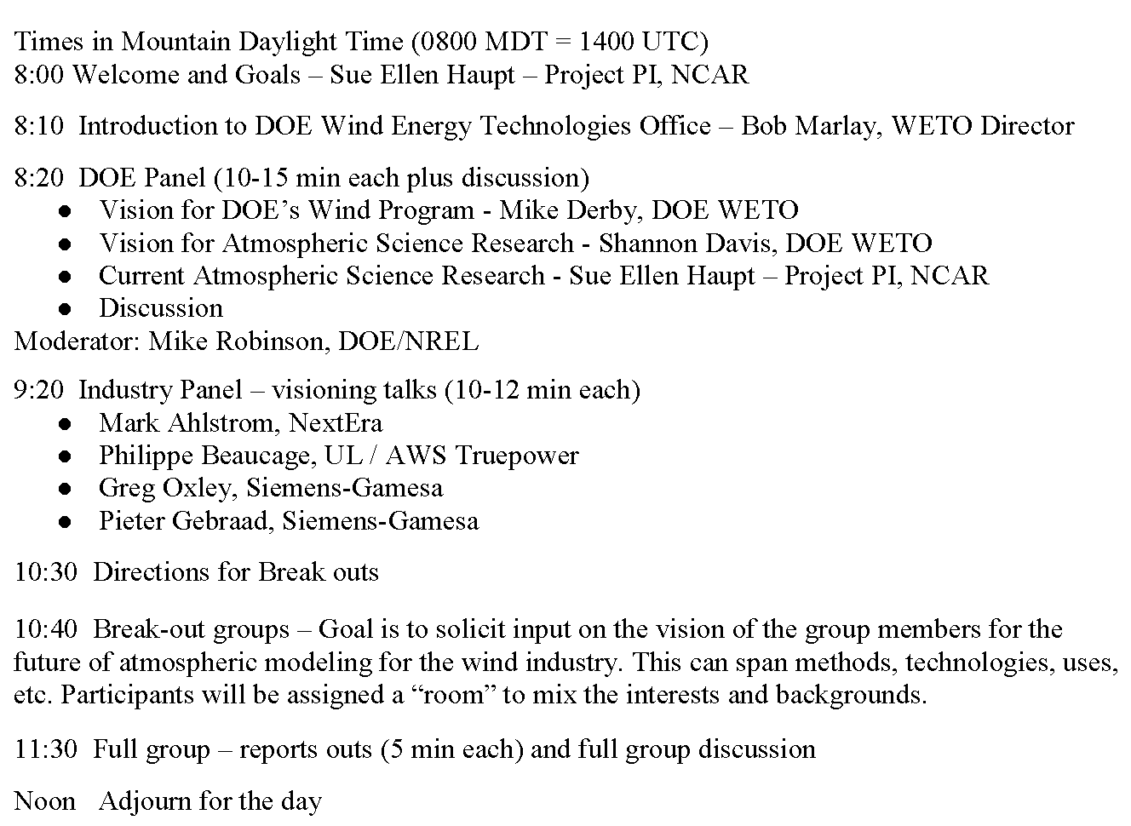
Agenda – Day 1: Monday, Oct. 19 Big Picture Vision for Atmospheric Science Research

Slide 4
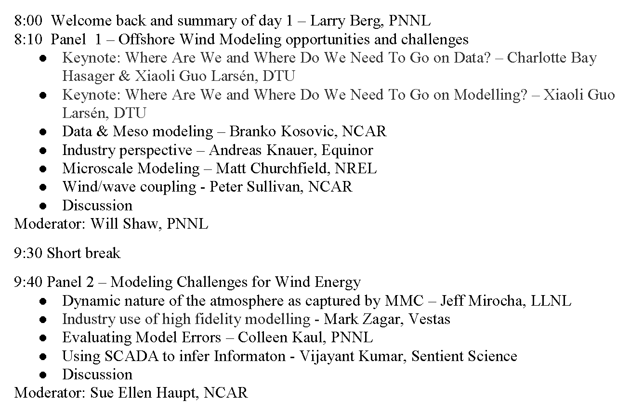
Agenda – Day 2: Tuesday, Oct. 20 Technical Research Conversations

Slide 5
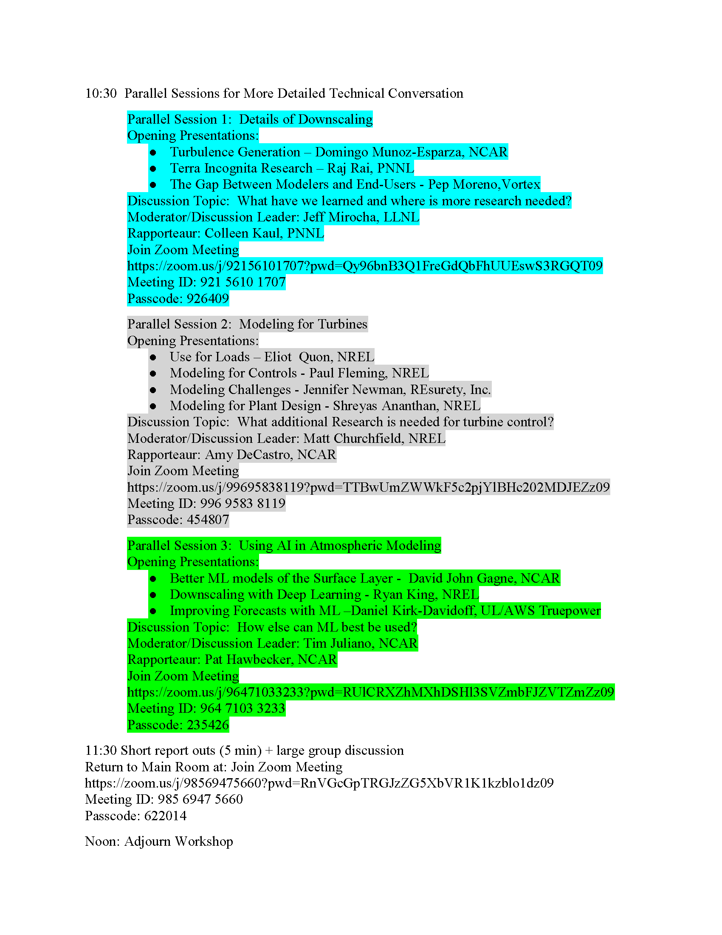
Agenda – Day 2: Tuesday, Oct. 20 Break-out Sessions

Slide 6
Logistics
Please keep yourself muted
Type questions in the chat – moderator will direct questions
Also OK to “Raise Hand”

Slide 7
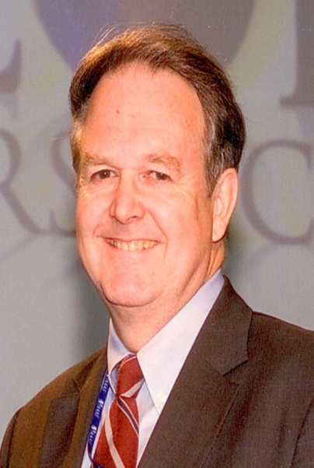
Dr. Robert Marlay, Ph.D., P.E.
Director, Wind Energy Technologies Office
U.S. Department of Energy
Dr. Marlay is Director, Wind Energy Technologies Office, Office of Energy Efficiency and Renewable Energy (EERE), U.S. Department of Energy (DOE). He is a 30-year veteran of the government’s Senior Executive Service. Within DOE, apart from EERE, he has worked in the Office of Science, Office of Policy, Office of Nuclear Energy, and in the Office of International Affairs. He also served as an officer in the U.S. Navy’s Civil Engineer Corps. Dr. Marlay holds a Ph.D. in nuclear science and engineering from MIT. He is a licensed Professional Engineer in the District of Columbia; a Fellow of the American Association for the Advancement of Science; and an Ambassador in DOE’s Clean Energy Education and Empowerment initiative, or C3E, which is designed to attract, retain and advance the careers of women in the field.

