Slide 1

DOE Wind Energy Technologies Office Program Update and Research Priorities
Dr. Robert C. Marlay, Ph.D., P.E.
Director, Wind Energy Technologies Office
Office of Energy Efficiency and Renewable Energy
October 19, 2020

Slide 2
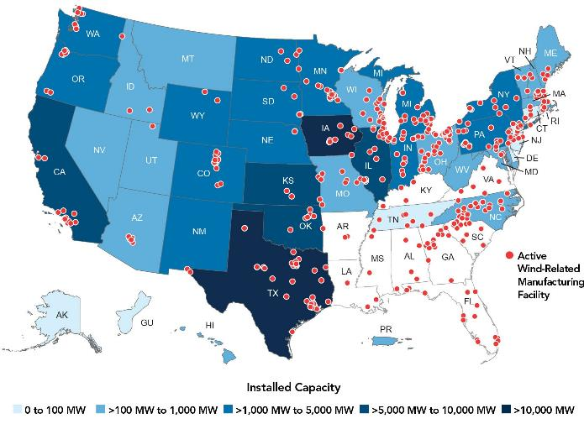
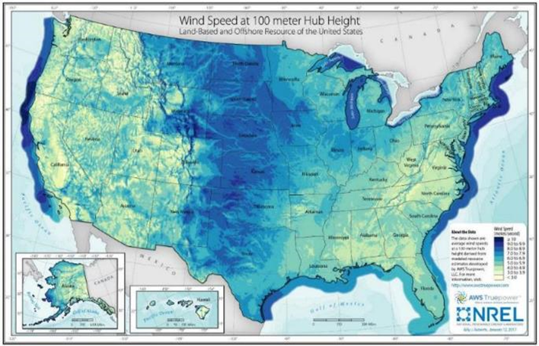
U.S. Wind Energy
U.S. Wind Energy Spurs Economic Growth
U.S. Wind Resource is Vast
Illustration from AWEA
Economic Aspects of Wind Power Deployment & Supply Chain
U.S. Land-Based and Offshore Wind Resources
Annual Average Wind Speed at 100 Meters Above the Ground
Key Challenges Remain
Unsubsidized costs are still too high for some applications
Many technical challenges remain, especially for floating offshore
Environmental & siting constraints
Integration of large-scale power into the grid presents complexities
Notes:
U.S. Wind Energy is Strong and Growing
In 2019, wind produced 7% of all U.S. electricity
Land-based utility-scale wind power is now in 41 states
Distributed (smaller) wind turbines are in all 50 states
14 states have ≥10% wind generation; 6 states >%20; 2 states >40%
U.S. Wind Energy Spurs Economic Growth <map on slide>
Supports 120,000 domestic jobs
Over 530 manufacturing facilities in 43 States
Turbine manufacturers with at least one U.S. manufacturing facility built 95% of wind capacity installed in the United States in 2019
U.S. manufacturing capacity (annual): 15,000 MW of turbine nacelles; 11,400 individual blades; and 3,650 towers
U.S. jobs are well-paid -- in construction, manufacturing, and operations
U.S. Wind Resource is Vast (On-Land and Offshore) <map on slide>
Resource potential is more than 10 times total U.S. electricity demand
Resource inexhaustible and clean
Contributes to energy security and resiliency

Slide 3
DOE’s R&D Role and Contributions
Innovation and R&D Drive Cost Reductions
DOE Innovations
Over 174 DOE-funded wind patents
Demonstrations of MW-class machines
Airfoil and blade designs + new materials → larger rotors, increased energy capture
Advances in atmospheric science & wind turbine/farm interactions, code development & model validation
DOE’s Cost-Reduction Goals
Land-Based Wind: . . . . . 2 cents*
Offshore Wind: . . . . . . . 5 cents
Distributed Wind:
MW-scale: . . . . . . . 4 cents
kW-scale: . . . . . . . 7 cents
* $/kWh, by 2030
Notes:
DOE’s Innovation and R&D Drive Cost Reductions
Since 1980, wind power cost has dropped 90%
As of 2019, industry deployed over 105 GW
DOE Innovations: <shortened version on slide>
Since 1978, 174 DOE-funded wind patents, more in the pipeline
Demonstrations of MW-class machines built investor confidence & enabled cost-competitive utility-scale wind
Airfoil and blade designs, coupled with new materials, enabled larger rotors with increased energy capture
Advanced computer code development and model validation have accelerated innovative designs and wind turbine and wind plant efficiency

Slide 4
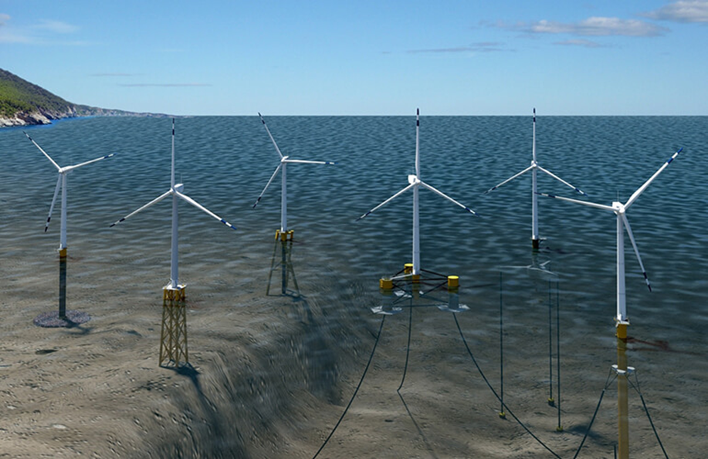
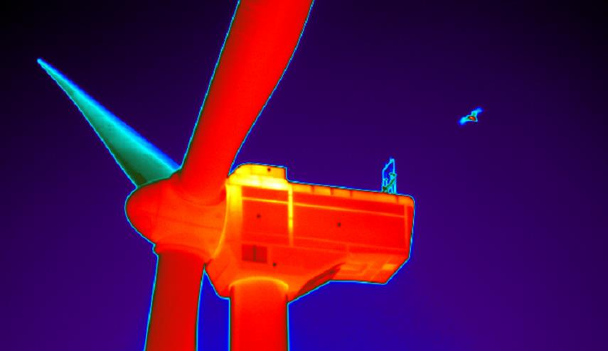
R&D Program Overview
WETO R&D Focus Areas
Offshore Wind
Land-Based Wind
Distributed Wind
Systems Integration
Data, Modeling & Analysis
Illustrations by NREL
Top-Line R&D Priorities
Aggressive cost reduction
Scaling and light-weighting
Environmental & siting challenges
Grid services, cybersecurity, and hybrid systems
Photo by NREL
Notes:
Top-Line R&D Priorities: <shortened version on slide>
Continue aggressive cost-reduction for all technologies
Enable supersized, lightweight wind turbines
Address key environmental & siting challenges
Develop electric energy and grid services provided by affordable, transmission-facilitated, cyber-secure, and hybrid-ready wind
DOE Continues to Support Activities Valued by Industry:
Wind energy resource assessments
Component testing facilities
Experimental technology demonstrations
Analytical reports on data and technology
Activities aimed at enabling competitive U.S. manufacturing (e.g., automation)
Education and training programs for a future workforce

Slide 5
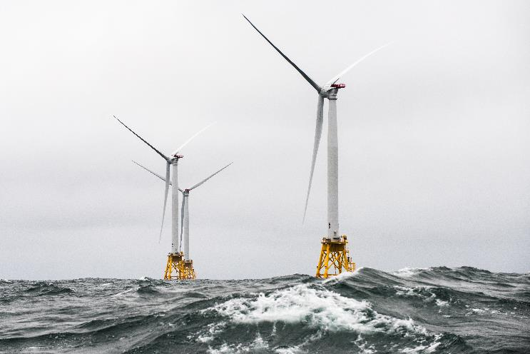
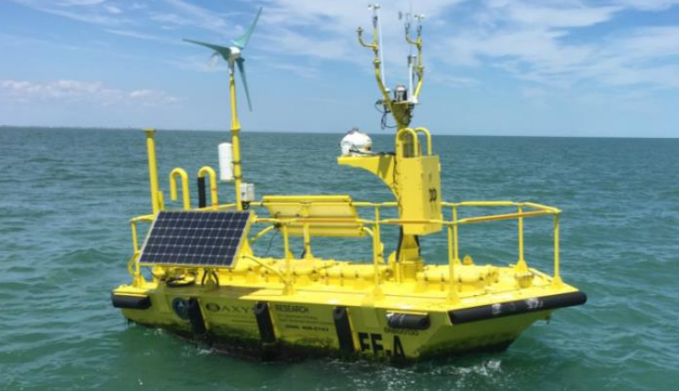
Offshore Wind
Challenges
Technology, cost, and siting challenges
U.S.-specific design challenges (deep water, hurricanes, and icing)
Fixed-Bottom R&D Priorities
Wind resource characterization
Wildlife, radar, and community impacts
Optimization tools for wind plant operation
Floating Offshore R&D Priorities
Floating platform design & systems innovation
Simulation and scaled testing to reduce need for field demonstrations
Marine-Air Boundary Layer Characterization
Cross-Cutting R&D
Ultra-large, ultra-lightweight turbines, including blade manufacturing breakthroughs
Autonomous inspection & maintenance
Photo by NREL
Photo by PNNL
Notes:
Challenges: <shortened version on slide>
Despite a vast wind energy resource that spans the East and West Coasts and the Great Lakes, offshore wind (OSW) is constrained by technology, cost, and siting challenges
OSW presents design challenges that are unique to the U.S. (e.g., deep water, hurricanes, and icing), not experienced in Europe
Fixed-Bottom R&D Priorities: <shortened version on slide>
Address wind resource characterization gaps
Resolve significant wildlife, radar, and community impacts
R&D to inform & develop solutions to wildlife impacts
R&D to understand and mitigate impacts on radar system
Research to understand and mitigate impacts on coastal communities
Floating Offshore R&D Priorities: <shortened version on slide>
High-fidelity simulation and scaled experiments to accelerate floating wind platform design and systems innovation
Simulation and testing to reduce need for future demonstrations
Cross-Cutting R&D: <shortened version on slide>
Complete advanced technology demonstration projects
Advanced technology for ultra-large, ultra-lightweight turbines
Breakthroughs in ultra-large blade manufacturing
Autonomous inspection & maintenance systems
Recent R&D Highlights:​
• Established the National OSW R&D Consortium to address technological barriers and lower costs and risks (>$40M)
Released open-source 15-MW reference turbine for fixed-bottom and floating foundations and moorings
OSW research at 6 national-level test facilities ($7M), including upgrade to the Wind Technology Testing Center in Boston
Wind resource modeling and prediction in OSW development areas ($10M, performer to be announced later this year)
• Offshore wind instrumentation for environmental monitoring (>$2M), including a buoy network to monitor right whales

Slide 6
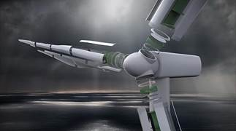
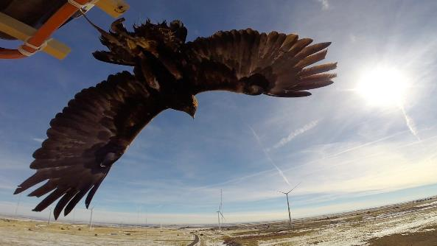
Land-Based Wind
Challenges
Innovation needed to compete without subsidy
Siting constraints impact 100% of locations
Cost Reduction R&D Priorities
Tall Wind
Taller towers and larger, lighter, more flexible rotors
Manufacturing and logistics innovations
Wind Plant Optimization
Wind resource science to better predict and optimize performance
Inform design, financing and grid integration
Controls to reduce wake effects and loads
Environment and Siting R&D
Reduce wildlife impacts, radar interference, and community impacts
Research to characterize risk
Advance technologies to reduce impacts and costs
Convening stakeholders, information synthesis, and dissemination.
Illustration by Blade Dynamics
Photo by NREL
Notes:
Challenges: <shortened version on slide>
Cost is important and analyses suggest that continued innovation in land-based wind technologies is required to compete at unsubsidized levels
Siting constraints, such as wildlife impact and radar interference, affect 100% of U.S. wind resource locations; conflicts are expected to increase
Cost Reduction R&D Priorities: <shortened version on slide>
Tall Wind:
Larger turbines are the single-most important driver to achieving needed 50% cost reductions
R&D Priorities are:
Increase cost-effective hub heights and develop larger, lighter, and more flexible rotors
Drive innovation in manufacturing and logistics to address issues of components too big and too heavy for current methods
Wind Plant Optimization:
Wind resource science to better predict and optimize plant performance
Results inform design, financing, and integration with the grid
Controls to reduce wake effects and increase performance
Controls to reduce loads and stress and extend useful life
Environment and Siting R&D Priorities: <shortened version on slide>
R&D to inform and identify solutions to reduce wildlife impacts, wind turbine radar interference, and address impacts to communities
R&D to advance technology to reduce impacts and costs
R&D to reduce regulatory uncertainty for projects and impacted resources
Cooperation with affected agencies: DOI, NOAA, DOD, FAA, and others
Recent R&D Highlights:
Validate & demonstrate tall tower manufacturing innovations ($10M FY19 FOA)
Develop next-generation, lightweight generators ($7M FY18 FOA)
Wildlife impact mitigation technology development ($5M FY18 FOA +NREL Technology Development &Innovation project)

Slide 7
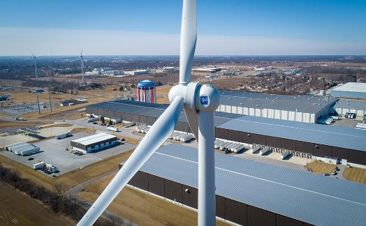
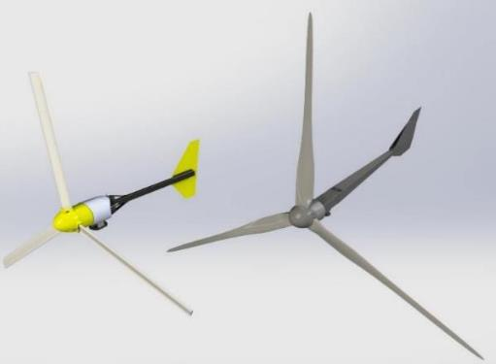
Distributed Wind (kW and MW scale)
Challenges
Significant untapped potential, especially in MW-scale, industrial applications
Adoption impeded by hardware costs (especially at kWscale), “soft” costs, and development challenges
Distributed Wind R&D Priorities
Hybrid/microgrid system integration and controls
Packaged hybrid systems (wind+solar, storage, other DERs)
Turbine cost reduction (kW scale)
Affordable, accurate resource assessment
Grid services at distributed scale
Reduce balance of station costs
Address barriers to adoption via standardization and best practices.
Bergey Excel 10
LCOE: 25¢/kWh
Bergey Excel 15
LCOE: 12¢/kWh
Notes:
Challenges: <shortened version on slide>
Distributed wind has significant unrealized economic potential at up to 40+ GW by 2030, and 85 GW by 2050, mostly in MW-scale, industrial applications
Presently, 1.1 GW is installed across 50 states
Greater adoption of distributed wind systems is impeded by high cost of hardware, “soft” costs, and a number of developmental challenges
Distributed Wind (MW-Scale) R&D Priorities: <shortened version on slide>
Hybrid/microgrid system integration and controls
Packaged hybrid systems, enabling distributed wind to deploy with solar, storage and other DERs
Increased capabilities to provide additional and valued grid services, at the company facility, rural cooperative, or large farm scale
Reduce balance of station costs
Address barriers to adoption by rural electric cooperatives via standardization and development of best practices
Recent Highlight:
4 Wind Innovations for Rural Economic Development (WIRED) projects supporting rural electric utilities and communities by reducing the technical complexity and risks associated with distributed wind and distributed energy resource development and deployment ($6M, FY19 FOA)

Slide 8
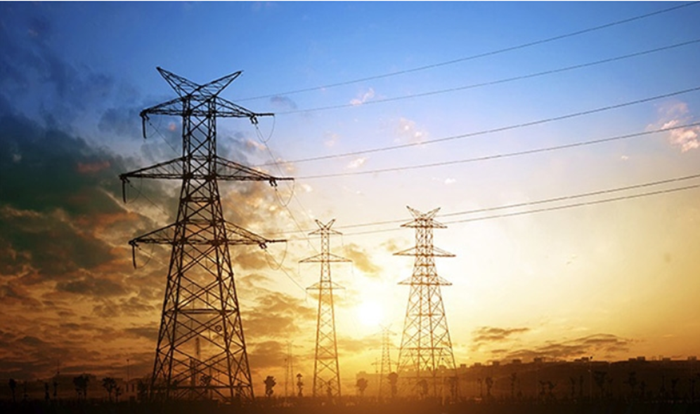
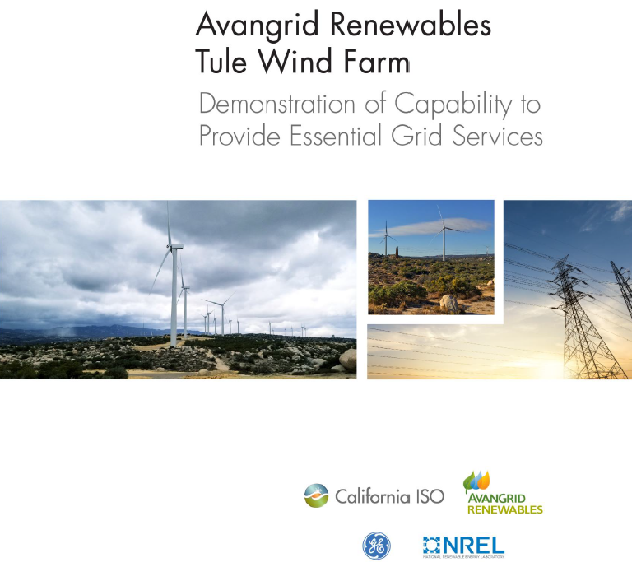
Systems Integration
Challenges
Increased wind penetration demands greater grid flexibility and reliability
Inverter-based generation raises grid stability and resiliency concerns
Digitization increases risk of cyberattack
Systems Integration R&D Priorities
DOE Energy Storage Grand Challenge
Provision of grid services from wind
Enabling technologies for offshore wind integration
Resilient wind plants that detect, respond to, and recover from cyber-attacks.
Notes:
Challenges: <shortened version on slide>
Increased level of variable wind, when integrated with the grid, demands greater grid flexibility and resiliency (that includes flexibility that can be provided by wind and other generation sources, and flexibility from demand side)
Increased proportion of inverter-based generation raises grid stability and resiliency concerns
Digitization and control of wind energy systems increases risk of cyberattack.
Grid Integration R&D Priorities <shortened version on slide>
Energy Storage Grand Challenge
New DOE program for American global leadership in energy storage
Provision of grid services from wind
Enabling technologies for large-scale offshore wind plant integration
Resilient wind plants that detect, respond to, and recover from cyber-attacks
Recent Activities:
Design and operate wind plants to provide essential grid reliability services
Frequency response, balancing services, and voltage control
Grid forming wind for grid balancing and resiliency
Wind controls to modulate grid interactions, via advanced modeling and dynamic analysis
Enhance the utilization of transmission infrastructure
Establish reference model for cybersecurity and wind plant communications
Grid Modernization Laboratory Consortium (GMLC):
Leverages resources across EERE and DOE’s Offices of Electricity, Fossil Energy, Nuclear Energy, and Cybersecurity, Energy Security, and Emergency Response
Hybrid energy system control and demonstration
ISO/RTO technical assistance
Malware detection

Slide 9
Data Analysis & Modeling
Challenges
Identify and understand the most promising technology opportunities and R&D pathways
Analyze and compare multiple technology alternatives against varied future scenarios
Need robust empirical data
Analytical Priorities
R&D pathway assessments to find the most promising areas for federal R&D investment
Maintain quantitative benchmarks of wind technology trends
Provide insight into wind’s potential role in various potential energy futures.
Various future wind LCOE trajectories from the literature
Associated wind deployment in scenario analysis
Notes:
Challenges: <shortened version on slide>
Identify and understand the most promising technology opportunities and R&D pathways
Must analyze and compare multiple technology alternatives against varied future scenarios
Must be supported by robust empirical data
Analytical Priorities: <shortened version on slide>
R&D Pathway Assessments
Technical and economic analysis to find the most promising pathways for federal R&D investment to reduce cost, increase value to grid, address regulation, and overcome market barriers
Analysis:
Maintain solid quantitative benchmarks of wind technology trends
Provide insight into wind’s potential role in various potential energy futures
Bottom figure: Associated wind deployment in scenario analysis performed using NREL’s Regional Energy Deployment System model. Source: Mai et al 2017, “The Value of Wind Technology Innovation: Implications for the U.S. Power System, Wind Industry, Electricity Consumers, and Environment”, NREL/TP-6A20-70032.

Slide 10
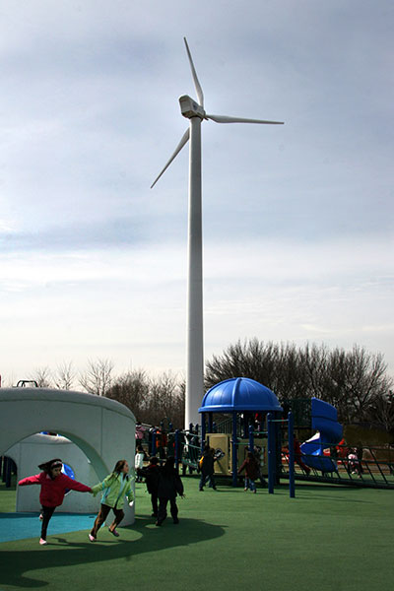
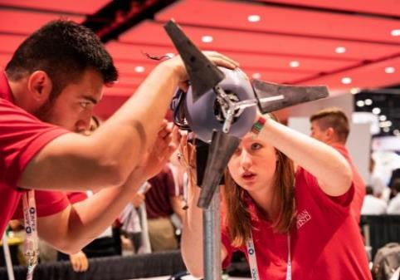
Education, Training, & Wind Workforce Development
Challenge
Growing demand for skilled domestic labor
Program Priorities
Assess national workforce needs and gaps
Convene industry and educational organizations to address gaps
Carry out educational programs
Wind for Schools
Collegiate Wind Competition.
Photo by NREL
Notes:
Challenge: <shortened version on slide>
Fast-growing demand for skilled, domestic wind energy labor, with shortage of technically trained and qualified personnel
Program Priorities: <shortened version on slide>
Research and understand the wind workforce training and acquisition pipeline and STEM ) Science, Technology, Engineering, and Math) training needs.
Assess Workforce Needs
Analysis of national workforce needs and trends
Evaluate workforce development strategies
Carry out Industry and Educational Programs
Ensure efforts are well aligned to meet future needs
Wind for Schools
Integrates small wind turbines into rural U.S. elementary & secondary schools to power their schools
Complements curriculum and K–12 STEM activities
Collegiate Wind Competition (CWC)
Provides real-world experience to challenge and prepare college students to develop solutions to complex wind energy issues
Recent Accomplishments:
2019 Study: The Wind Energy Workforce in the United States: Training, Hiring, and Future Needs
CWC: More than 300 students participated in Collegiate Wind Competitions
Wind For Schools: Inspired 60+ university courses and events providing wind/solar education; engaged 800 students; and led to more than 140 turbines at schools

Slide 11
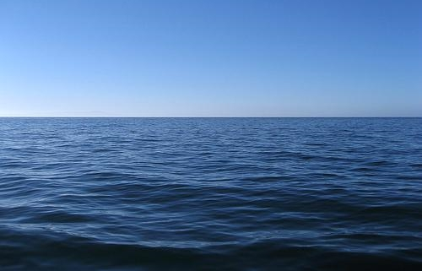

Thank you.

