Slide 1
Atmospheric Challenges
FOR the Wind Energy Industry
SGRE Digital Ventures Lab’s Perspective
Gregory Oxley, PhD
Lead Data Scientist, SGRE COG DVL
Gregory.Oxley@siemensgamesa.com
©SIEMENS GAMESA RENEWABLE ENERGY

Slide 2
Building bridges
Digitally.
An innovation group formed to focus on the digital transformation of SGRE’s onshore, offshore and service businesses.
Combine domain knowledge with data science, foster partnerships, unleash open innovation and empowering talents.
Optimization of operations and processes through the whole SGRE value chain.
.

Slide 3
DIGITAL PROPOSAL MANAGER
WHAT Are WE DOING?
“Holistic” multi-parameter, multi-objective wind farm design optimization evolving through all stages of the proposal flow:
Wind plant prospecting
Conceptual design
Detail design
Activate different “levers” in the optimization according to proposal stage, freeze portions of the dependency graphs, optimize in different directions. (i.e. not just plant design optimization but go the other other way and advise into a data/model-driven product portfolio roadmap).
Capture elements as accurately as needed:
Constants
Historical models
Engineering & ML-based models
First-principles
Multi-modal design space, discontinuous models, precludes the use of gradient-based methods

Slide 4
DIGITAL PROPOSAL MANAGER
WHAT WE NEED?
Bring the mesoscale down to the microscale (MMC community)… BUT QUICKLY!!!
R&D community focused on high fidelity first principles-based modelling approaches, BUT:
Unlikely to see these HIFI approaches widely used in the next 5-10 years in industry (a few do it)
Internal cost pressures in the race to drive down LCoE DO NOT suggest future expanded use of HPC centers by majority of OEMs or others
Over a decade later, microscale CFD-RANS remains a struggle to deploy on OEM operational scales
Even for the HPC-Resource-Rich, how useful is a 36-sector RANS-ASL CFD simulation driven by guessed BCs on complex terrain anyways? (not very)
What we need:
Improved ability to estimate site/turbine-specific extremes in complex terrain
Use HIFI models to create meso-informed microscale surrogates, ability to ensemble average large number of scenarios (also important operationally in our Wake Adapt product)
ML-based wake modelling, better understanding of the mesoscale role in large array effects

Slide 5
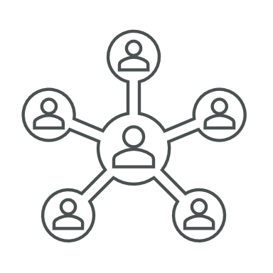
DEFINING OPEN INNOVATION
Open Innovation is:
The antithesis of vertical integration in which internal R&D lead to internally development, production and distribution.¹
An innovation process that relies on purposively managed interorganizational knowledge flows.
Knowledge sharing supporting the innovative capabilities of a company².
“Digitalization IS the approach to lower the LCoE of renewables.
To me, Open Innovation and Digitalization goes hand in hand.”
Daniel Luecht, Chief Digital Officer, SGRE
Open Innovation is not only:
An approach for better financial returns on R&D³
A concept which includes BMI and SI, in contexts of multiple collaborations, communities, and entire ecosystems^{1.}
Crowdsourcing, submitting a problem to be solved by a group.
An approach to manage suppliers better.
Open sourcing and the open-source methods¹.
¹Chesbrough (2017) | ²(Rohrbeck, 2009) | ³(Du, et al, 2014)

Slide 6
Open Innovation Ecosystem
Background and Delimitations
The New Business MODEL of OPEN Innovation¹
R&D & BUSINESS MODELS
Open Innovation R&D will support new Business Models. Today we will focus on the enabling such activities.
CLOSED INNOVATION
OPEN INNOVATION
Sales/Divest
OPEN COLLABORATION
Focus on the open collaboration between a leading company in the wind industry and research institutions.
New
Revenue
Spin-off
License
Market Revenue
Market Revenue
INNOVATION ECOSYSTEM
The first step towards true open innovation ecosystems fostering multiple (new) industrial and academic partners.
0
Internal
development
costs
In- and external development costs
Savings
¹Chesbrough (2007)

Slide 7
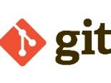
Open Innovation Ecosystem
DVL’s PORTAL FOR OPEN INNOVATION R&D
All but Microsoft Azure is Open Source, which supports the Open Innovation Strategy of DVL. This ensures excellent collaboration opportunities with 3rd party research partners and databases.
DEVELOPMENT
ALGORITHMS
DVLpy
UNIT & REGRESSION
TESTING
SCM & CI\CD
DOCUMENTATION
DEPLOYMENT

Slide 8
SITE PROSPECTING
OUR CURRENT GLOBAL RESEARCH NETWORK
A variety of worldwide renown research institutes and universities have contributed to this application
INVOLVED
PARTIALLY INVOLVED

Slide 9
GET IN TOUCH, THANK YOU!
For all enquiries regarding existing research projects, future collaborations, and novel ideas.
Siemens Gamesa Digital Ventures Lab
Contact
Peter.Enevoldsen@siemensgamesa.com
Gregory.Oxley@siemensgamesa.com

